Slide 1

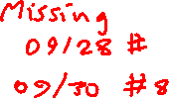
Block Ciphers & DES
King Fahd University of Petroleum & Minerals
College of Computer Sciences & Engineering
Cryptography and Blockchain Applications
Prepared by:
Sultan Almuhammadi
This lecture is based on:
Stallings, Cryptography and Network Security: Chapter 4
Forouzan, Cryptography and Network Security: Chapter 5, 6*

Slide 2

Outline
Stream cipher vs. Block cipher
Motivation
Reversible vs. Irreversible mapping
Ideal Block Cipher
DES
2

Slide 3
Stream Cipher & Block Cipher
stream cipher: encrypts data stream one bit or one byte at a time. E.g.:
  Caesar shift cipher (one letter at time)
  XOR-scheme (one bit at a time)
block cipher: a block of plaintext is treated as a whole and used to produce a ciphertext block of equal length.
  Block size (typically): 64 or 128 bits
  e.g. Feistel cipher and DES
3

Slide 4
Motivation
A block cipher operates on a block of n bits.
It produces a ciphertext block of n bits.
There are 2^{n} possible different plaintext/ciphertext blocks.
The encryption must be reversible. i.e.
  decryption to be possible.
  each plaintext must produce a unique ciphertext block. (one-to-one correspondence)
4

Slide 5
Reversible vs. Irreversible
Reversible Mapping
Plaintext Ciphertext
00 11
01 10
10 00
11 01
Irreversible Mapping
Plaintext Ciphertext
00 11
01 10
10 01
11 01
5

Slide 6
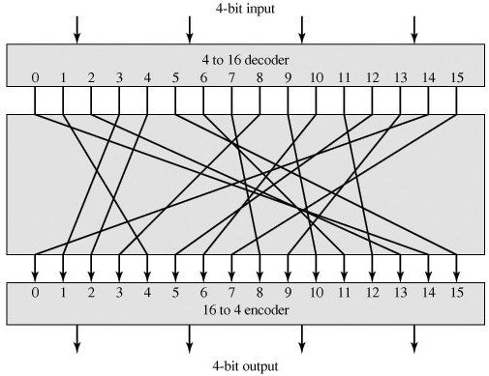
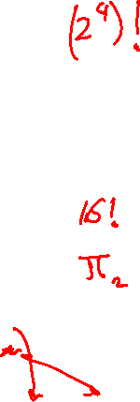
Ideal Block Cipher
(a general substitution cipher)
0 0 1 1
0 0 0 1
6

Slide 7
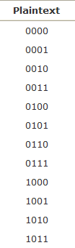
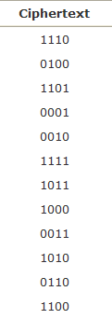
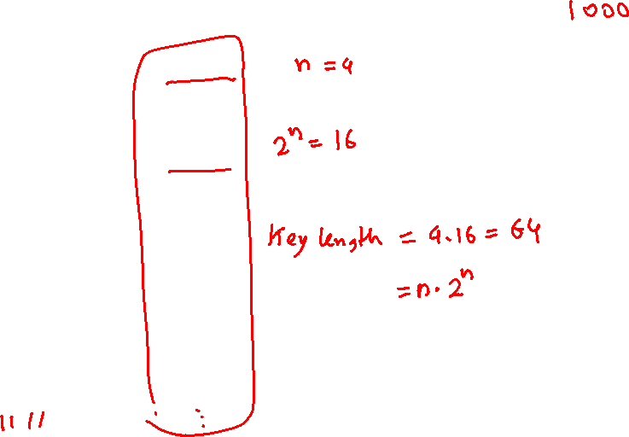
Encryption/Decryption Table for Substitution Cipher
7

Slide 8
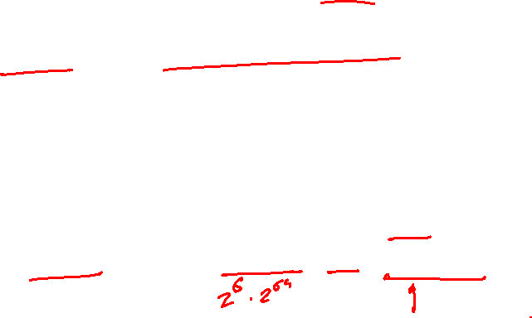
Problems with Ideal Cipher
If a small block size, such as n = 4, is used, then the system is equivalent to a classical substitution cipher → Easy attack (statistical analysis of the plaintext)
If large block size is used → not practical (for implementation and performance)
  Huge encryption/decryption tables
  → Huge key:
  for n = 4, key size = 4 bits x 16 rows = 64 bits
  for n = 64, key size = 64 x 2⁶⁴ = 2⁷⁰ = 10²¹ bits
8

Slide 9
Product Ciphers
Shannon introduced the concept of a product cipher.
Product cipher: is a complex cipher that combines simple ciphers, like: substitution, permutation, and other components.
Feistel cipher is an example of product cipher.
9

Slide 10

Feistel Cipher
Feistel designed a very intelligent and interesting cipher that has been used for decades (sine 1970s).
Part of the data is used to encrypted the other part.
A Feistel cipher can have three types of components:
  self-invertible, invertible, noninvertible
Non-Feistel cipher uses only invertible components.
Examples of Feistel cipher:
  DES (1977)
  Bluefish (1993)
  GOST (1994)
  Twofish (1998)
10

Slide 11
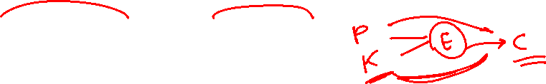
Confusion and Diffusion
Confusion hides the relationship between the ciphertext and the key.
Diffusion hides the relationship between the ciphertext and the plaintext.
11

Slide 12
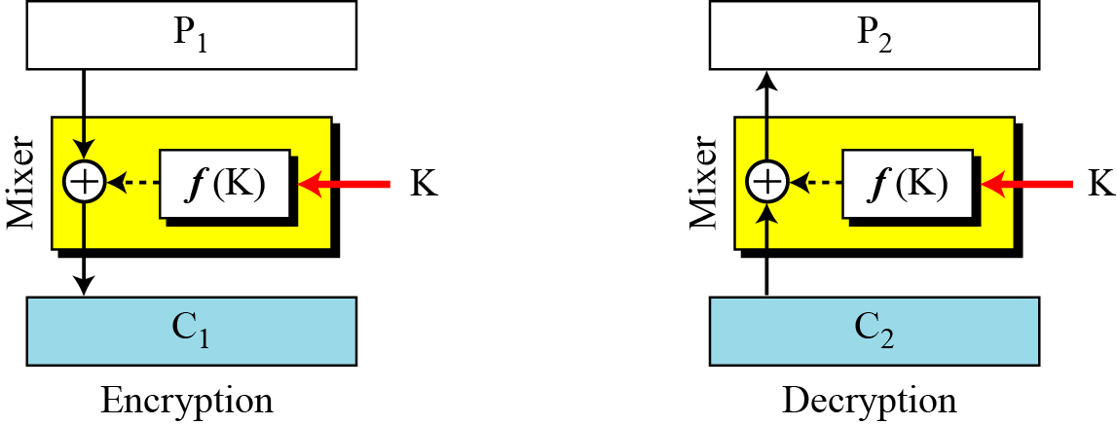
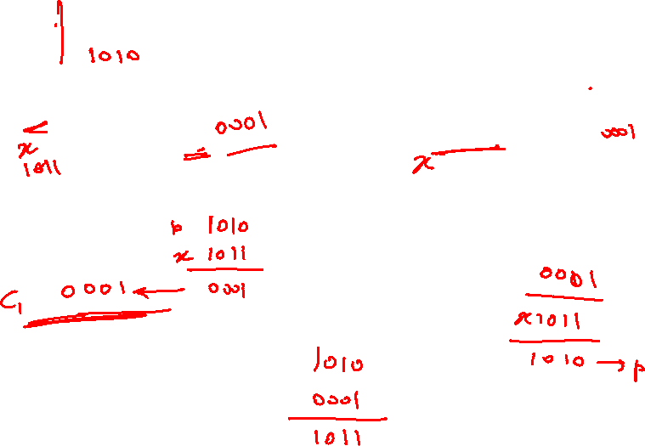
Feistel Cipher (First design)
12

Slide 13
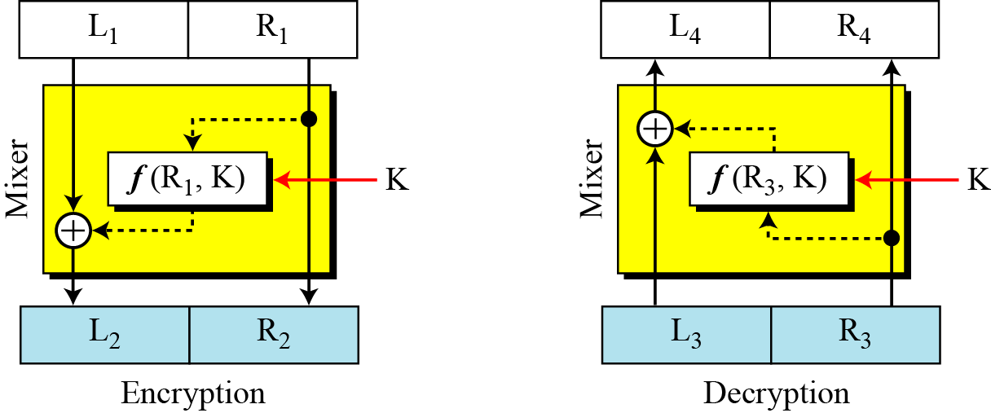
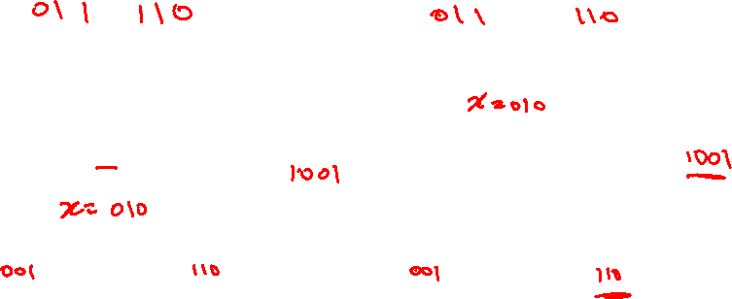
Feistel Cipher (Improved design)
13

Slide 14
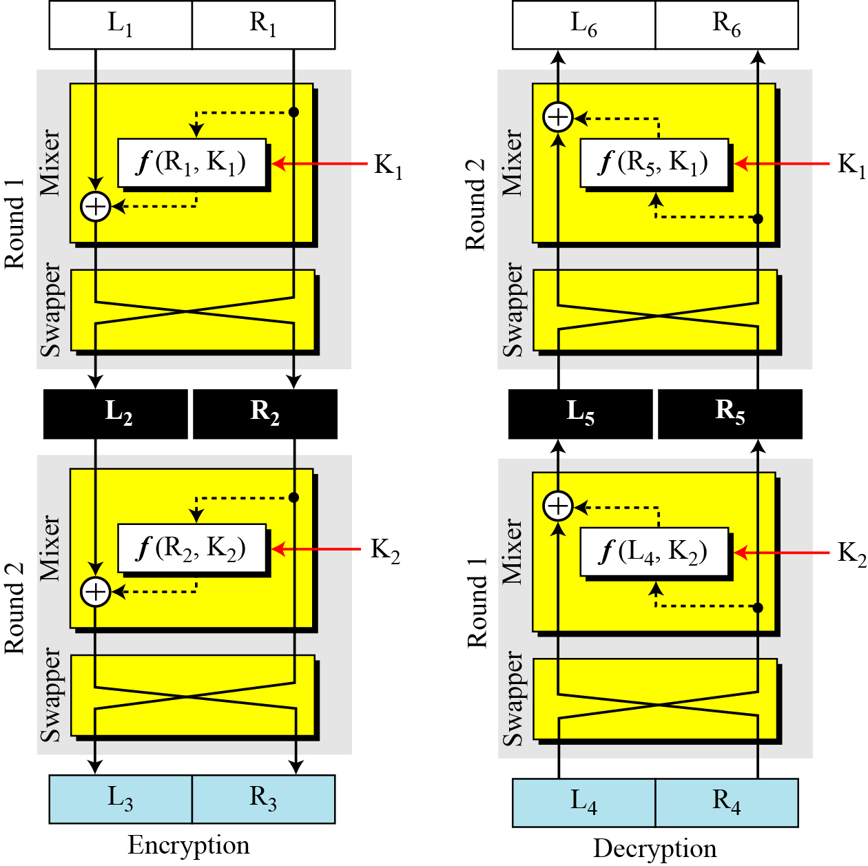
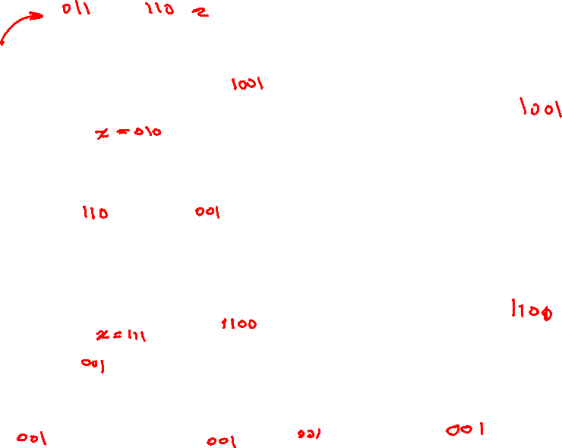
Feistel Cipher
(Final design of two rounds)
14

Slide 15
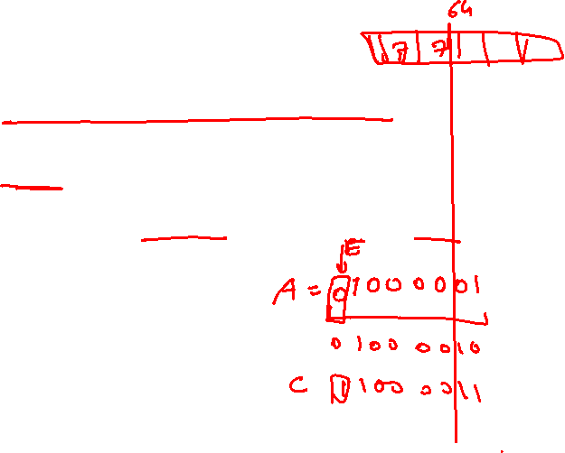
Data Encryption Standard (DES)
Widely used encryption scheme.
Adopted by National Bureau of Standards in 1977.
The algorithm itself is called Data Encryption Algorithm (DEA).
Data are encrypted in 64-bit blocks using a 56-bit key.
15

Slide 16
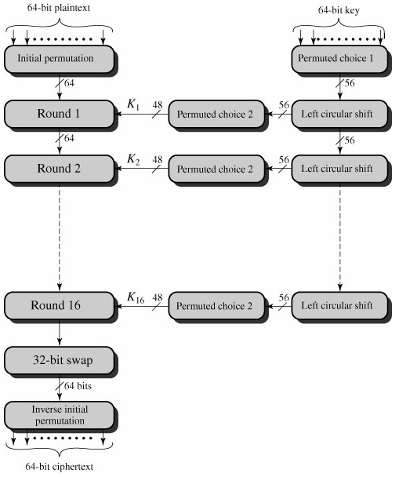

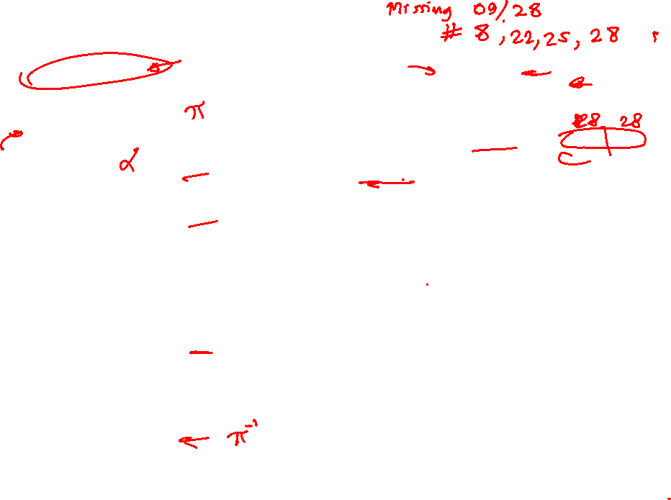
DES Encryption
16

Slide 17
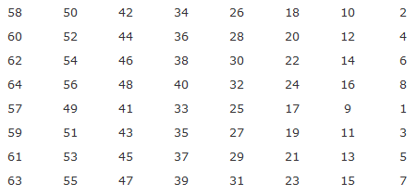
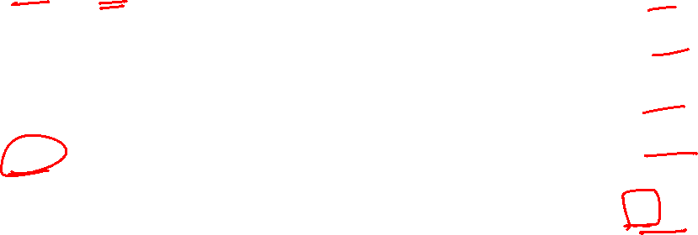
DES: Initial Permutation (IP)
17

Slide 18
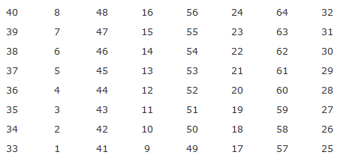
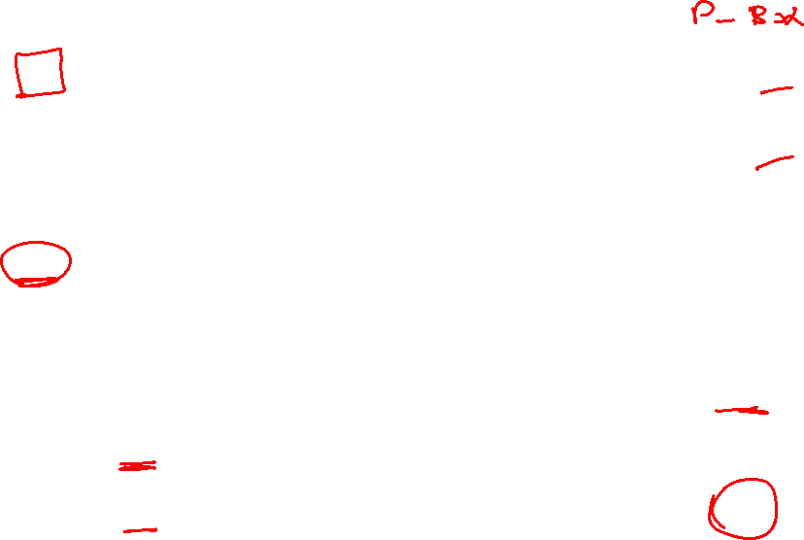
DES: Inverse Initial Permutation
18

Slide 19
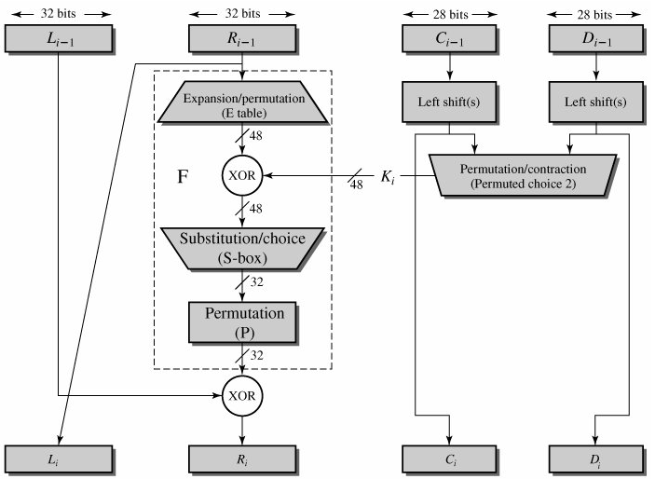
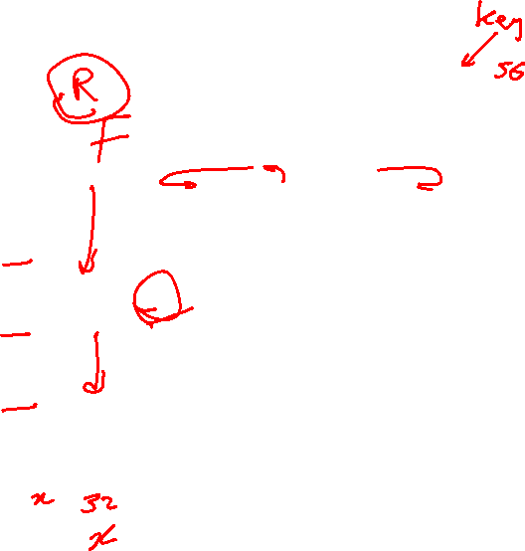
Single Round of DES Algorithm
19

Slide 20
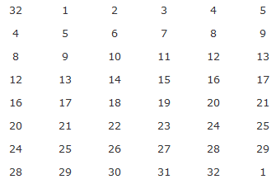

DES: Expansion Permutation (E)
20

Slide 21
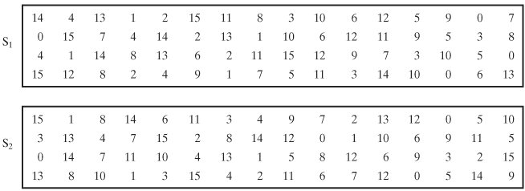
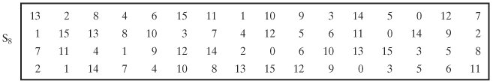
DES: S-Boxes
21

Slide 22
DES Encryption
22

Slide 23
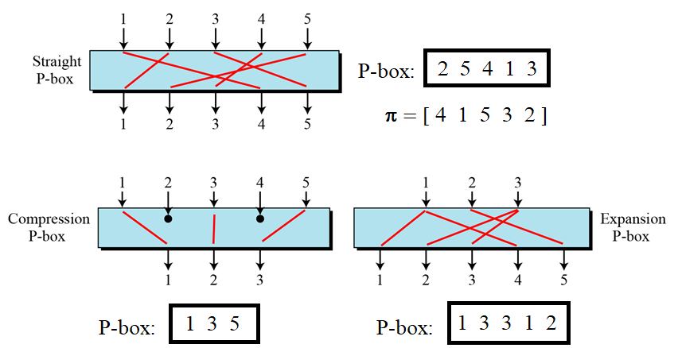


Permutation Box (P-box)
An (n x m) P-box has n input bits and m output bits.
Three types of P-boxes
  Straight P-box: n = m
  Compression P-box: n > m
  Expansion P-box: n < m
Notation:
23

Slide 24
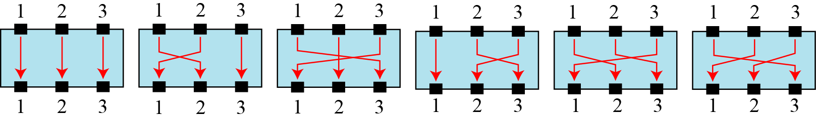
The possible mappings of a 3 × 3 P-box
24

Slide 25
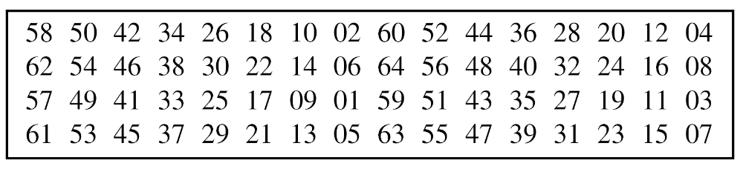
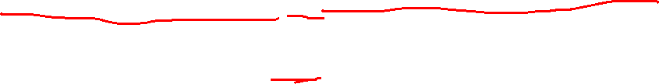
Example of a permutation table for a straight P-box
25

Slide 26
Example
Design an 8 × 8 permutation table for a straight P-box that moves the two middle bits (bits 4 and 5) in the input word to the two ends (bits 1 and 8) in the output words. Relative positions of other bits should not be changed.
Solution
We need a straight P-box with the table [4 1 2 3 6 7 8 5]. The relative positions of input bits 1, 2, 3, 6, 7, and 8 have not been changed, but the first output takes the fourth input and the eighth output takes the fifth input.
26

Slide 27
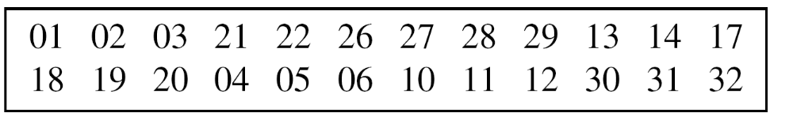
A compression P-box is a P-box with n inputs and m outputs where m < n.
Example of a 32 × 24 permutation table
27

Slide 28
Example of a 32 × 24 permutation table
28

Slide 29
An expansion P-box is a P-box with n inputs and m outputs where m > n.
Example of a 12 × 16 permutation table
29

Slide 30

Note
A straight P-box is invertible, but compression and expansion P-boxes are not.
30

Slide 31
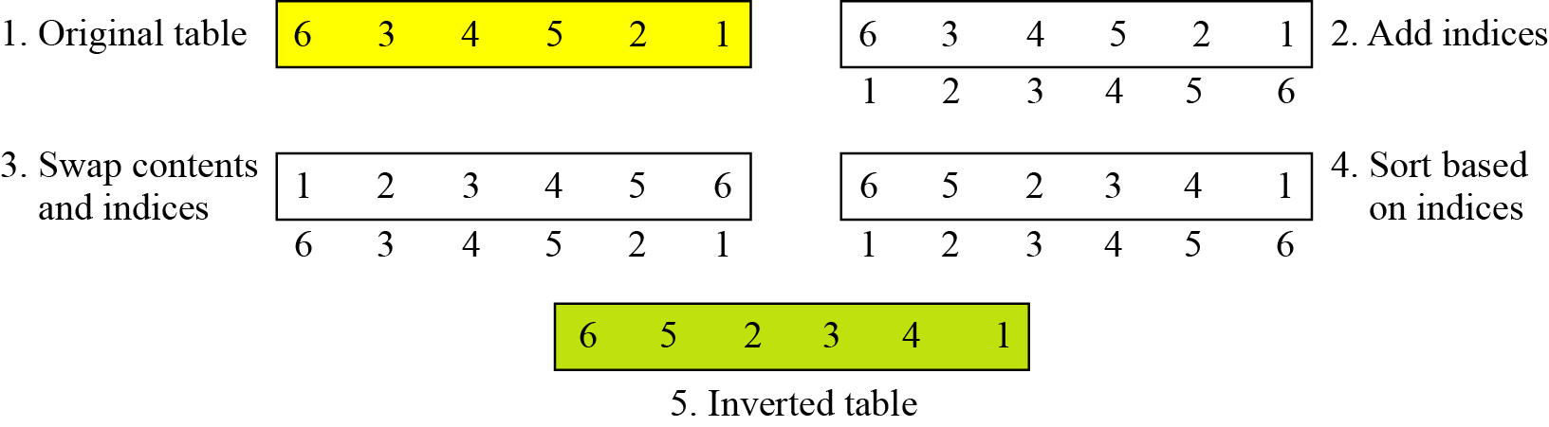

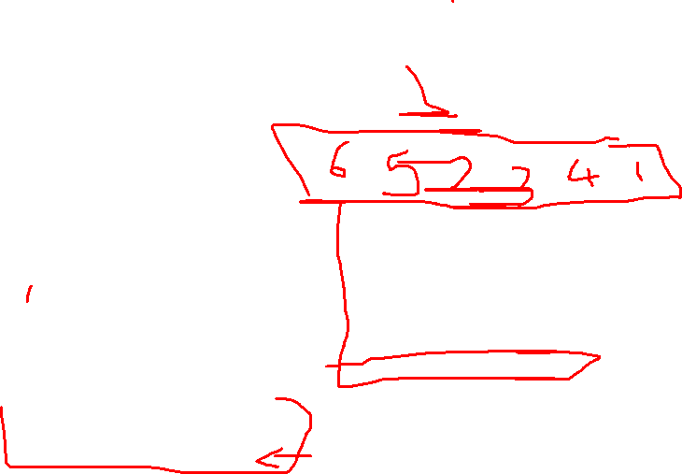
Inverting a permutation table
31

Slide 32
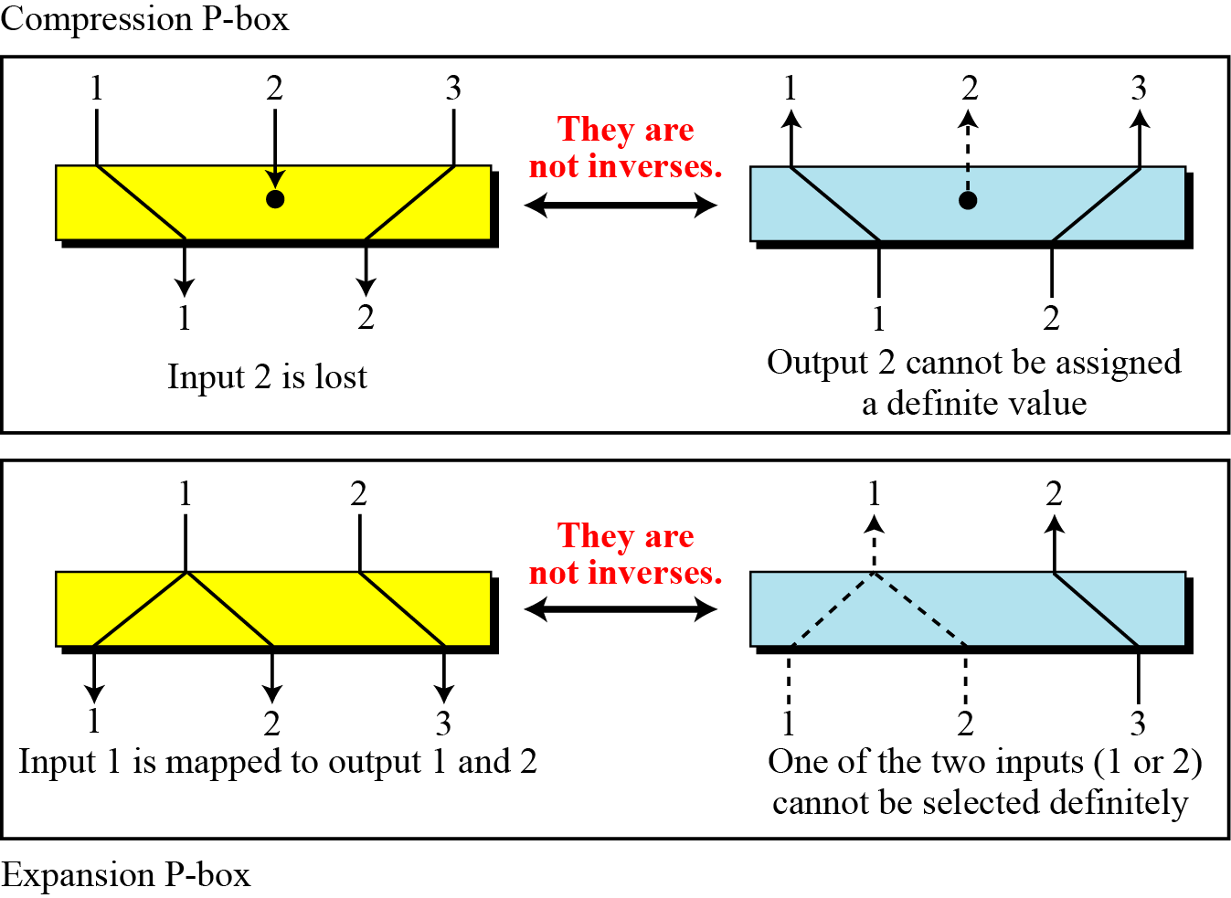
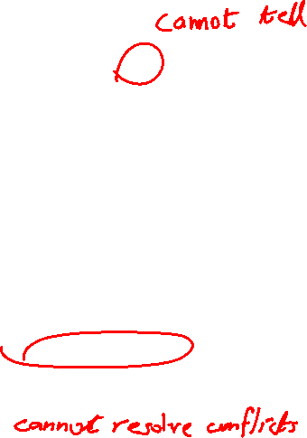

Compression and expansion P-boxes are non-invertible
32

Slide 33
S-Box
An S-box (substitution box) can be thought of as a miniature substitution cipher.
Note
An S-box is an m × n substitution unit, where m and n are not necessarily the same.
33

Slide 34
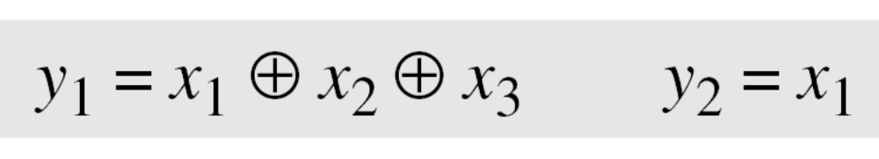
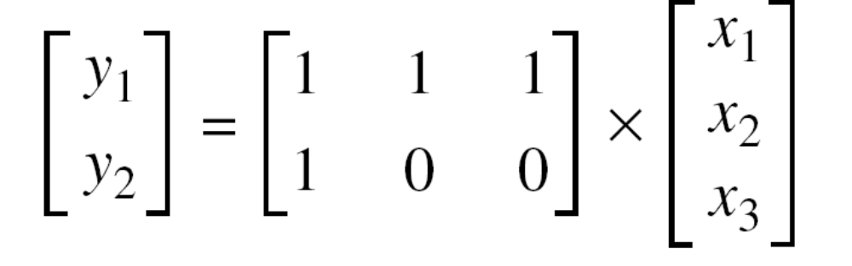
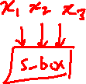
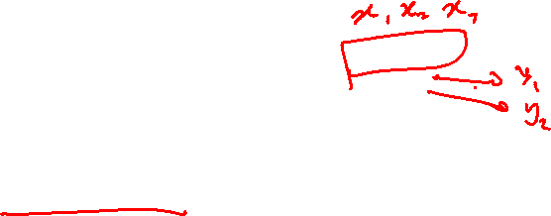
In an S-box with three inputs and two outputs, we have
The S-box is linear because a_{1,1} = a_{1,2} = a_{1,3} = a_{2,1} = 1 and
a_{2,2} = a_{2,3} = 0. The relationship can be represented by matrices, as shown below:
34

Slide 35
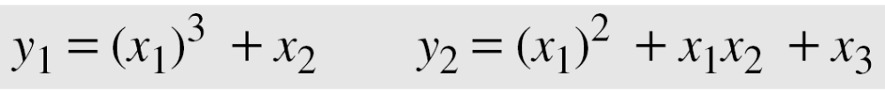
In an S-box with three inputs and two outputs, we have
where multiplication and addition is in GF(2). The S-box is nonlinear because there is no linear relationship between the inputs and the outputs.
35

Slide 36
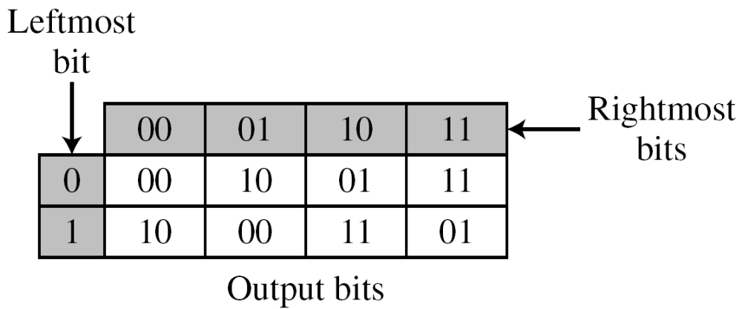
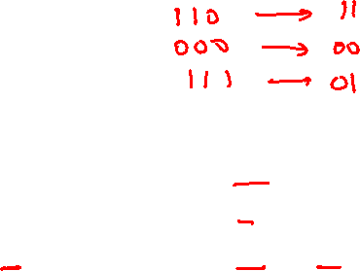
The following table defines the input/output relationship for an S-box of size 3 × 2. The leftmost bit of the input defines the row; the two rightmost bits of the input define the column. The two output bits are values on the cross section of the selected row and column.
Based on the table, an input of 010 yields the output 01. An input of 101 yields the output of 00.
36

Slide 37
An S-box may or may not be invertible. In an invertible
S-box, the number of input bits should be the same as the number of output bits.
37

Slide 38
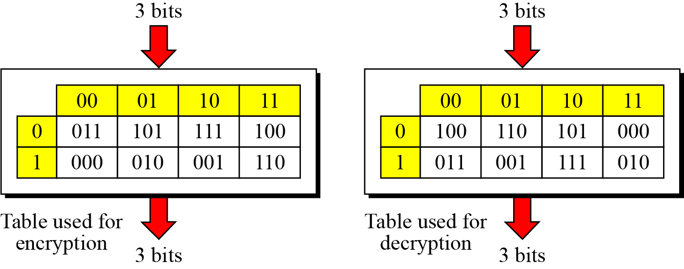
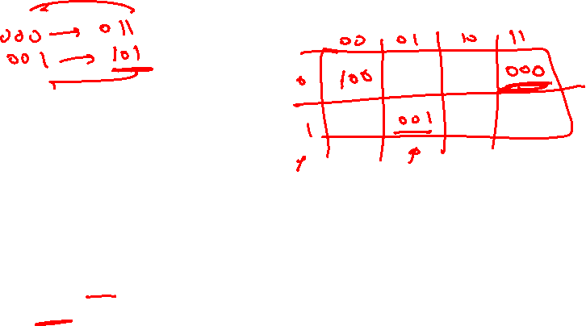
Example: S-box table
38

Slide 39
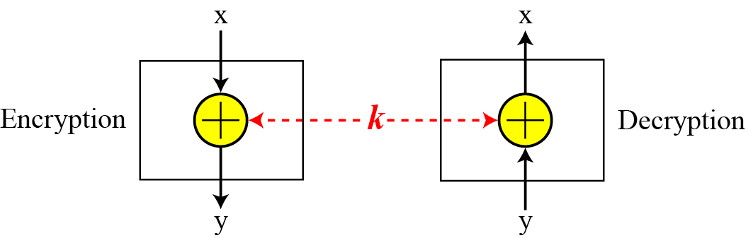

Exclusive-Or
An important component in most block ciphers is the exclusive-or operation.
Invertibility of the exclusive-or operation
39

Slide 40
40

Slide 41
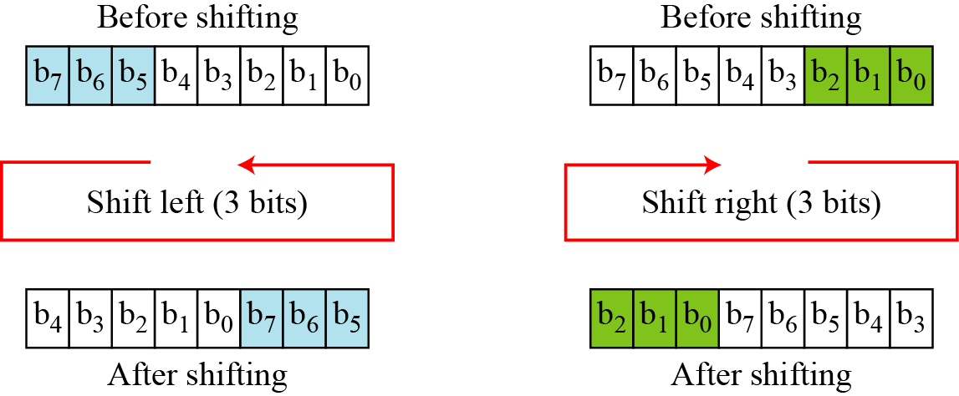

Circular Shift
Another component found in some modern block ciphers is the circular shift operation.
Circular shifting an 8-bit word to the left or right
41

Slide 42
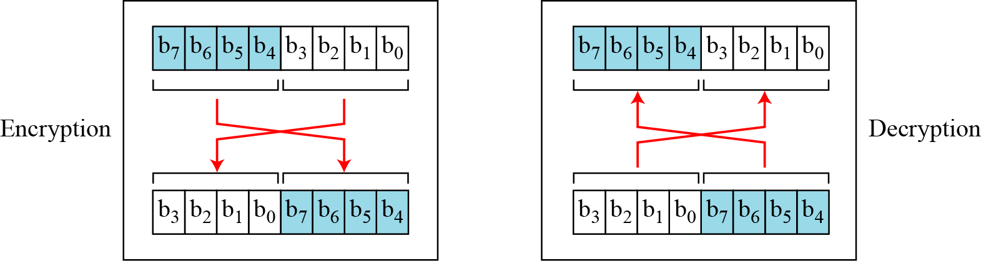

Swap
The swap operation is a special case of the circular shift operation where k = n/2.
Swap operation on an 8-bit word
42

Slide 43
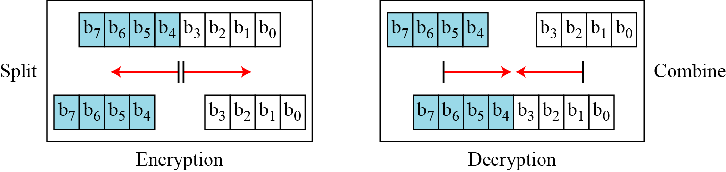
Two other operations found in some block ciphers are split and combine.
Split and combine operations on an 8-bit word
43

Slide 44
44

Slide 45
Rounds
Diffusion and confusion can be achieved using iterated product ciphers where each iteration is a combination of S-boxes, P-boxes, and other components.
45

Slide 46
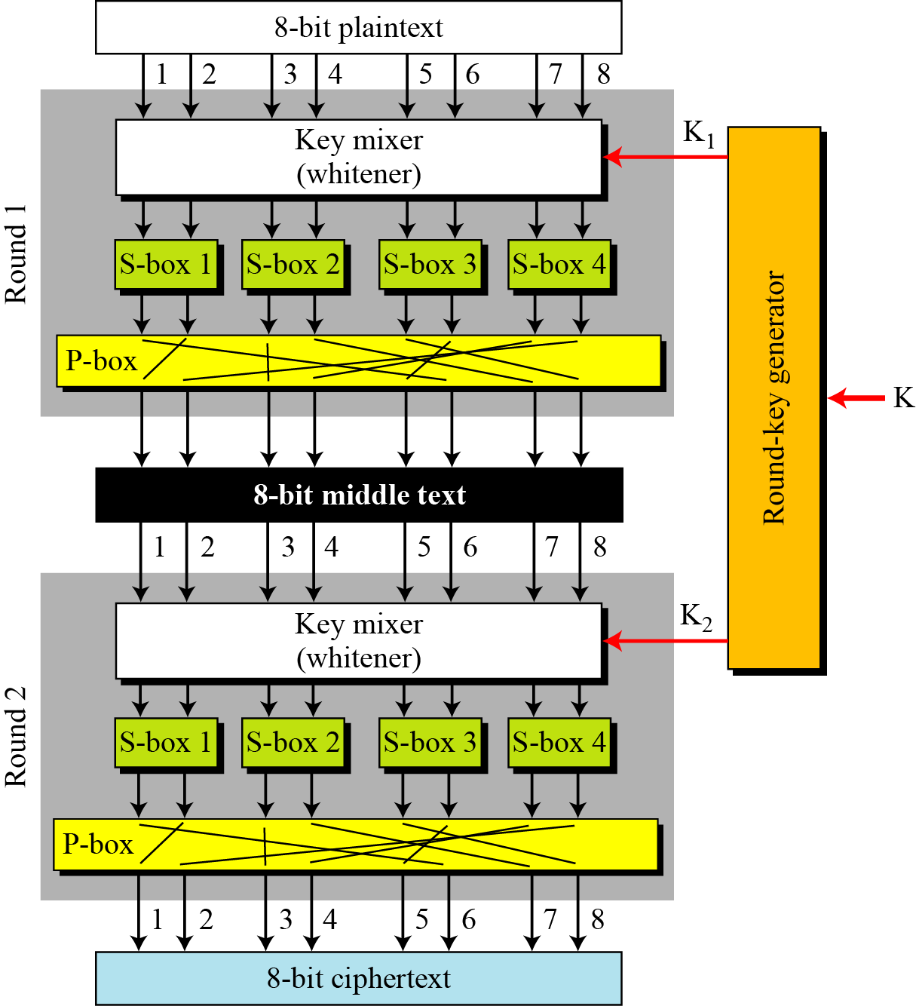
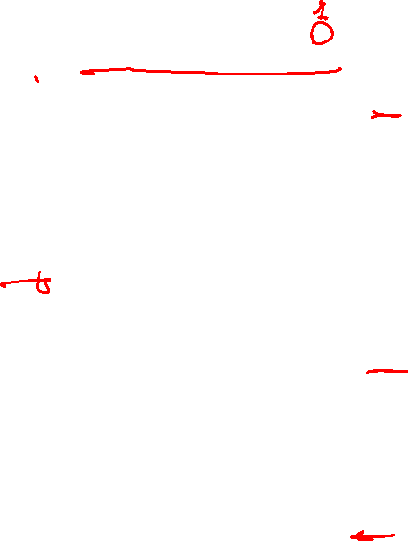
A product cipher made of two rounds
46

Slide 47




Diffusion and confusion in a block cipher
47

Slide 48



Multiple DES
The major criticism of DES regards its key length.
Fortunately DES is not a group.
  This means that we can use double or triple DES to increase the key size.
Topics discussed in this section:
6.4.1 Double DES
6.4.4 Triple DES

Slide 49

Continued
A substitution that maps every possible input to every possible output is a group.
Figure 6.13 Composition of mapping

Slide 50

Double DES
The first approach is to use double DES (2DES).
Key length: 56 + 56 = 112 bits
Vulnerable to known-plaintext attack: (Meet-in-the-Middle Attack)

Slide 51
Meet-in-the-middle attack for double DES
Using a known-plaintext attack called meet-in-the-middle attack shows that double DES improves this vulnerability slightly (to 2⁵⁷ tests), but not tremendously (to 2¹¹²).

Slide 52


Meet-in-the-middle attack for double DES

Slide 53


Meet-in-the-middle attack for double DES
Figure 6.15 Tables for meet-in-the-middle attack

Slide 54


Triple DES
Triple DES with two keys

Slide 55

Triple DES
Triple DES with Three Keys
Key length: up to 168 bits with a different key in each stage.
The possibility of known-plaintext attacks on triple DES with two keys has enticed some applications to use triple DES with three keys.
The middle stage uses reverse cipher for backward compatibility.
Triple DES with three keys is used by many applications such as Pretty Good Privacy (PGP) for e-mails (See Forouzan’s Chapter 16).

