Slide 1

King Fahd University of Petroleum & Minerals
College of Computer Science & Engineering
Information & Computer Science Department
Mathematics for Cryptography:
Divisibility, Primes, Modular Arithmetic
Cryptography and Blockchain Applications
These slides are based on:
Forouzan: Chapter 2.
Stallings: Chapter 2 (Sections 2.1 – 2.4)
Rosen: Chapter 4.

Slide 2
Chapter 2
Objectives
To review integer arithmetic and divisibility
To emphasize the importance of modular arithmetic and
the modulo operator, because they are extensively used in
cryptography
Note: Inquiry-Based Learning (IBL) will be used.

Slide 3
2-1 INTEGER ARITHMETIC
In integer arithmetic, we use a set and a few operations. You are familiar with this set and the corresponding operations, but they are reviewed here to create a background for modular arithmetic.
Topics discussed in this section:
2.1.1 Set of Integers
2.1.2 Binary Operations
2.1.3 Integer Division
2.1.4 Divisibility

Slide 4

2.1.1 Set of Integers
The set of integers, denoted by Z, contains all integral numbers (with no fraction) from negative infinity to positive infinity (Figure 2.1).
Figure 2.1 The set of integers

Slide 5
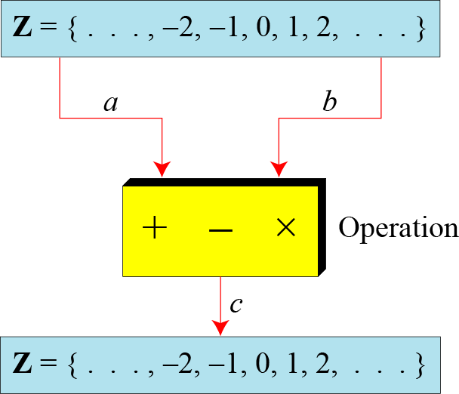
2.1.2 Binary Operations
In cryptography, we are interested in three binary operations applied to the set of integers. A binary operation takes two inputs and creates one output.
Figure 2.2 Three binary operations for the set of integers

Slide 6
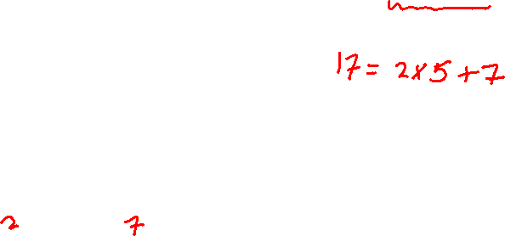
2.1.3 Integer Division
Division Algorithm
Theorem: When an integer a is divided by a nonzero integer n, there are two unique integers, q and r, such that:
a = q × n + r (where 0 ≤ r < n)
e.g. For a = 17, b = 5
we have:
17 = 3 x 5 + 2
So, q = 3 and r = 2

Slide 7
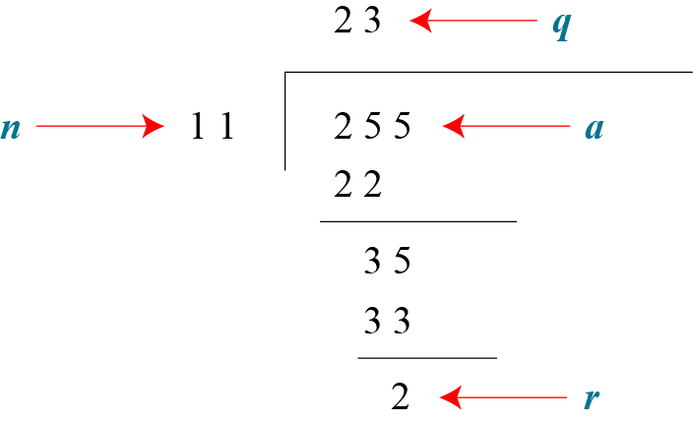
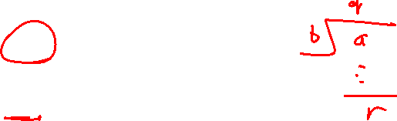
2.1.3 Continued
Example 2.2
Assume that a = 255 and n = 11. We can find q = 23 and r = 2 using the division algorithm.
Figure 2.3 Example 2.2, finding the quotient and the remainder

Slide 8
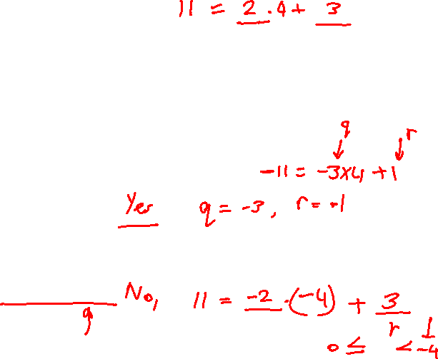
2.1.3 Continued
Examples
Find q and r when:
11 is divided by 4
IBL Exer 1: (Inquery-based learning activity)
Can we allow negative numbers in the division?
Eg.1: Divide (– 11) by 4
Eg.2: Divide 11 by (– 4)

Slide 9
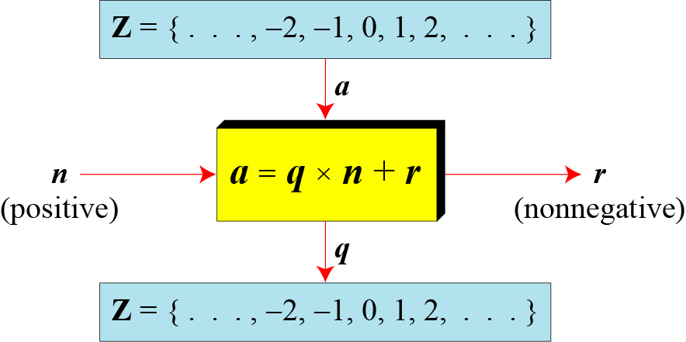

2.1.3 Continued
Figure 2.4 Division algorithm for integers
( 0 ≤ r < n )

Slide 10
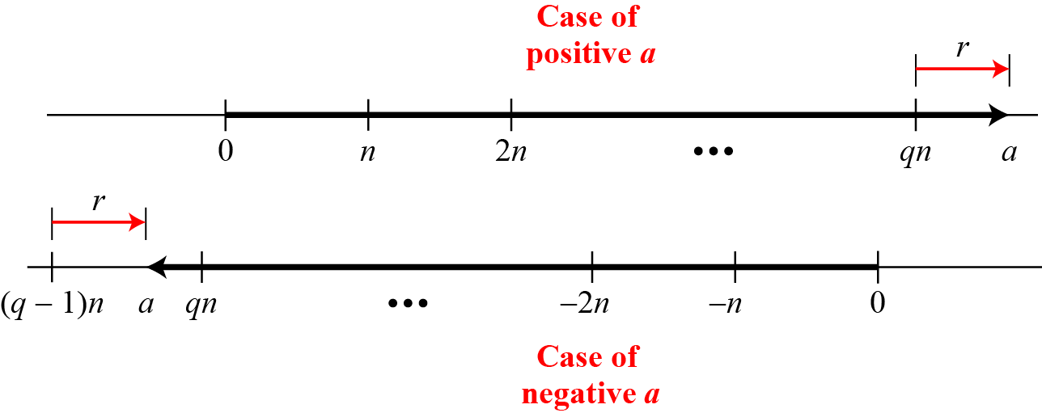

2.1.3 Continued
Figure 2.5 Graph of division alogorithm

Slide 11
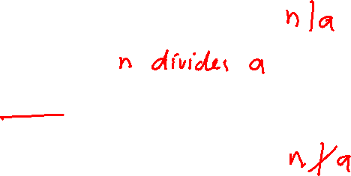
2.1.4 Divisbility
If a is not zero and r = 0 in the division relation, we get
a = q × n
If the remainder is zero, n | a
If the remainder is not zero, n ∤ a

Slide 12
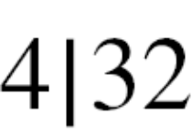
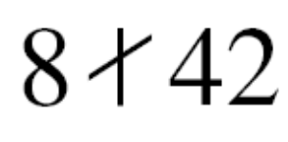

2.1.4 Continued
Example 2.4
The integer 4 divides the integer 32 because 32 = 8 × 4. We show this as
b. The number 8 does not divide the number 42 because
42 = 5 × 8 + 2. There is a remainder, the number 2, in the equation. We show this as

Slide 13
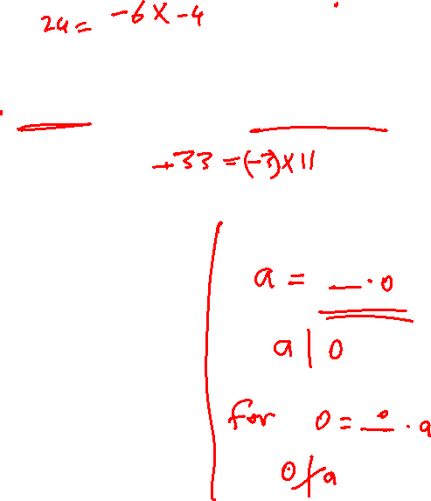
2.1.4 Continued
Example 2.5

Slide 14

2.1.4 Continued
Properties
Property 1: if a|1, then a = ±1.
Property 2: if a|b and b|a, then a = ±b.
Property 3: if a|b and b|c, then a|c.
Property 4: if a|b and a|c, then
a|(m × b + n × c), where m
and n are arbitrary integers

Slide 15

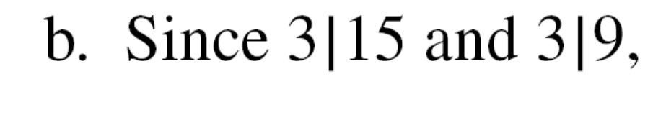
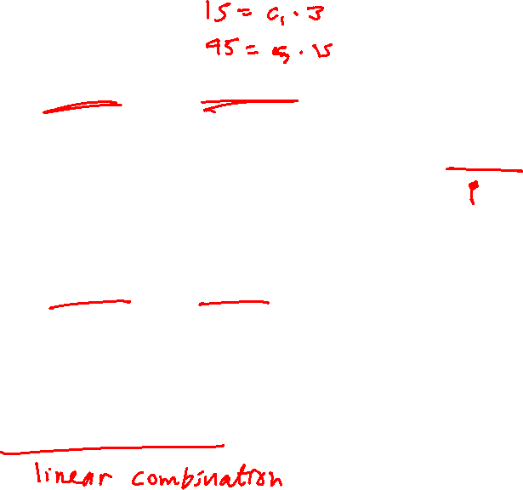
2.1.4 Continued
Example 2.6

Slide 16

Prime Numbers (§2.4 Stallings)
What is a prime number?

Slide 17
Prime Numbers (§2.4 Stallings)
Definition:
An integer n > 1 is called a prime if it has exactly two positive divisors, 1 and n itself.
If n > 1 is called composite if it is not prime.

Slide 18

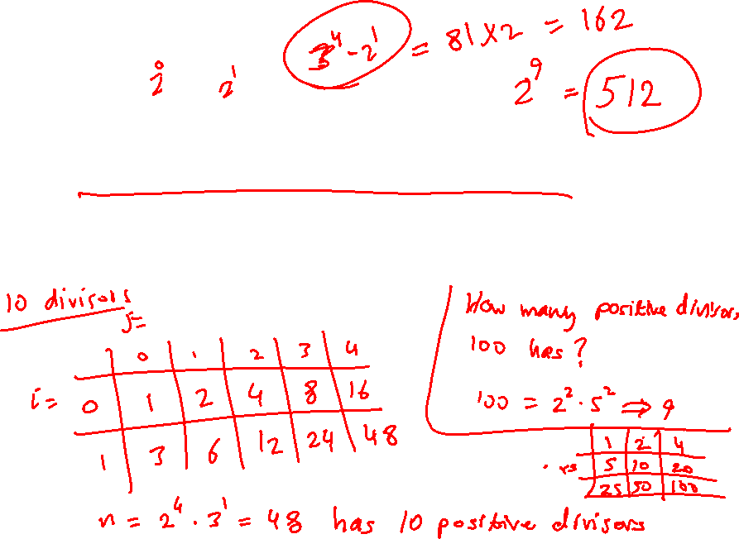
Continued
Note
The Fundamental Theorem of Arithmetic: Every integer n > 1 is either a prime or can be written uniquely as a product of primes.
Example:
Find the prime factorization of n = 54 and 300

Slide 19
Continued
Note
The Fundamental Theorem of Arithmetic: Every integer n > 1 is either a prime or can be written uniquely as a product of primes.
Example:
Find the prime factorization of n = 54 and 300

Slide 20
2.1.4 Continued
Note
Fact 1: The integer 1 has only one positive divisor, itself.
Fact 2: Any positive integer has at least
two divisors, 1 and itself (but it
can have more).

Slide 21
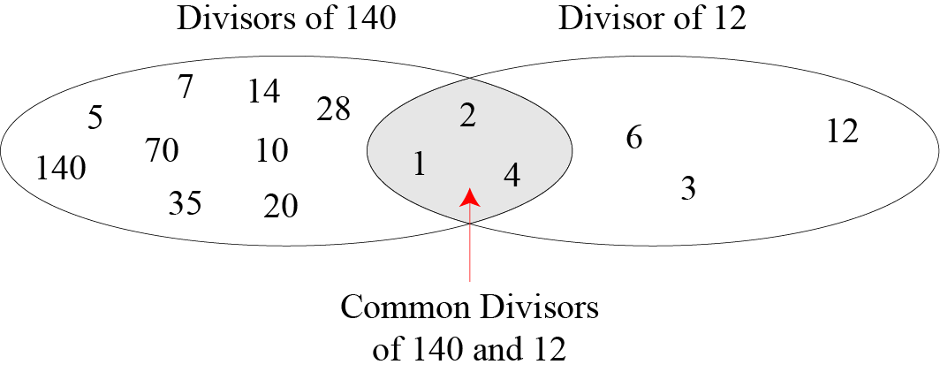
2.1.4 Continued
Figure 2.6 Common divisors of two integers

Slide 22
2.1.4 Continued
Greatest Common Divisor
The greatest common divisor of two integers is the largest (or greatest) positive integer that divides both integers.
Example:
Find the greatest common divisor (gcd):
gcd (12, 140)?
Common divisors include: 1, 2, and 4
gcd(12, 140) = 4
gcd (36, 54)?

Slide 23

Greatest Common Divisor (gcd)
Positive integer d is said to be the gcd of a and b if:
  d is a divisor of a and b
  Any divisor of a and b is a divisor of d
IBL Exer 2:
  What is gcd(a,0)?
  What is gcd(0,0)?
Notes:
More formally, the positive integer c is said to be the greatest common divisor
of a and b if
1. c is a divisor of a and of b .
2. Any divisor of a and b is a divisor of c .
An equivalent definition is the following:
gcd(a , b ) = max[k , such that k | a and k | b ]

Slide 24
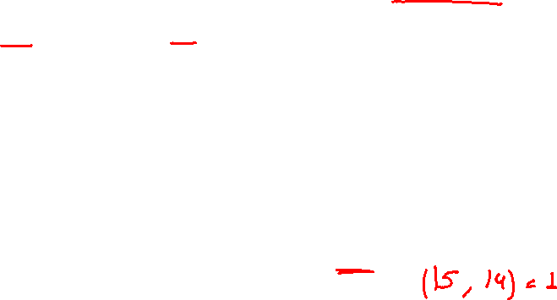
gcd
Because we require that the greatest common divisor be positive, gcd(a,b) = gcd(a,-b) = gcd(-a,b) = gcd(-a,-b)
In general, gcd(a,b) = gcd(| a |, | b |)
Two integers a and b are relatively prime (or coprime) if gcd(a,b) = 1
gcd(60, 24) = gcd(60, - 24) = 12
Notes:
Because we require that the greatest common divisor be positive, gcd(a , b ) =
gcd(a , -b ) = gcd(-a , b ) = gcd(-a ,-b ). In general, gcd(a , b ) = gcd( | a | , | b | ).
Also, because all nonzero integers divide 0, we have gcd(a , 0) = a .
We stated that two integers a and b are relatively prime if their only common
positive integer factor is 1. This is equivalent to saying that a and b are relatively
prime if gcd(a , b ) = 1.

Slide 25
2.1.4 Continued
Euclidean Algorithm (EA)
1. gcd(a,b) = gcd(b, a mod b)
2. gcd (a, 0) = a

Slide 26
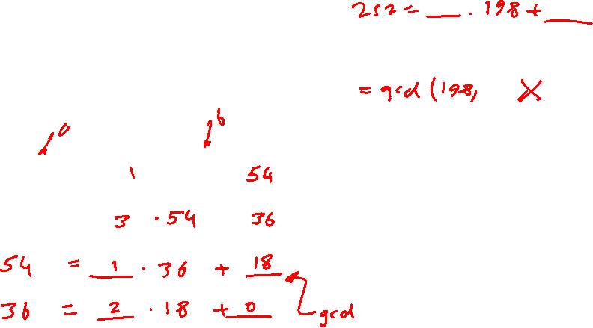
Example (EA Solving for the gcd)
Euclidean Algorithm:
gcd(a,b) = gcd(b, a mod b)
Example:
Apply the EA to find gcd(252, 198)
Soln.
= _______ . 198 + ________
198 = _____________ + _______
…
Notes:
One of the basic techniques of number theory is the Euclidean algorithm, which
is a simple procedure for determining the greatest common divisor of two positive
integers. First, we need a simple definition: Two integers are relatively prime if their
only common positive integer factor is 1.

Slide 27
Example (EA Solving for the gcd)
Euclidean Algorithm:
gcd(a,b) = gcd(b, a mod b)
Example:
Find gcd(252, 198)
Soln.
= 1 . 198 + 54
198 = 3 . 54 + 36
54 = 1 . 36 + 18
36 = 2 . 18 + 0 ➔ gcd = 18
Notes:
One of the basic techniques of number theory is the Euclidean algorithm, which
is a simple procedure for determining the greatest common divisor of two positive
integers. First, we need a simple definition: Two integers are relatively prime if their
only common positive integer factor is 1.

Slide 28
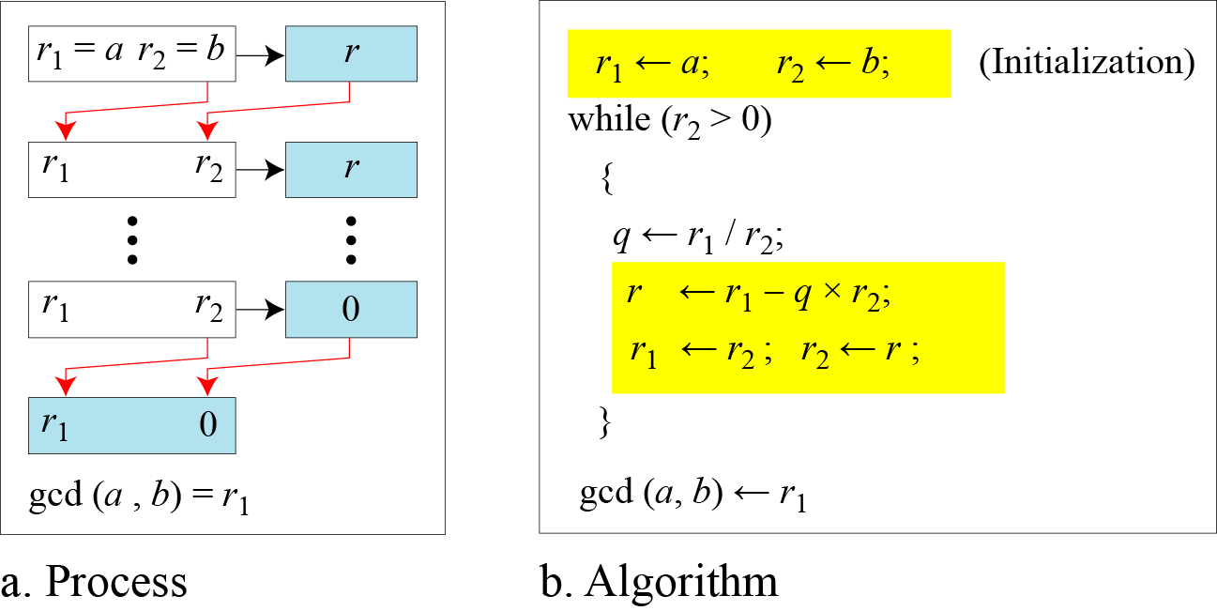
2.1.4 Continued
Figure 2.7 Euclidean Algorithm
(a) Flowchart and (b) Pseudocode

Slide 29
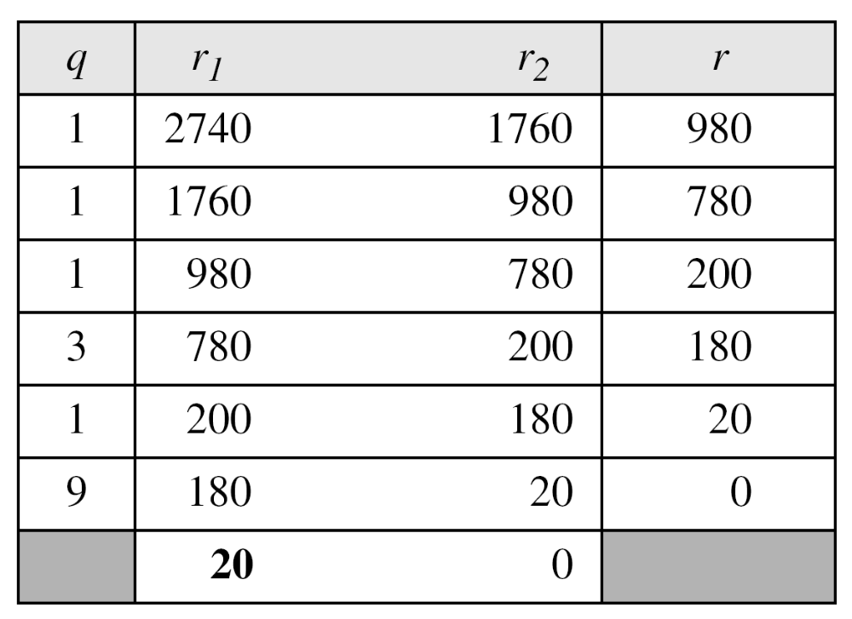

Example (Executing the algorithm)
Example 2.7
Find (2740, 1760) Trace the variables (r1, r2, q and r)
Soln.
2740 = 1 . 1760 + 980
1760 = 1 . 980 + 780
980 = 1 . 780 + 200
780 = 3 . 200 + 180
200 = 1 . 180 + 20
180 = 9 . 20 + 0
➔ gcd = 20

Slide 30
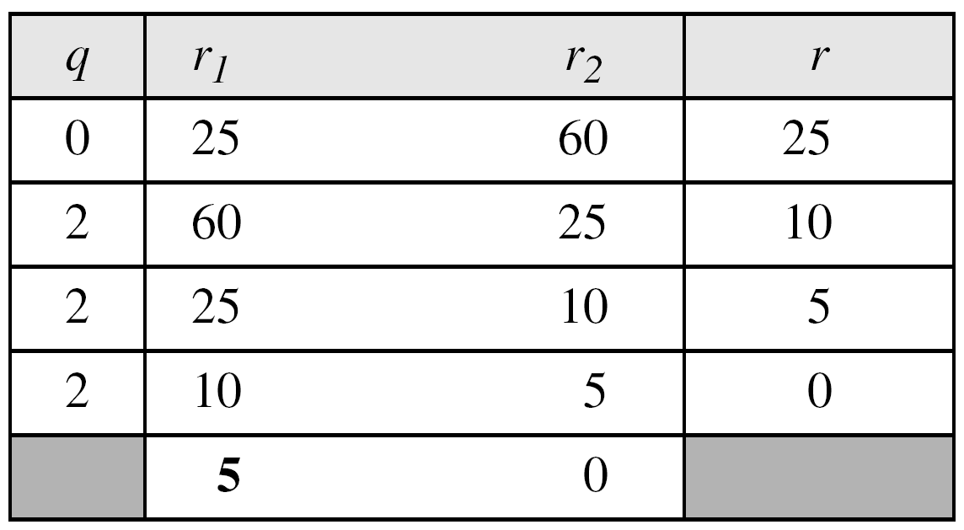

2.1.4 Continued
Example 2.8
What if b > a?
Example: Find the gcd (25, 60)
Solution
We have gcd (25, 60) = 5.

Slide 31

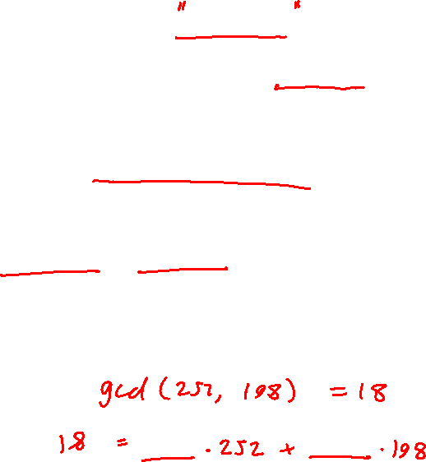
2.1.4 Continued
Extended Euclidean Algorithm (EEA)
Given two integers a and b, then the gcd(a,b) can be expressed as a linear combination of a and b.
Thus, there are two integers, s and t, such that
The extended Euclidean algorithm can calculate the gcd (a, b) and at the same time calculate the value of s and t.

Slide 32
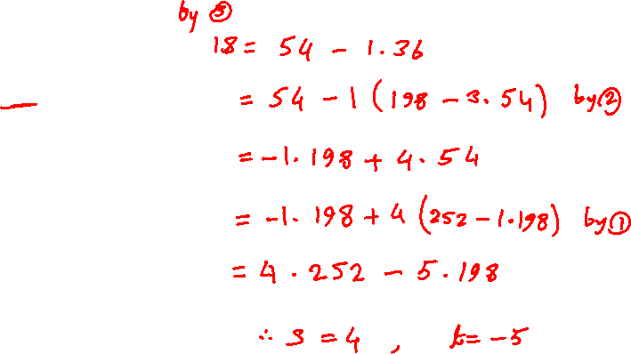
Example (Apply EEA, solve for s and t)
Express the gcd(252,198) as a linear combination of 252, 198.
Recall EA
= 1 . 198 + 54 _____(1)
198 = 3 . 54 + 36 _____(2)
54 = 1 . 36 + 18 _____(3)
= 2 . 18 + 0
➔ gcd = 18
Extend EA and solve for s and t
Notes:
One of the basic techniques of number theory is the Euclidean algorithm, which
is a simple procedure for determining the greatest common divisor of two positive
integers. First, we need a simple definition: Two integers are relatively prime if their
only common positive integer factor is 1.

Slide 33
Example (Apply EEA, solve for s and t)
Express the gcd(252,198) as a linear combination of 252, 198.
Recall EA
= 1 . 198 + 54 _____(1)
198 = 3 . 54 + 36 _____(2)
54 = 1 . 36 + 18 _____(3)
= 2 . 18 + 0
➔ gcd = 18
Extend EA and solve for s and t
From (3):
18 = 54 – 1 . 36
= 54 – 1 . (198 – 3 . 54) by (2)
= – 1 . 198 + 4 . 54
= – 1 . 198 + 4 . (252 – 1 . 198) by (1)
= 4 . 252 – 5 . 198
Thus, s = 4 and t = – 5
Notes:
One of the basic techniques of number theory is the Euclidean algorithm, which
is a simple procedure for determining the greatest common divisor of two positive
integers. First, we need a simple definition: Two integers are relatively prime if their
only common positive integer factor is 1.

Slide 34
2-2 MODULAR ARITHMETIC
The division relationship (a = q × n + r) discussed in the previous section has two inputs (a and n) and two outputs (q and r). In modular arithmetic, we are interested in only one of the outputs, the remainder r.
Topics discussed in this section:
2.2.1 Modular Operator
2.2.2 Set of Residues
2.2.3 Congruence
2.2.4 Operations in Z_{n}
2.2.5 Addition and Multiplication Tables
2.2.6 Different Sets

Slide 35
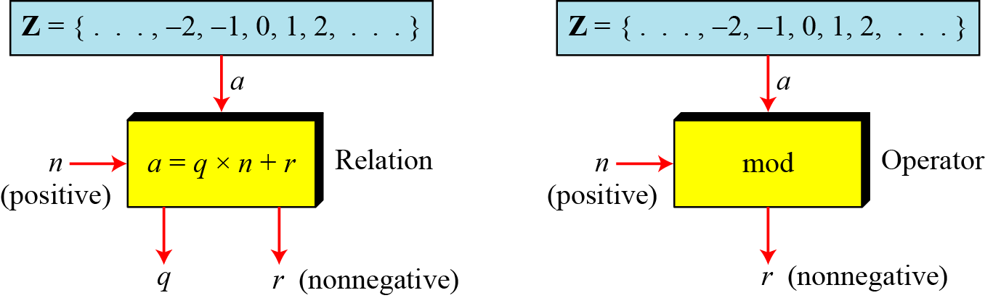
2.2.1 Modulo Operator
The modulo operator is shown as mod. The second input (n) is called the modulus. The output r is called the residue.
Figure 2.9 Division algorithm and modulo operator

Slide 36
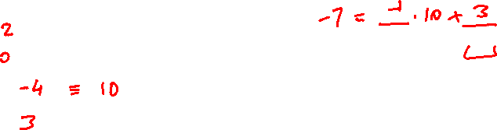
2.1.4 Continued
Example 2.14
Find the result of the following operations:
a. 27 mod 5
b. 36 mod 12
c. −18 mod 14
d. −7 mod 10
Solution

Slide 37
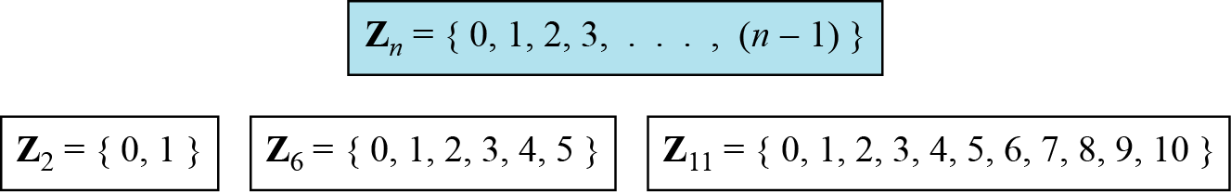
2.2.2 Set of Residues
The modulo operation creates a set, which in modular arithmetic is referred to as the set of least residues modulo n, or Z_{n}.
Figure 2.10 Some Z_{n} sets

Slide 38
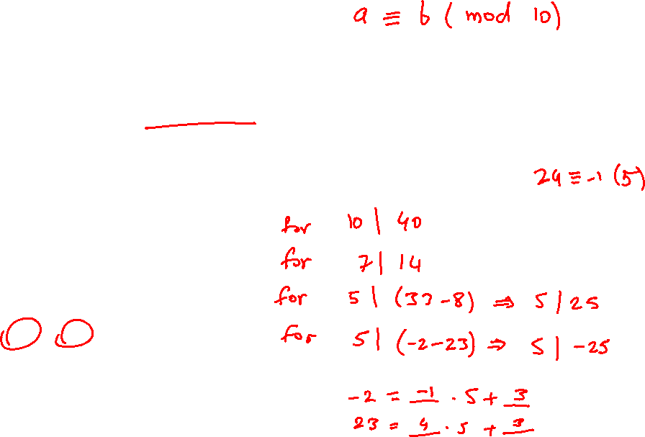
2.2.3 Congruence
Definition:
Let a and b be two integers, we say a is congruent to b modulo n if n | (a – b), denoted by a ≡ b (mod n)
Examples:
13 ≡ 43 (mod 10)
17 ≡ 31 (mod 7)
8 ≡ 33 (mod 5)
-2 ≡ 23 (mod 5)

Slide 39
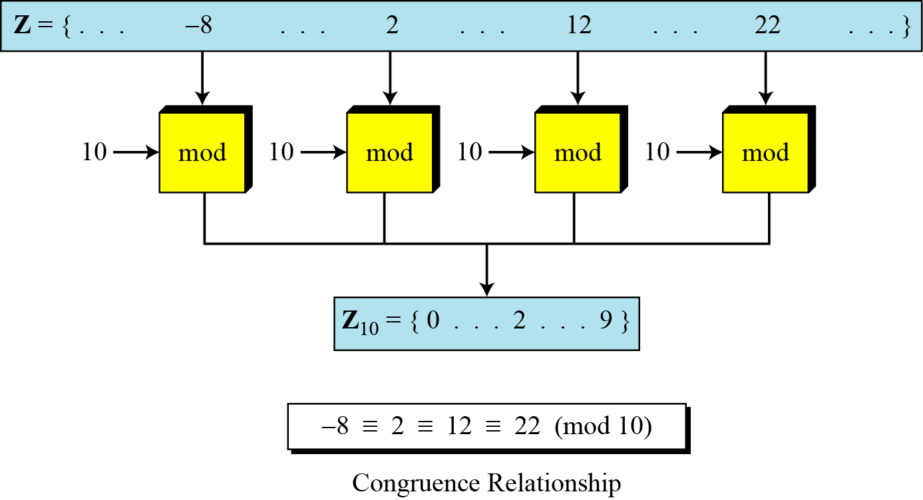
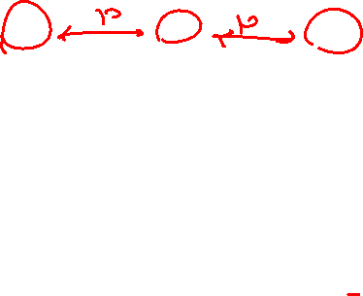
2.2.3 Continued
Figure 2.11 Concept of congruence

Slide 40
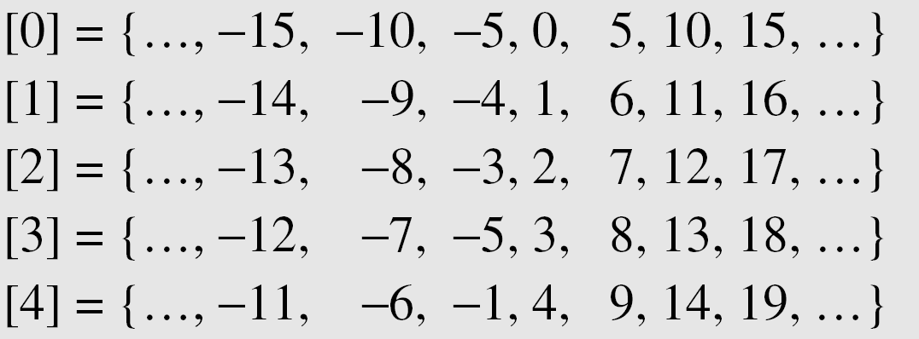

2.2.3 Continued
Residue Classes
A residue class [a] or [a]_{n} is the set of integers congruent modulo n.

Slide 41
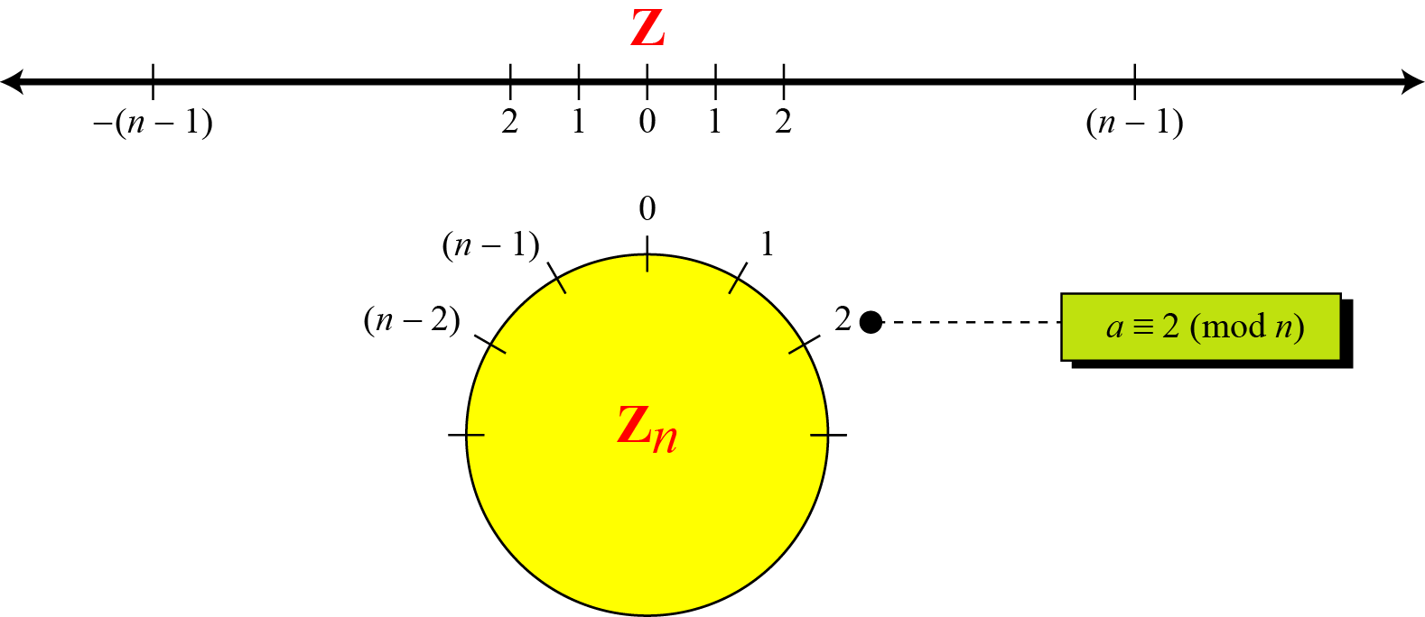
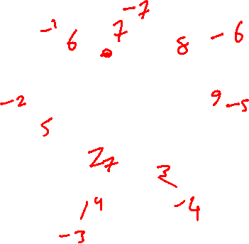

2.2.3 Continued
Figure 2.12 Comparison of Z and Z_{n} using graphs

Slide 42
2.2.3 Continued
Example 2.15
We use modular arithmetic in our daily life; for example, we use a clock to measure time. Our clock system uses modulo 12 arithmetic. However, instead of a 0 we use the number 12.

Slide 43
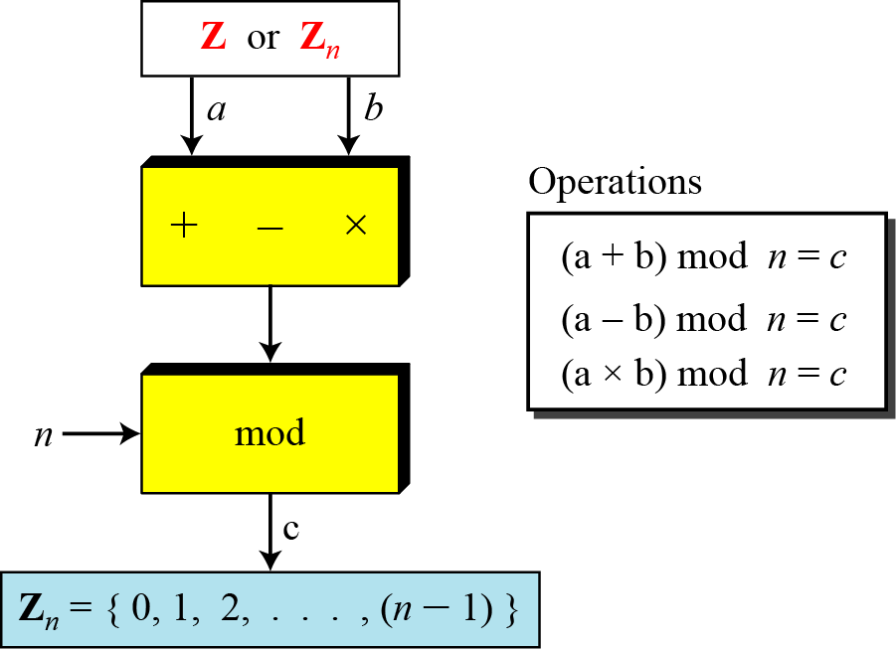

2.2.4 Operation in Z_{n}
The three binary operations that we discussed for the set Z can also be defined for the set Zn. The result may need to be mapped to Zn using the mod operator.
Figure 2.13 Binary operations in Z_{n}

Slide 44
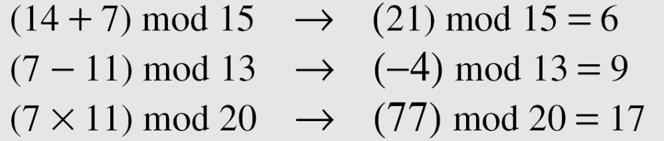
2.2.4 Continued
Example 2.16
Perform the following operations (the inputs come from Zn):
a. Add 7 to 14 in Z₁₅.
b. Subtract 11 from 7 in Z₁₃.
c. Multiply 11 by 7 in Z₂₀.
Solution

Slide 45
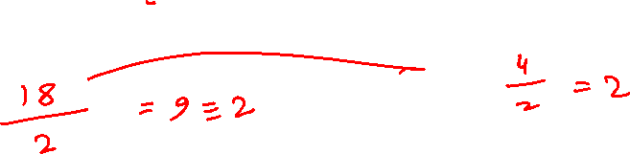
2.2.4 Continued
IBL Exer 3:
What is the best way to perform modular arithmetic?
E.g.
Is (a + b) mod n = ((a mod n) + (b mod n)) mod n?
Is (a – b) mod n = ((a mod n) – (b mod n)) mod n?
Is (a × b) mod n = ((a mod n) × (b mod n)) mod n?
Is (a ÷ b) mod n = ((a mod n) ÷ (b mod n)) mod n?
E.g.
Compute:
2147 * 3520 (mod 7)

Slide 46
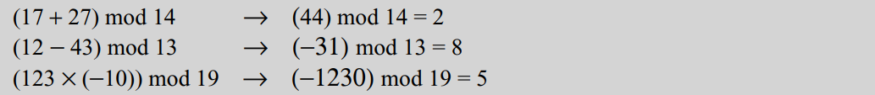
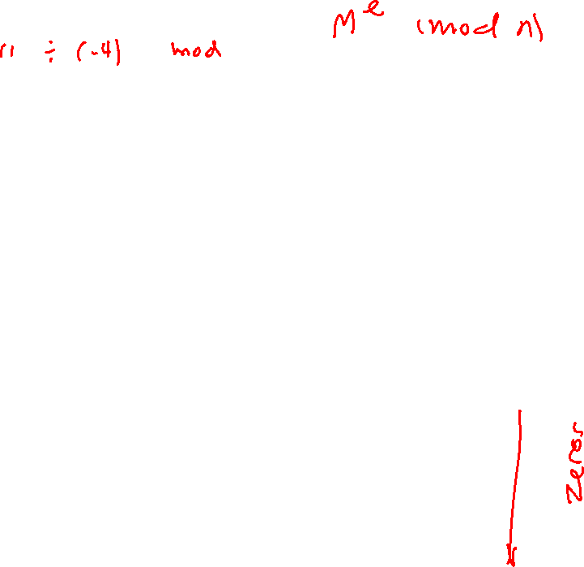
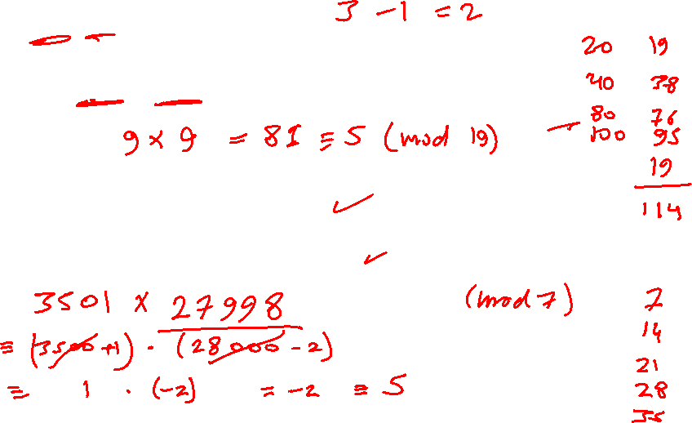
2.2.4 Continued
Perform the following operations (the inputs come from either Z or Z_{n}):
a. Add 17 to 27 in Z₁₄.
b. Subtract 43 from 12 in Z₁₃.
c. Multiply 123 by −10 in Z₁₉.
Solution

Slide 47
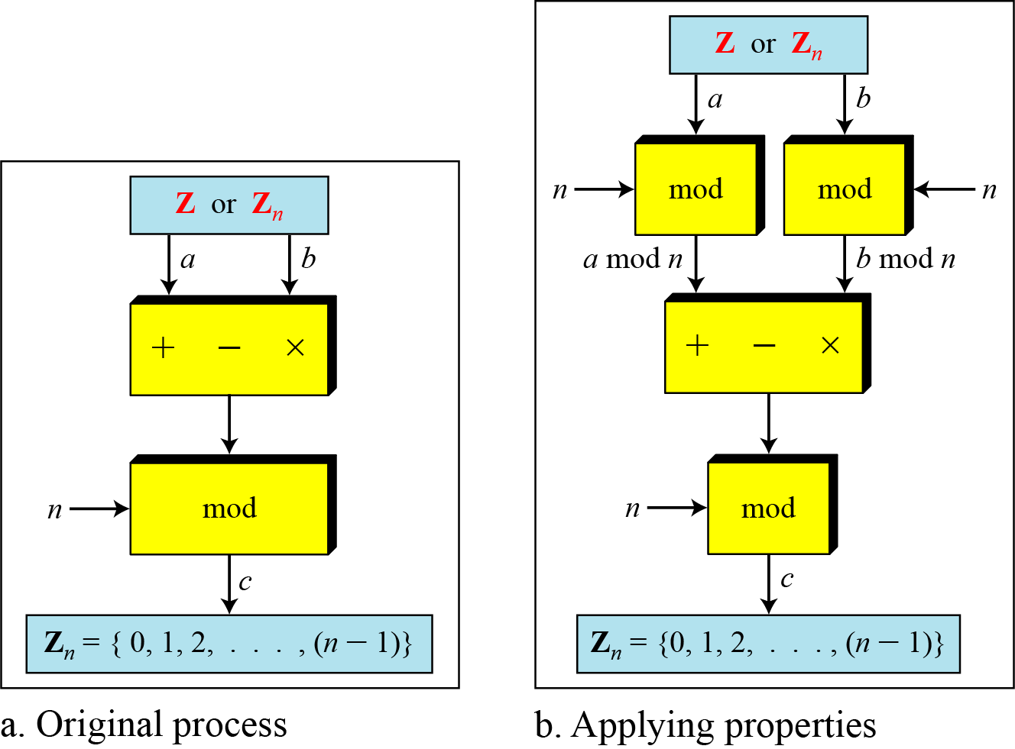
2.2.4 Continued
Figure 2.14 Properties of mode operator

Slide 48
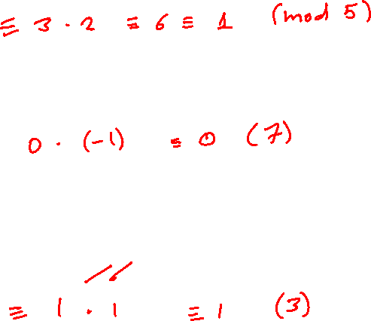
2.2.4 Continued
Example
Compute:
123 * 4567 (mod 5)
210 * 3499 (mod 7)
1234 * 4567 (mod 3)

Slide 49

2.2.5 Continue
Additive Inverse
In Z_{n}, two numbers a and b are additive inverses of each other if
Note
In modular arithmetic, each integer has an additive inverse. The sum of an integer and its additive inverse is congruent to 0 modulo n.

Slide 50
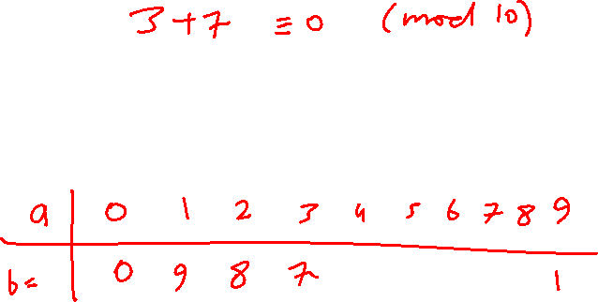
2.2.5 Continued
Example 2.21
Find all additive inverse pairs in Z₁₀
Solution

Slide 51
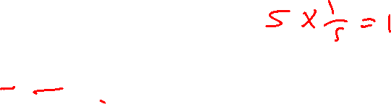
2.2.5 Continued
Multiplicative Inverse
In Z_{n}, the inverse of a is a^{–1} such that
a × a^{–1} ≡ 1
Note
In modular arithmetic, the product of the integer and its multiplicative inverse is congruent to 1 modulo n.

Slide 52
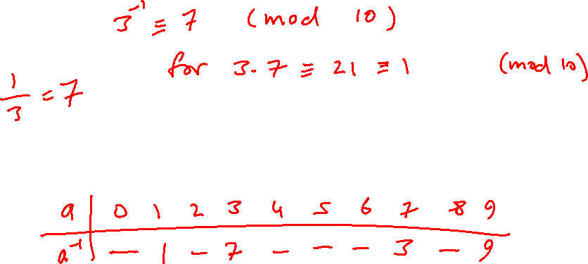
2.2.5 Continued
Example 2.22
Find the multiplicative inverse of 3 in (mod 10)
Solution
IBL Exer:
Find all multiplicative inverses in Z₁₀

Slide 53
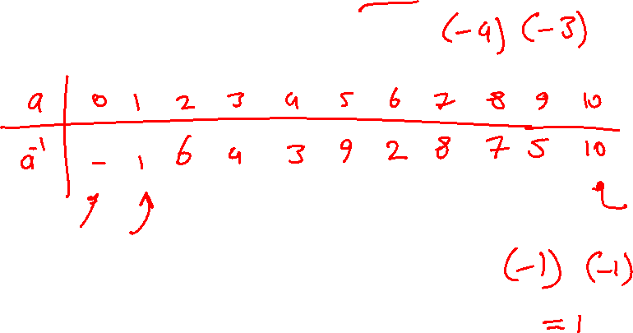
2.2.5 Continued
Example 2.24
Find all multiplicative inverse pairs in Z₁₁.
Solution

Slide 54
2.2.5 Continued
Note
An integer a has a multiplicative inverse modulo n if and only if a is coprime to n.

Slide 55
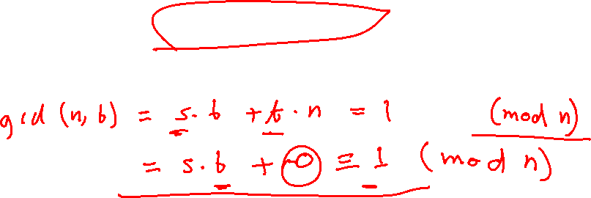
2.2.5 Continued
Note
The extended Euclidean algorithm finds the multiplicative inverses of b in Z_{n} when n and b are given and
gcd (n, b) = 1.
How?

Slide 56
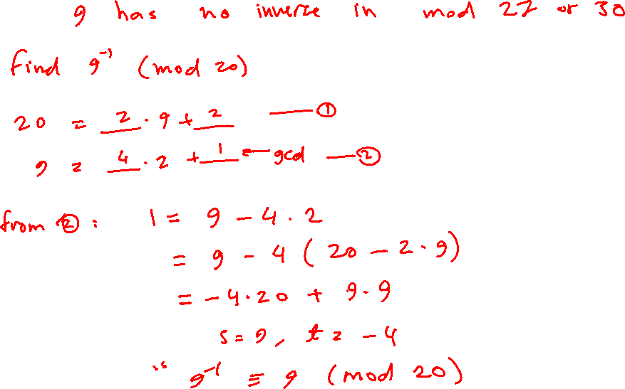
2.2.5 Continued
Figure 2.15 Using extended Euclidean algorithm to
find multiplicative inverse

Slide 57
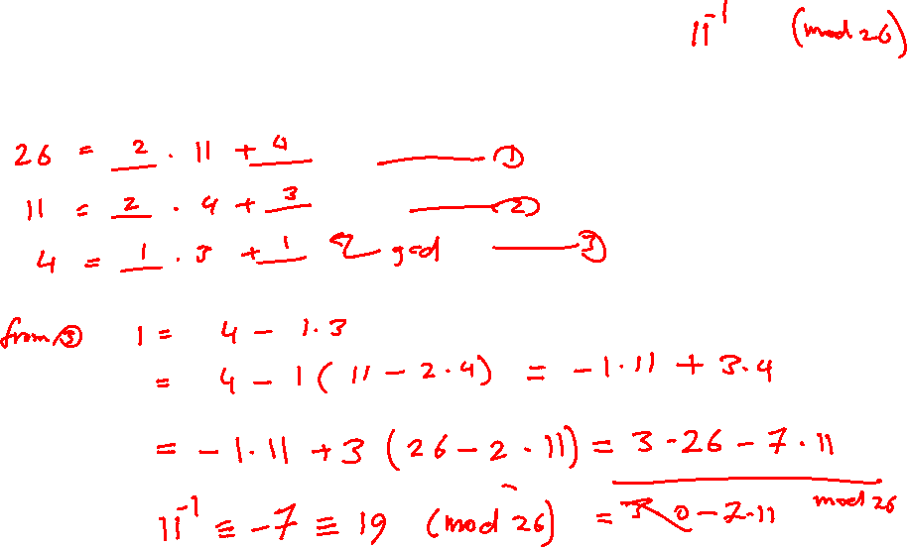
2.2.5 Continued
Example 2.25
Find the multiplicative inverse of 11 in Z₂₆.
Solution

Slide 58
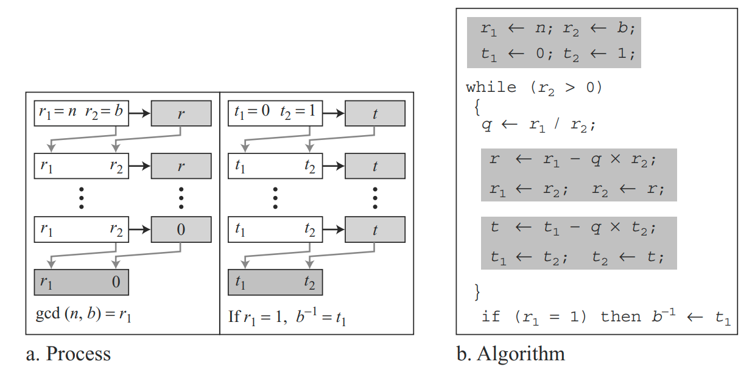
2.2.5 Continued
Figure 2.15 Using extended Euclidean algorithm to
find multiplicative inverse

Slide 59
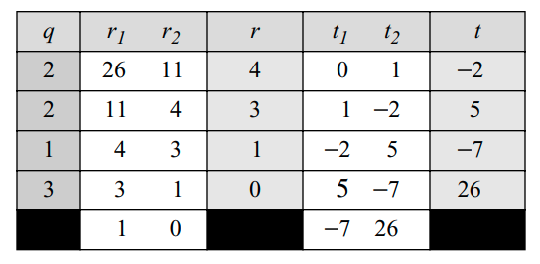
2.2.5 Continued
Example 2.25
Find the multiplicative inverse of 11 in Z₂₆.
Solution

Slide 60
2.2.5 Continued
Example 2.26
Find the multiplicative inverse of 23 in Z₁₀₀.
Solution

Slide 61
2.2.5 Continued
Example 2.27
Find the inverse of 12 in Z₂₆.
Solution

Slide 62
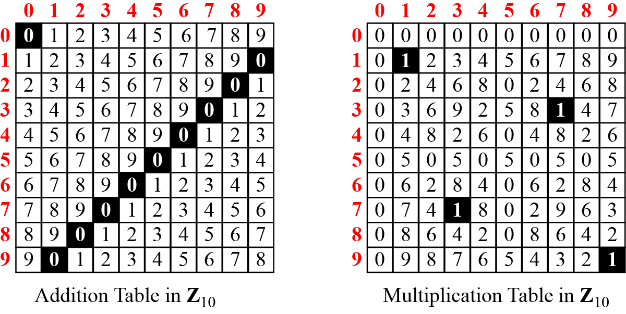

2.2.6 Addition and Multiplication Tables
Figure 2.16 Addition and multiplication table for Z₁₀

Slide 63
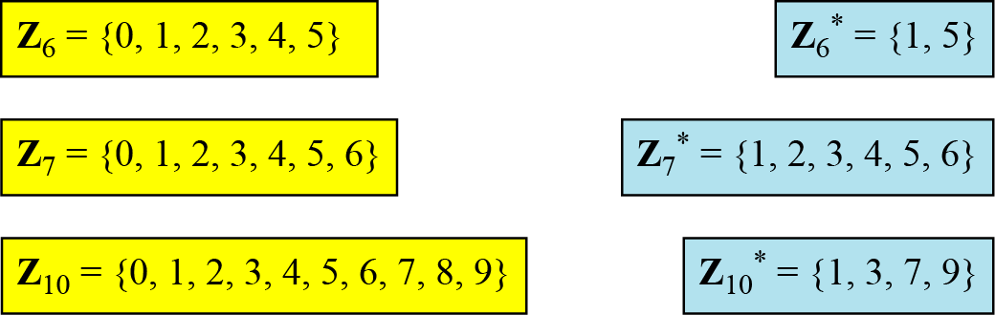

2.2.7 Different Sets
Figure 2.17 Some Z_{n} and Z_{n}* sets
Note
We need to use Zn when additive inverses are needed; we need to use Zn* when multiplicative inverses are needed.

Slide 64


2.2.8 Two More Sets
Cryptography often uses two more sets: Z_{p} and Z_{p}*. The modulus in these two sets is a prime number.

Slide 65
2-4 LINEAR CONGRUENCE
Cryptography often involves solving an equation or a set of equations of one or more variables with coefficient in Z_{n}. This section shows how to solve equations when the power of each variable is 1 (linear equation).
Topics discussed in this section:
2.4.1 Single-Variable Linear Equations
2.4.2 Set of Linear Equations

Slide 66

2.4.1 Single-Variable Linear Equations
Equations of the form ax ≡ b (mod n) might have no solution or a limited number of solutions.
Examples:
3x ≡ 5 (mod 11)
4x ≡ 6 (mod 13)
4x ≡ 6 (mod 10)

Slide 67




2.4.1 Single-Variable Linear Equations
Equations of the form ax ≡ b (mod n ) might have no solution or a limited number of solutions.

Slide 68
2.4.1 Continued
Example 2.35
Solve the equation 10 x ≡ 2(mod 15).
Solution
First we find the gcd (10 and 15) = 5. Since 5 does not divide 2, we have no solution.

Slide 69


2.4.1 Continued
Example 2.36
Solve the equation 14 x ≡ 12 (mod 18).
Solution
Divide by 2:
7 x ≡ 6 (mod 9)
Since 7 has an inverse (mod 9), will get 2 solutions in (mod 18)

Slide 70
2.4.1 Continued
Example 2.37
Solve the equation 3x + 4 ≡ 6 (mod 13).
Solution

Slide 71


2.4.2 Single-Variable Linear Equations
We can also solve a set of linear equations with the same modulus if the matrix formed from the coefficients of the variables is invertible.
Figure 2.27 Set of linear equations

Slide 72

2.4.2 Continued
Example 2.38
Solve the set of following three equations:
Solution
x ≡ 15 (mod 16),
y ≡ 4 (mod 16),
z ≡ 14 (mod 16).
We can check the answer by inserting these values into the equations.

