Slide 1
Bitcoin
King Fahd University of Petroleum & Minerals
College of Computer Sciences & Engineering
Cryptography and Blockchain Applications
Prepared by:
Sultan Almuhammadi
This lecture is based on:
Satoshi Nakamoto: (Bitcoin White Paper) and bitcoin.org

Slide 2
Outline
Introduction
Transactions
Timestamp Server
Proof-of-Work
Network
Incentive
Reclaiming Disk Space
Payment Verification
Combining and Splitting Value
Privacy and Security
Bitcoin Economics and Mining
Bitcoin Wallet

Slide 3

Introduction
Bitcoin:
A peer-to-peer electronic cash system
Published in 2008 under the pseudonym Satoshi Nakamoto.
First used in 2009
Solves Double-spending problem by using a peer-to-peer distributed timestamp server
Transactions are computationally impractical to reverse (protect the seller)
The system is secure as long as honest nodes control more CPU power than any cooperating group of attacker nodes. (51% attack)

Slide 4
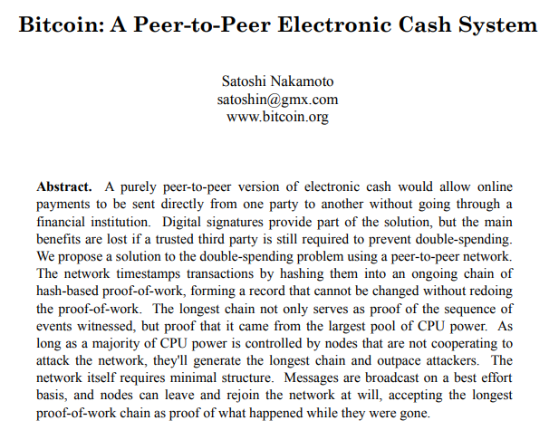
Bitcoin White-Paper (2008)

Slide 5
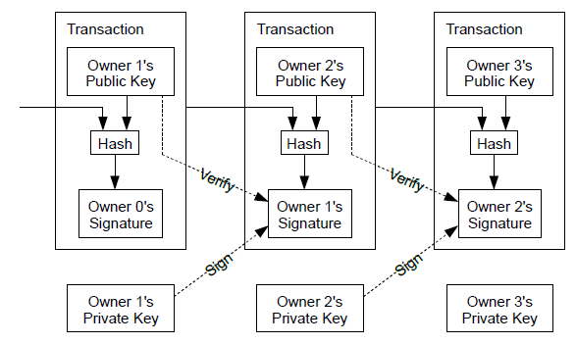
Transactions
Each owner transfers the coin to the next by digitally signing a hash of the previous transaction and the public key of the next owner and adding these to the end of the coin. A payee can verify the signatures to verify the chain of ownership.

Slide 6
Transactions
Solving the double-spending problem
The earliest transaction is the one that counts.
All transactions must be publicly announced.
The payee needs proof that at the time of each transaction, the majority of nodes agreed it was the first received.

Slide 7
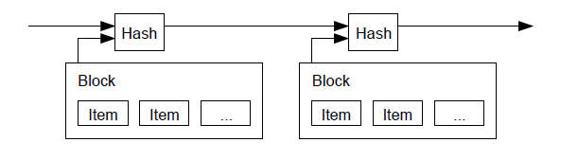
Timestamp Server
A timestamp server works by taking a hash of a block of items to be timestamped and widely publishing the hash, such as in a newspaper or Usenet post.
The timestamp proves that the data must have existed at the time in order to get into the hash.
Each timestamp includes the previous timestamp in its hash, forming a chain.

Slide 8
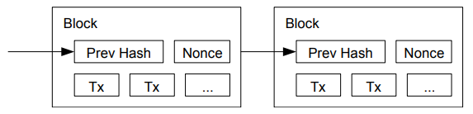
Proof-of-Work (POW)
Proof-of-work involves scanning for a value (Nonce) that when hashed, with SHA-256, the hash code should be less than a predefined target-hash.
The average work required is exponential in the number of zero bits in the target-hash and can be verified by executing a single hash.
As later blocks are chained after it, the work to change the block would include redoing all the blocks after it.
For decision making, the proof-of-work is “one-CPU-one-vote”.
The majority decision is represented by the longest chain.

Slide 9
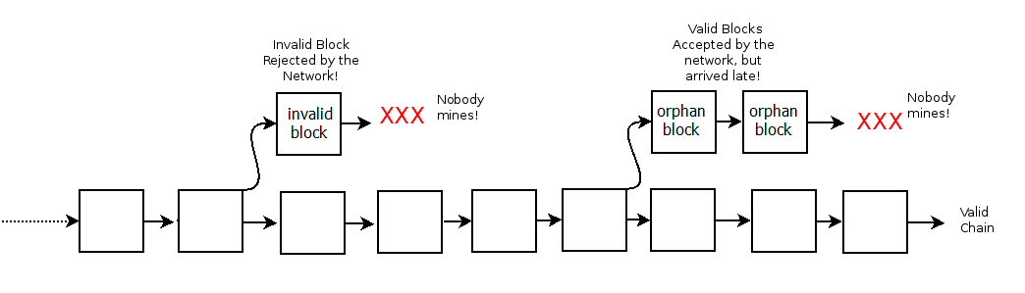
Proof-of-Work (POW)
Maintaining the longest chain:
If someone tries to propagate an invalid block, the network will reject it.
If valid blocks accepted by the network, but arrive late to other peers, they might have been already beaten in propagation by other blocks, and hence they will no longer be mined any further (orphan blocks).
Eventually, the blockchain name is given to the longest chain of valid blocks.

Slide 10
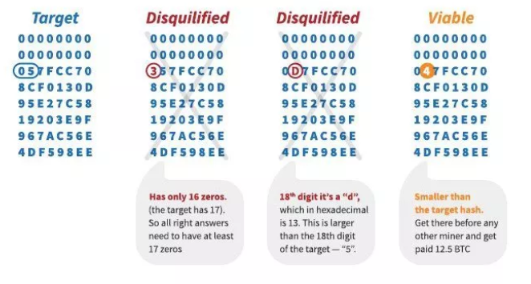
Proof-of-Work (POW)
How to determine the number of zero bits?
In Bitcoin, the required number of zeros is set such that all peers in the network need about 10 minutes to solve the challenge on average and add a new block to the blockchain.
The average time to add a new block is called block-time. It is set to 10 minutes in Bitcoin.
As more peers join the network, the level of “difficulty” is increased by increasing the target number of zeros in the target-hash to maintain the 10 minute average time.
Additional bits (or Hex digits) can be used to fine-tune the difficulty.
Example:
Suppose the target number of zero bits is: 69 bits (or 17 Hex zeros + 1 bit)

Slide 11
Network
How to run the network?
New transactions are broadcast to all nodes.
Each node collects new transactions into a block.
Each node works on finding a difficult proof-of-work for its block.
When a node finds a proof-of-work, it broadcasts the block to all nodes.
Nodes accept the block only if all transactions in it are valid and not already spent.
Nodes express their acceptance of the block by working on creating the next block in the chain, using the hash of the accepted block as the previous hash.
Nodes always consider the longest chain to be the correct one and will keep working on extending it.

Slide 12
Incentive
The first transaction in a block is a special transaction that starts a new coin owned by the creator of the block as an incentive for nodes to support the network. (This is called mining)
The steady addition of a constant of amount of new coins is analogous to gold miners expending resources to add gold to circulation.
In Bitcoin, CPU time and electricity are expended.
The incentive can also be funded with transaction fees.
Once a predetermined number of coins (21 M) have entered circulation, the incentive can transition entirely to transaction fees and be completely inflation free.
The incentive helps encourage nodes to stay honest:
If a greedy attacker is able to assemble 51% of computational power, he would have to choose between using it to defraud people by stealing back his payments or using it to generate new coins.
He ought to find it more profitable to play by the rules

Slide 13
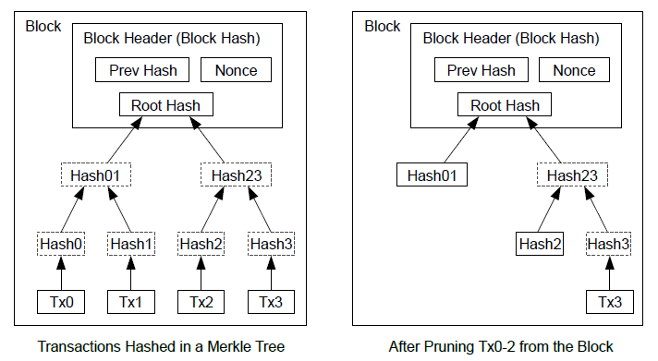
Reclaiming Disk Space
Once the latest transaction in a coin is buried under enough blocks, the spent transactions before it can be discarded to save disk space.
Use Merkle Tree with only the root included in the block's hash.
Old blocks can then be compacted by stubbing off branches of the tree.
The interior hashes do not need to be stored.

Slide 14
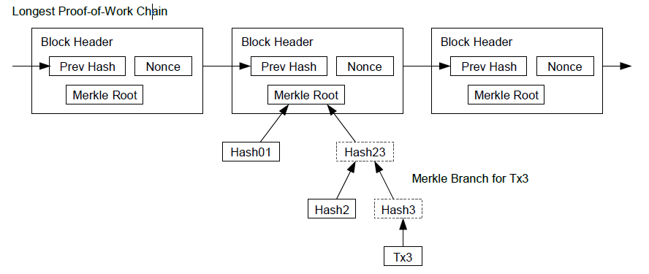
Simplified Payment Verification
It is possible to verify payments without running a full node.
A user only keeps a copy of the block headers of the longest proof-of-work chain (by querying network nodes until he is convinced that he has the longest chain)
Obtain the Merkle branch linking the transaction to the block it's timestamped in.

Slide 15
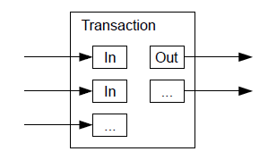
Combining and Splitting Value
To allow value to be split and combined:
Transactions contain multiple inputs and outputs.
There will be either a single input from a larger previous transaction or multiple inputs combining smaller amounts,
At most two outputs: one for the payment, and one returning the change, if any, back to the sender.

Slide 16
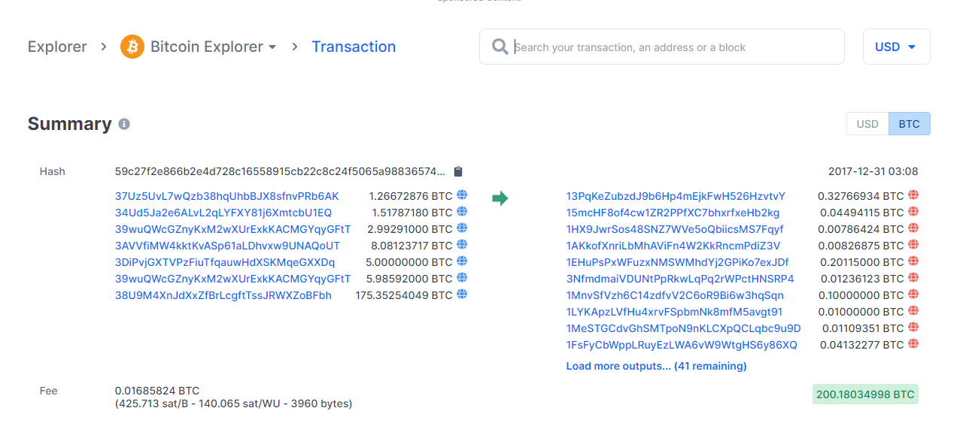
Combining and Splitting Value
Example:

Slide 17
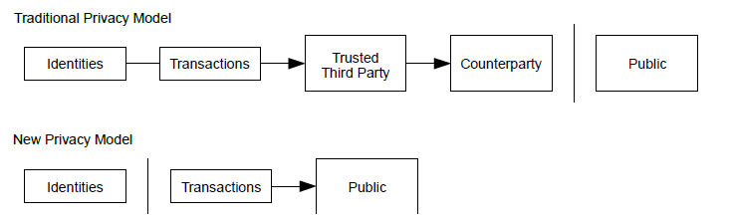
Privacy
Privacy is achieved by keeping public keys anonymous:
The public can see that someone is sending an amount to someone else.
No information linking the transaction to anyone.

Slide 18

Honest Node vs Attacker Calculations
The race between the honest chain and an attacker chain can be characterized as a Binomial Random Walk.
p = probability an honest node finds the next block
q = probability the attacker finds the next block
q_{z} = probability the attacker will ever catch up from z blocks behind

Slide 19
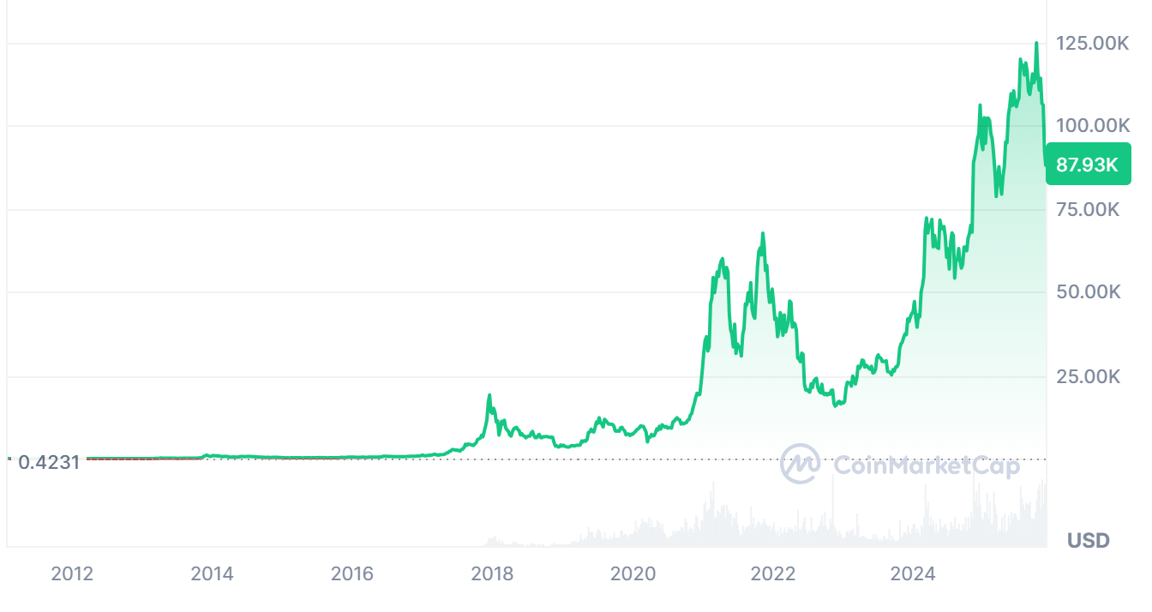
Bitcoin Economics
Bitcoin:
First used in 2009, about BTC 5000 were exchanged for $5.
The first major users of bitcoin were black markets, such as Silk Road.
In 2010, BTC 10,000 were paid for two pizzas ($41 value) at Papa John’s.
In 2012, bitcoin prices started at $5.27 growing to $13.30 for the year

Slide 20
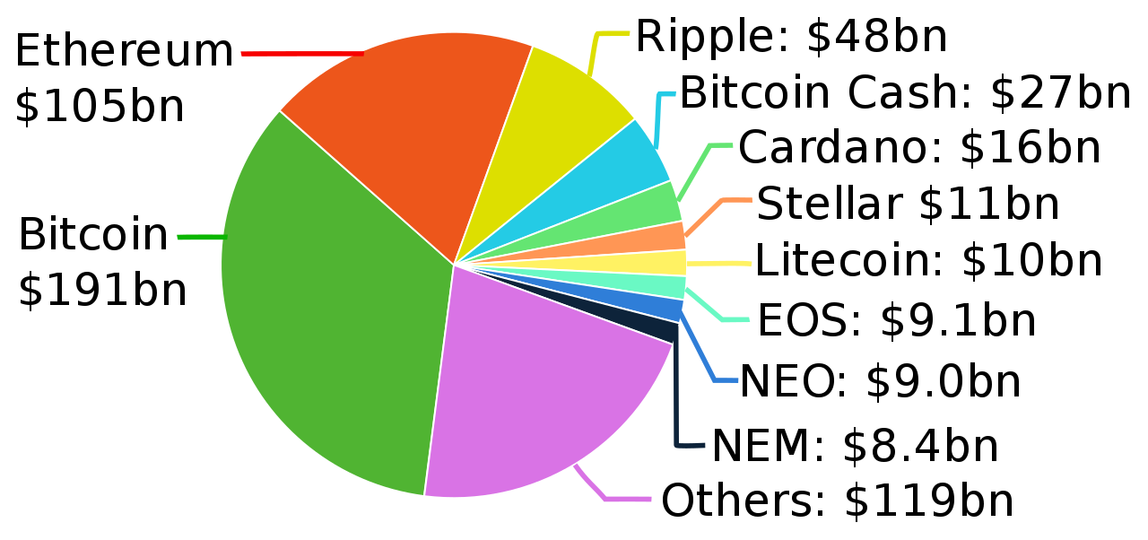
Bitcoin Market Cap.
As of Aug 2018:
As of 7 Oct 2025:
>27 M cryptocurrencies
Total Market cap: ~$4.28 Trillions
Bitcoin cap: ~$2.48 Trillions
See https://coinmarketcap.com/ for updates

Slide 21
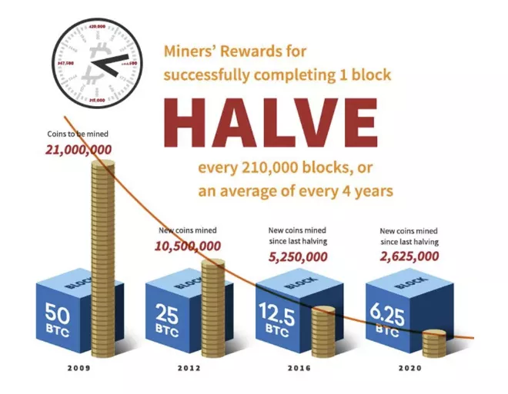
Bitcoin Inflation
Bitcoin inflation is mainly due to block rewards (mining):
Verifying thousands of transactions daily can be a lot of work for nodes (miners). ﻿
As incentives for their efforts, miners are rewarded bitcoin whenever they add a new block of transactions to the blockchain.
The amount of new bitcoin given with each mined block is called block reward.
The block reward is halved every 210,000 blocks (or roughly every 4 years).
Block reward was 50 BTC in 2009
1st halving to 25 BTC on 28 Nov 2012
2nd halving to 12.5 BTC on 9 July 2016
3rd halving to 6.25 BTC on 11 May 2020
4th halving to 3.125 on 20 April 2024
5th halving to 1.5625 is expected in 2028
Expected inflation-free starts in 2140

Slide 22
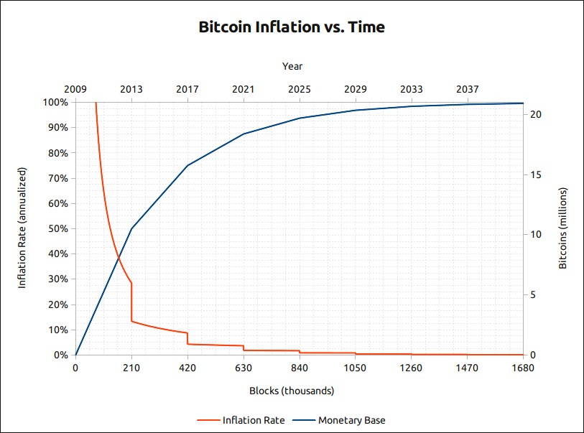
Bitcoin Inflation
Predictable monetary supply:
People can rely on programmed/controlled supply of Bitcoin from block rewards.
Easy prediction of future inflation rate (how many Bitcoins are in circulation and how many remain left to be mined) helps people make informed decisions.

Slide 23
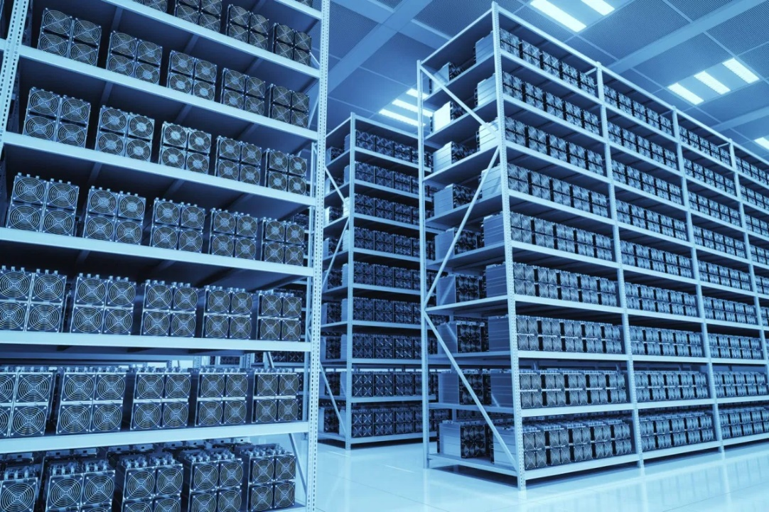
Bitcoin Mining
Bitcoin mining is the process of creating new bitcoin by solving a computational puzzle (Proof-of-Work).
Mining is necessary to maintain the ledger of transactions upon which bitcoin is based (to provide incentive for nodes to support the network).
Miners have become very sophisticated over the last several years using complex machinery to speed up mining operations.

Slide 24

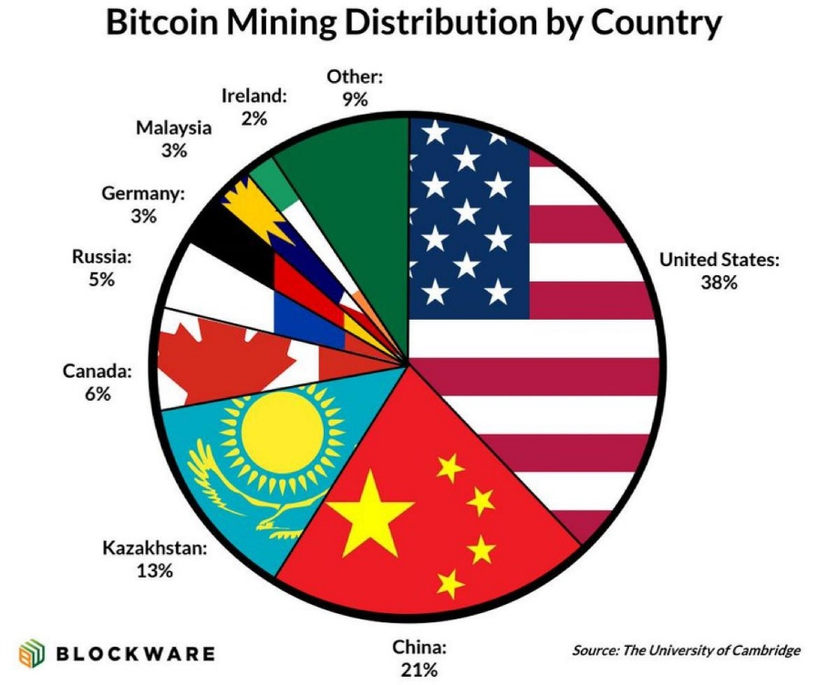
Bitcoin Mining
As of today, Bitcoin mining requires huge amount of computational power.
Main mining problems:
Electricity
Heat
65~80% of global Bitcoin are mined in China (in 2018-2020)
As of 2025, USA and Chian are the top countries in Bitcoin mining.

Slide 25
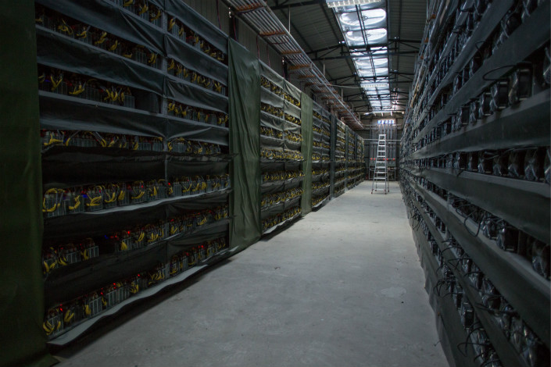
Bitcoin Mining (China)

Slide 26
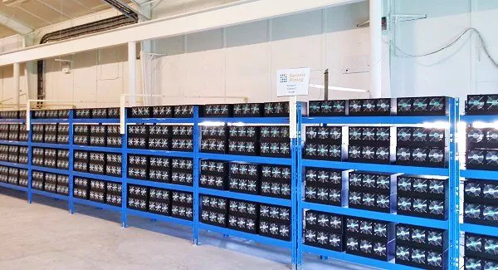
Bitcoin Mining (Iceland)

Slide 27
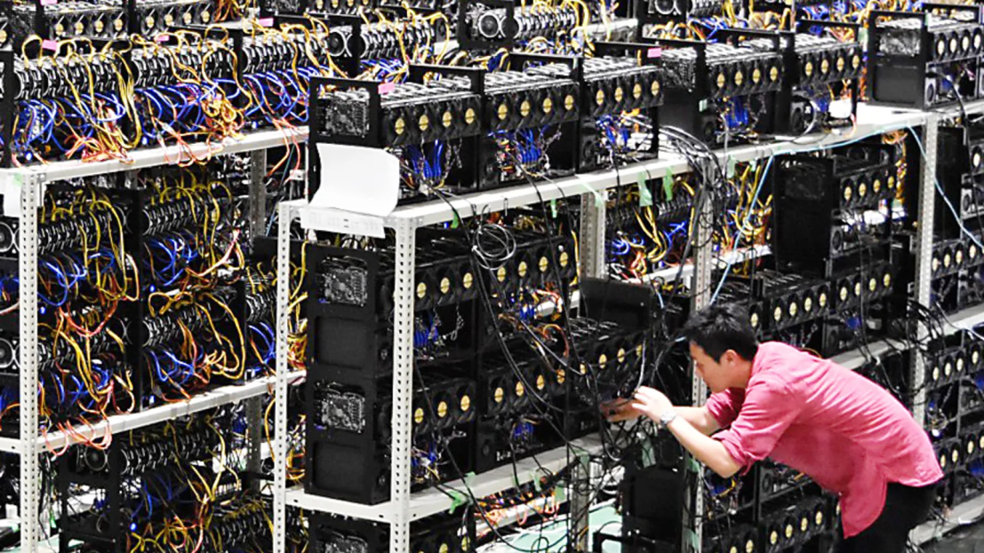
Bitcoin Mining (Japan)

Slide 28
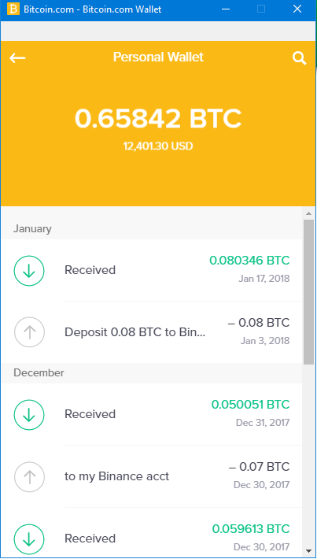
Bitcoin Wallet

