Slide 1
Shor’s Algorithm
King Fahd University of Petroleum & Minerals
College of Computer Sciences & Engineering
ICS 562 – Quantum Cryptography
Prepared by:
Sultan Almuhammadi
This lecture is based on:
Yanofsky: Section 6.5 (and recall of 6.3*)

Slide 2
Integer Factorization
Factorization Problem:
  Given a large integer N, find its prime factors
    E.g. N = 105 = 3 * 5 * 7
  The problem become harder if N is larger and has only 2 prime factors
    E.g. N = 143 = 11 * 13
Application in Cryptography:
  Many cryptographic algorithms depends on factorizations
    E.g. RSA and Rabin Cryptosystem,
    In practice, N is an n-bit integer, where n > 1000 bits (more than 300 digits)

Slide 3


Factorization Algorithms
Deterministic Factorization Algorithms:
  Trial division algorithm (for n bit integer)
    Time complexity: O(2^{n/2})
    Exponential in terms of n.
  General number field sieve (GNFS) algorithm (best known)
    Time complexity:
    Sub-exponential in terms of n (sub-class of the exponential complexity)
    Based on advanced number theory.
Quantum Factorization Algorithm
  Shor’s Algorithm
    Time complexity:
    Polynomial in terms of n.
    Based on number theory (modular arithmetic) and period finding.

Slide 4
Simon’s Algorithm (Review)
Recall Simon’s Periodicity Algorithm
  To find patterns in functions
Simon’s Periodicity Problem:
  Given a function f : {0, 1}^{n} → {0, 1}^{n} as a black box, with a secret binary string c = c₀c₁c₂ · · · c_{n−1}, such that for all strings x, y ∈ {0, 1}^{n}, we have
  f (x) = f (y) if and only if x = y ⊕ c
  Here, c is called the period of f.
Example: for n = 3, c = 101, we have
  000 ⊕ 101 = 101; hence, f (000) = f (101)
  100 ⊕ 101 = 001; hence, f (100) = f (001)
Note:
  if c = 0^{n} , then f is one-to-one, otherwise f is two-to-one.

Slide 5
Simon’s Algorithm (Cont.)
How to find the period classically?
  Given a function f : {0, 1}^{n} → {0, 1}^{n} as a black box.
  To fine c, evaluate function on more half of the inputs in domain,
  and look for any pair of inputs x, y, such that f (x) = f (y)
  Then, compute: c = x ⊕ y
  Thus, we need to evaluate the function (2^{n-1} +1) times.
  Time complexity: O(2^{n}) , i.e. exponential time

Slide 6
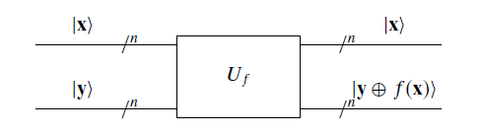
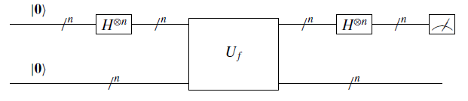
Simon’s Quantum Circuits
The unitary operation of f
  |x, y> |x, y ⊕ f (x) >
  If we set y = 0^{n} , this circuit will compute f (x)
The quantum part of Simon’s algorithm:
  This operation is repeated several times to compute c.
Simon’s algorithm needs n evaluations of f to find the period c.

Slide 7
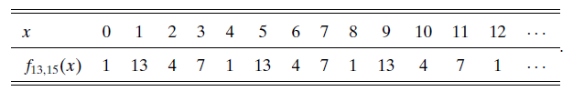
Shor’s Algorithm (Overview)
About Shor’s Algorithm
  Solves factorization problem in polynomial time.
  Uses modular arithmetic and quantum Fourier transform (QFT) to find the period to the factors.
Modular Arithmetic
  All computations are done in (Modulo-N) for some integer N > 1.
Quantum Fourier Transform
  To find the period of a periodic function. (See Simon’s Algorithm)
The exponent function
  f_{a,N} (x) = a^{x} Mod N
  E.g. Let a = 13, N = 15. Find f (x)

Slide 8
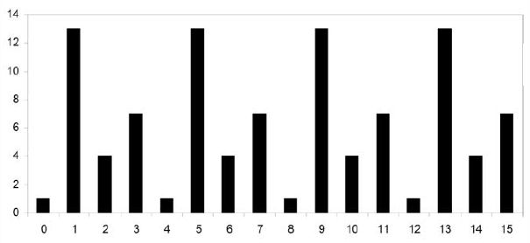
Finding the period
Periodic function:
  A function that has a repeated pattern (period).
  E.g. f_{13,15} (x), (the period = 4)

Slide 9
Finding the period
To find the period of f_{a,N} (x)
  The period of f_{a,N} (x) = the order of a in the multiplicative group Z*_{N}
  E.g. for f_{13,15} (x), the period = ord(13) = 4
  We need to find the smallest r such that a^{r} Mod N = 1

Slide 10
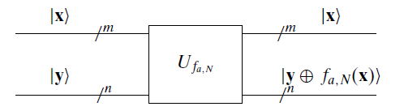
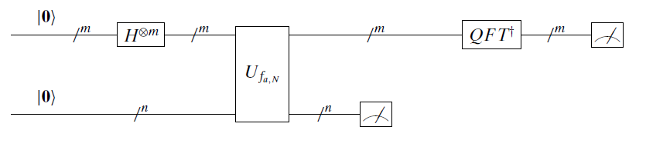
Shor’s Algorithm
The Quantum Part of the Algorithm:
  Quantum circuit for Uf_{a,N}
  To find the period: (see Circuit 6.166 page 209)

Slide 11



Shor’s Algorithm
When measure the top register
  Uses modular arithmetic and quantum Fourier transform (QTF) to find the period to the factors.
    and so on

Slide 12
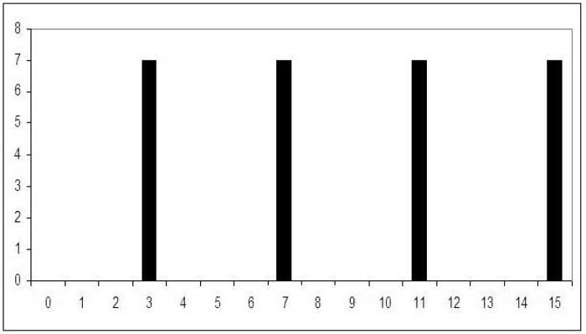
Shor’s Algorithm
  E.g. f_{13,15} (x) after measurement of 7

Slide 13



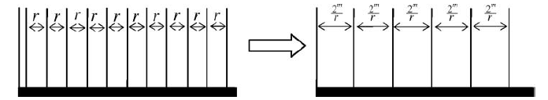


Quantum Fourier Transform
Discrete Fourier transform (DTF)
  _ where ω is the Mth root of unity
  _
  What it does?
Using Quantum Fourier transform (QTF)
  r can be obtained by 2^{m}/(2^{m}/r)

Slide 14
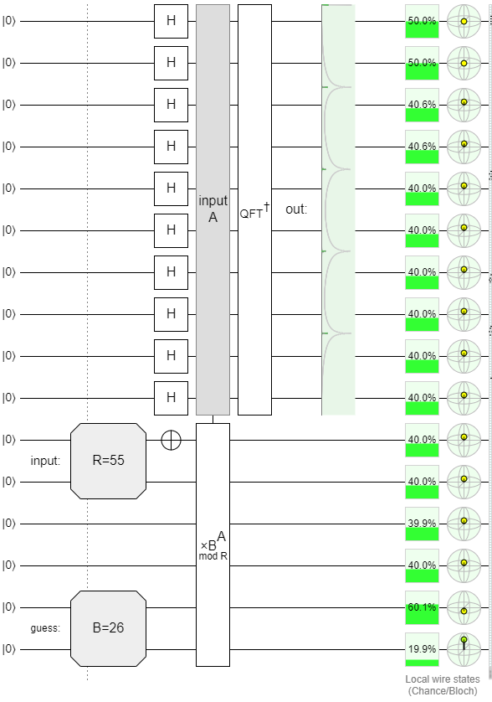
Shor’s Algorithm
Shor’s Period Finding (Implementation)

Slide 15



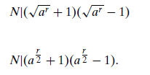
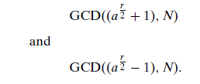
Shor’s Algorithm
From the period of f to the factors of N
  we compute:

Slide 16

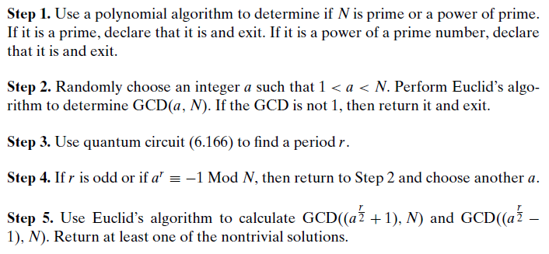
Shor’s Algorithm
Shor’s Algorithm

Slide 17
Demo
Demo:
  See Shor’s algorithm demo on Quirk (Period finding)
Examples:
  See Examples 6.5.6, 6.5.8, 6.5.10, in the textbook.
  See also Examples (6.5.7, 6.5.9, 6.5.11, 6.5.12)* for more details.

