Slide 1
Public Key Cryptography (& RSA)
King Fahd University of Petroleum & Minerals
College of Computer Sciences & Engineering
Cryptography
Prepared by:
Sultan Almuhammadi
This lecture is based on:
Stallings: Chapter 9
Forouzan: Section 10.2
Notes:
This book focuses on two broad areas: cryptographic algorithms and protocols, which
have a broad range of applications; and network and Internet security, which rely
heavily on cryptographic techniques.

Slide 2
Public-Key Encryption
Misconceptions about Public-key encryption:
Public-key encryption is more secure from cryptanalysis than symmetric encryption
Public-key encryption is a general-purpose technique that has made symmetric encryption obsolete
There is a feeling that key distribution is trivial when using public-key encryption, compared to the cumbersome handshaking involved with key distribution centers for symmetric encryption
Notes:
Before proceeding, we should mention several common misconceptions concerning
public-key encryption. One such misconception is that public-key encryption
is more secure from cryptanalysis than is symmetric encryption. In fact, the
security of any encryption scheme depends on the length of the key and the computational
work involved in breaking a cipher. There is nothing in principle about
either symmetric or public-key encryption that makes one superior to another from
the point of view of resisting cryptanalysis.
A second misconception is that public-key encryption is a general-purpose
technique that has made symmetric encryption obsolete. On the contrary, because
of the computational overhead of current public-key encryption schemes, there
seems no foreseeable likelihood that symmetric encryption will be abandoned. As
one of the inventors of public-key encryption has put it [DIFF88], “the restriction
of public-key cryptography to key management and signature applications is almost
universally accepted.”
Finally, there is a feeling that key distribution is trivial when using public-key
encryption, compared to the rather cumbersome handshaking involved with
key distribution centers for symmetric encryption. In fact, some form of protocol
is needed, generally involving a central agent, and the procedures involved are not
simpler nor any more efficient than those required for symmetric encryption (e.g.,
see analysis in [NEED78]).

Slide 3
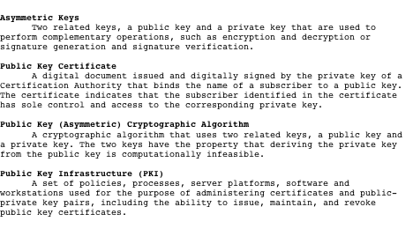
Table 9.1 Terminology Related to Asymmetric Encryption
Source: Glossary of Key Information Security Terms, NIST IR 7298 [KISS06]
Notes:
Table 9.1 defines some key terms.

Slide 4
Principles of Public-Key Cryptosystems
The concept of public-key cryptography evolved from an attempt to attack two of the most difficult problems associated with symmetric encryption:
Whitfield Diffie and Martin Hellman from Stanford University achieved a breakthrough in 1976 by coming up with a method that addressed both problems and was radically different from all previous approaches to cryptography
Key distribution
How to have secure communications in general without having to trust a KDC with your key
Digital signatures
How to verify that a message comes intact from the claimed sender
Notes:
The concept of public-key cryptography evolved from an attempt to attack two of
the most difficult problems associated with symmetric encryption. The first problem
is that of key distribution, which is examined in some detail in Chapter 14.
As Chapter 14 discusses, key distribution under symmetric encryption requires
either (1) that two communicants already share a key, which somehow has been distributed
to them; or (2) the use of a key distribution center. Whitfield Diffie, one
of the discoverers of public-key encryption (along with Martin Hellman, both at
Stanford University at the time), reasoned that this second requirement negated
the very essence of cryptography: the ability to maintain total secrecy over your
own communication. As Diffie put it [DIFF88], “what good would it do after all to
develop impenetrable cryptosystems, if their users were forced to share their keys
with a KDC that could be compromised by either burglary or subpoena?”
The second problem that Diffie pondered, and one that was apparently
unrelated to the first, was that of digital signatures . If the use of cryptography
was to become widespread, not just in military situations but for commercial and
private purposes, then electronic messages and documents would need the equivalent
of signatures used in paper documents. That is, could a method be devised
that would stipulate, to the satisfaction of all parties, that a digital message had
been sent by a particular person? This is a somewhat broader requirement than
that of authentication, and its characteristics and ramifications are explored in
Chapter 13.
Diffie and Hellman achieved an astounding breakthrough in 1976
[DIFF76 a, b] by coming up with a method that addressed both problems and was
radically different from all previous approaches to cryptography, going back over
four millennia.

Slide 5
Public-Key Cryptosystems
A public-key encryption scheme has six ingredients:
Plaintext
The readable message or data that is fed into the algorithm as input
Encryption algorithm
Performs various transform-ations on the plaintext
Public key
Used for encryption or decryption
Private key
Used for encryption or decryption
Ciphertext
The scrambled message produced as output
Decryption algorithm
Accepts the ciphertext and the matching key and produces the original plaintext
Notes:
Asymmetric algorithms rely on one key for encryption and a different but related
key for decryption. These algorithms have the following important characteristic.
• It is computationally infeasible to determine the decryption key given only
knowledge of the cryptographic algorithm and the encryption key.
In addition, some algorithms, such as RSA, also exhibit the following characteristic.
• Either of the two related keys can be used for encryption, with the other used
for decryption.
A public-key encryption scheme has six ingredients (Figure 9.1a; compare
with Figure 2.1).
• Plaintext: This is the readable message or data that is fed into the algorithm as
input.
• Encryption algorithm: The encryption algorithm performs various transformations
on the plaintext.
• Public and private keys: This is a pair of keys that have been selected so that
if one is used for encryption, the other is used for decryption. The exact transformations
performed by the algorithm depend on the public or private key
that is provided as input.
• Ciphertext: This is the scrambled message produced as output. It depends on
the plaintext and the key. For a given message, two different keys will produce
two different ciphertexts.
• Decryption algorithm: This algorithm accepts the ciphertext and the matching
key and produces the original plaintext.

Slide 6
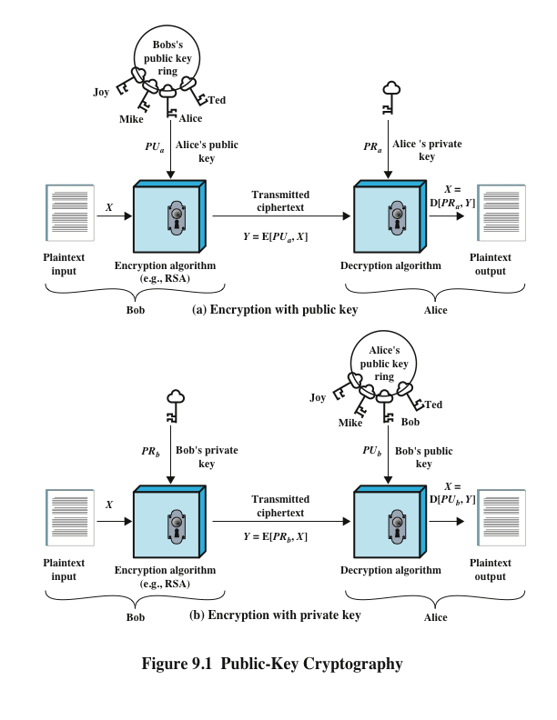
Public-Key Cryptography
Notes:
The essential steps are the following.
1. Each user generates a pair of keys to be used for the encryption and decryption
of messages.
2. Each user places one of the two keys in a public register or other accessible
file. This is the public key. The companion key is kept private. As Figure 9.1a
suggests, each user maintains a collection of public keys obtained from others.
3. If Bob wishes to send a confidential message to Alice, Bob encrypts the message
using Alice’s public key.
4. When Alice receives the message, she decrypts it using her private key. No
other recipient can decrypt the message because only Alice knows Alice’s private
key.
With this approach, all participants have access to public keys, and private
keys are generated locally by each participant and therefore need never be
distributed. As long as a user’s private key remains protected and secret, incoming
communication is secure. At any time, a system can change its private key and
publish the companion public key to replace its old public key.

Slide 7
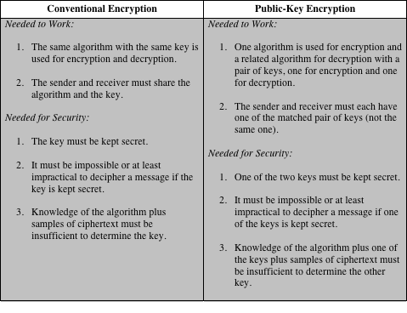
Table 9.2: Conventional and Public-Key Encryption
Notes:
Table 9.2 summarizes some of the important aspects of symmetric and public-key
encryption. To discriminate between the two, we refer to the key used in symmetric
encryption as a secret key . The two keys used for asymmetric encryption are
referred to as the public key and the private key . Invariably, the private key is kept
secret, but it is referred to as a private key rather than a secret key to avoid confusion
with symmetric encryption.

Slide 8
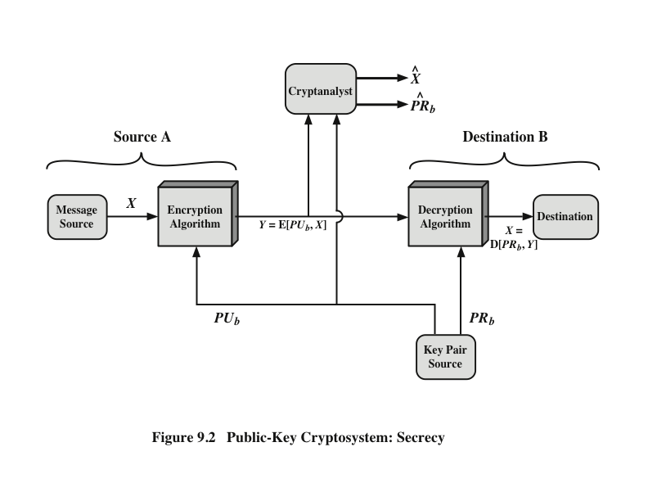
Public-Key Cryptosystem: Secrecy
Notes:
Let us take a closer look at the essential elements of a public-key encryption
scheme, using Figure 9.2 (compare with Figure 2.2).

Slide 9
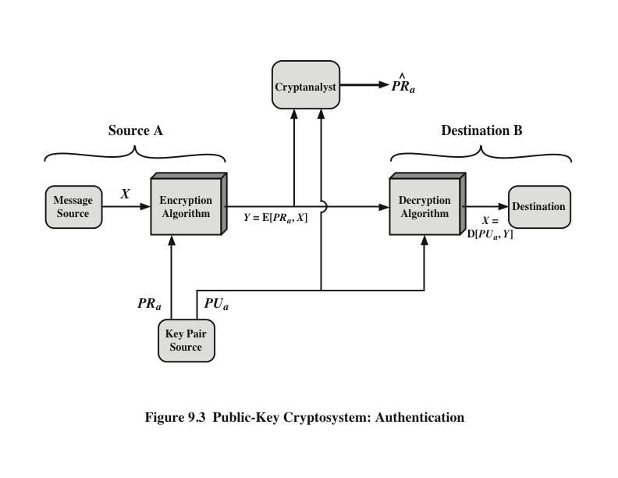
Public-Key Cryptosystem: Authentication
Notes:
We mentioned earlier that either of the two related keys can be used for encryption,
with the other being used for decryption. This enables a rather different
cryptographic scheme to be implemented. Whereas the scheme illustrated in
Figure 9.2 provides confidentiality, Figures 9.1b and 9.3 show the use of public-key
encryption to provide authentication.
It is important to emphasize that the encryption process depicted in
Figures 9.1b and 9.3 does not provide confidentiality. That is, the message being
sent is safe from alteration but not from eavesdropping. This is obvious in the
case of a signature based on a portion of the message, because the rest of the
message is transmitted in the clear. Even in the case of complete encryption,
as shown in Figure 9.3, there is no protection of confidentiality because any
observer can decrypt the message by using the sender’s public key.

Slide 10
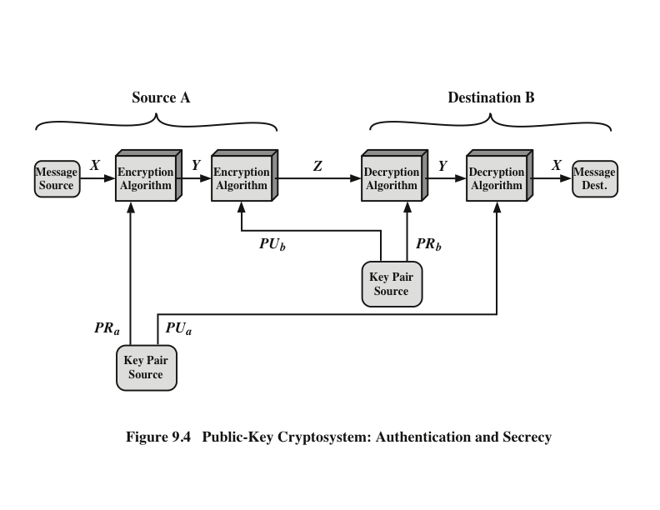
Public-Key Cryptosystem: Authentication and Secrecy
Notes:
It is, however, possible to provide both the authentication function and confidentiality
by a double use of the public-key scheme (Figure 9.4).
In this case, we begin as before by encrypting a message, using the sender’s private
key. This provides the digital signature. Next, we encrypt again, using the receiver’s
public key. The final ciphertext can be decrypted only by the intended receiver, who
alone has the matching private key. Thus, confidentiality is provided. The disadvantage
of this approach is that the public-key algorithm, which is complex, must be
exercised four times rather than two in each communication.

Slide 11
Applications for Public-Key Cryptosystems
Public-key cryptosystems can be classified into three categories:
Some algorithms are suitable for all three applications, whereas others can be used only for one or two
Encryption/decryption
The sender encrypts a message with the recipient’s public key
Digital signature
The sender “signs” a message with its private key
Key exchange
Two sides cooperate to exchange a session key
Notes:
Before proceeding, we need to clarify one aspect of public-key cryptosystems that is
otherwise likely to lead to confusion. Public-key systems are characterized by the use
of a cryptographic algorithm with two keys, one held private and one available publicly.
Depending on the application, the sender uses either the sender’s private key or
the receiver’s public key, or both, to perform some type of cryptographic function. In
broad terms, we can classify the use of public-key cryptosystems into three categories
• Encryption/decryption: The sender encrypts a message with the recipient’s
public key.
• Digital signature: The sender “signs” a message with its private key. Signing
is achieved by a cryptographic algorithm applied to the message or to a small
block of data that is a function of the message.
• Key exchange: Two sides cooperate to exchange a session key. Several different
approaches are possible, involving the private key(s) of one or both parties.

Slide 12
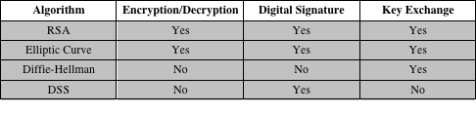
Table 9.3 Applications for Public-Key Cryptosystems
Table 9.3 Applications for Public-Key Cryptosystems
Notes:
Some algorithms are suitable for all three applications, whereas others can be
used only for one or two of these applications. Table 9.3 indicates the applications
supported by the algorithms discussed in this book.

Slide 13
Public-Key Requirements
Conditions that these algorithms must fulfill:
It is computationally easy for a party B to generate a pair (public-key PU_{b}, private key PR_{b})
It is computationally easy for a sender A, knowing the public key and the message to be encrypted, to generate the corresponding ciphertext
It is computationally easy for the receiver B to decrypt the resulting ciphertext using the private key to recover the original message
It is computationally infeasible for an adversary, knowing the public key, to determine the private key
It is computationally infeasible for an adversary, knowing the public key and a ciphertext, to recover the original message
The two keys can be applied in either order
Notes:
The cryptosystem illustrated in Figures 9.2 through 9.4 depends on a cryptographic algorithm based on two related keys. Diffie and Hellman postulated this system without demonstrating that such algorithms exist. However, they did lay out the conditions that such algorithms must fulfill:
It is computationally easy for a party B to generate a pair (public key PU_{b}, private key PR_{b}).
It is computationally easy for a sender A, knowing the public key and the message to be encrypted, M, to generate the corresponding ciphertext:
C = E(PU_{b}, M)
3. It is computationally easy for the receiver B to decrypt the resulting ciphertext using the private key to recover the original message: M = D(PR_{b}, C) = D[PR_{b}, E(PU_{b}, M)
4. It is computationally infeasible for an adversary, knowing the public key, PU_{b}, to determine the private key, PR_{b}
5. It is computationally infeasible for an adversary, knowing the public key, PU_{b}, and a ciphertext, C, to recover the original message, M.
6. (optional) The two keys can be applied in either order:
M = D[PU_{b} , E(PR_{b}, M)] = D[PR_{b}, E(PU_{b}, M)]
These are formidable requirements, as evidenced by the fact that only a few algorithms (RSA, elliptic curve cryptography, Diffie-Hellman, DSS) have received widespread acceptance in the several decades since the concept of public-key cryptography was proposed.

Slide 14
Public-Key Requirements
Need a trap-door one-way function
A one-way function is one that maps a domain into a range such that every function value has a unique inverse, with the condition that the calculation of the function is easy, whereas the calculation of the inverse is infeasible
Y = f(X) easy
X = f^{–1}(Y) infeasible
A trap-door one-way function is a family of invertible functions f_{k}, such that
Y = f_{k}(X) easy, if k and X are known
X = f_{k}^{–1}(Y) easy, if k and Y are known
X = f_{k}^{–1}(Y) infeasible, if Y known but k not known
A practical public-key scheme depends on a suitable trap-door one-way function
Notes:
Before elaborating on why the requirements are so formidable, let us first recast
them. The requirements boil down to the need for a trap-door one-way function.
A one-way function is one that maps a domain into a range such that every
function value has a unique inverse, with the condition that the calculation of the
function is easy, whereas the calculation of the inverse is infeasible
Y = f(X) easy
X = f^{–1}(Y) infeasible
Generally, easy is defined to mean a problem that can be solved in polynomial
time as a function of input length. Thus, if the length of the input is n bits, then the
time to compute the function is proportional to nª , where a is a fixed constant. Such
algorithms are said to belong to the class P . The term infeasible is a much fuzzier
concept. In general, we can say a problem is infeasible if the effort to solve it grows
faster than polynomial time as a function of input size. For example, if the length
of the input is n bits and the time to compute the function is proportional to 2^{n} ,
the problem is considered infeasible. Unfortunately, it is difficult to determine if a
particular algorithm exhibits this complexity. Furthermore, traditional notions of
computational complexity focus on the worst-case or average-case complexity of
an algorithm. These measures are inadequate for cryptography, which requires that
it be infeasible to invert a function for virtually all inputs, not for the worst case or
even average case. A brief introduction to some of these concepts is provided in
Appendix 9A.
We now turn to the definition of a trap-door one-way function , which is easy
to calculate in one direction and infeasible to calculate in the other direction unless
certain additional information is known. With the additional information the
inverse can be calculated in polynomial time. We can summarize as follows: A trapdoor
one-way function is a family of invertible functions f_{k} , such that
Y = f_{k}(X) easy, if k and X are known
X = f_{k}^{–1}(Y) easy, if k and Y are known
X = f_{k}^{–1}(Y) infeasible, if Y known but k not known
Thus, the development of a practical public-key scheme depends on discovery of a suitable trap-door one-way function.

Slide 15
Public-Key Cryptanalysis
A public-key encryption scheme is vulnerable to a brute-force attack
Countermeasure: use large keys
Key size must be small enough for practical encryption and decryption
Key sizes that have been proposed result in encryption/decryption speeds that are too slow for general-purpose use
Public-key encryption is currently confined to key management and signature applications
Another form of attack is to find some way to compute the private key given the public key
To date it has not been mathematically proven that this form of attack is infeasible for a particular public-key algorithm
Finally, there is a probable-message attack
This attack can be thwarted by appending some random bits to simple messages
Notes:
As with symmetric encryption, a public-key encryption scheme is vulnerable to a
brute-force attack. The countermeasure is the same: Use large keys. However, there
is a tradeoff to be considered. Public-key systems depend on the use of some sort of
invertible mathematical function. The complexity of calculating these functions may
not scale linearly with the number of bits in the key but grow more rapidly than that.
Thus, the key size must be large enough to make brute-force attack impractical but
small enough for practical encryption and decryption. In practice, the key sizes that
have been proposed do make brute-force attack impractical but result in encryption/
decryption speeds that are too slow for general-purpose use. Instead, as was mentioned
earlier, public-key encryption is currently confined to key management and
signature applications.
Another form of attack is to find some way to compute the private key given
the public key. To date, it has not been mathematically proven that this form of attack
is infeasible for a particular public-key algorithm. Thus, any given algorithm,
including the widely used RSA algorithm, is suspect. The history of cryptanalysis
shows that a problem that seems insoluble from one perspective can be found to
have a solution if looked at in an entirely different way.
Finally, there is a form of attack that is peculiar to public-key systems. This is,
in essence, a probable-message attack. Suppose, for example, that a message were to
be sent that consisted solely of a 56-bit DES key. An adversary could encrypt all possible
56-bit DES keys using the public key and could discover the encrypted key by
matching the transmitted ciphertext. Thus, no matter how large the key size of the
public-key scheme, the attack is reduced to a brute-force attack on a 56-bit key. This
attack can be thwarted by appending some random bits to such simple messages.

Slide 16
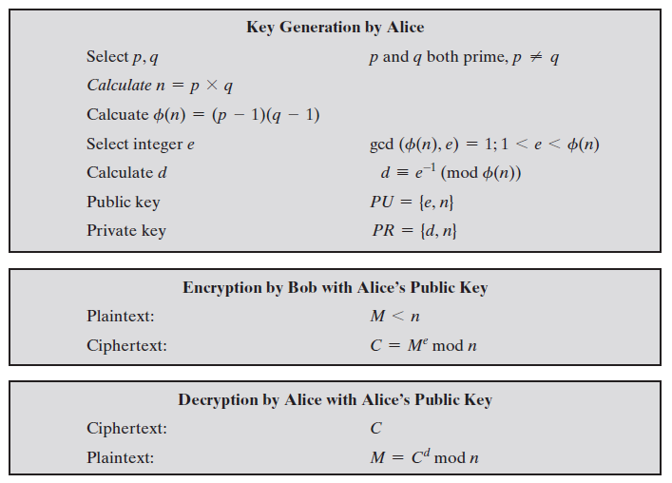
RSA Scheme

Slide 17

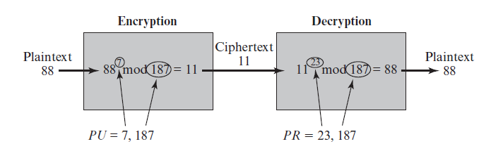


RSA Example

Slide 18
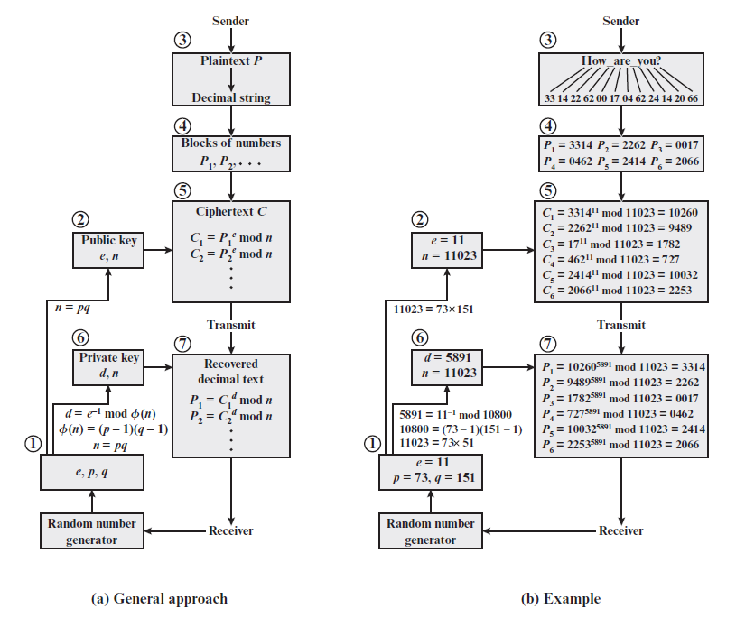
RSA Example

Slide 19
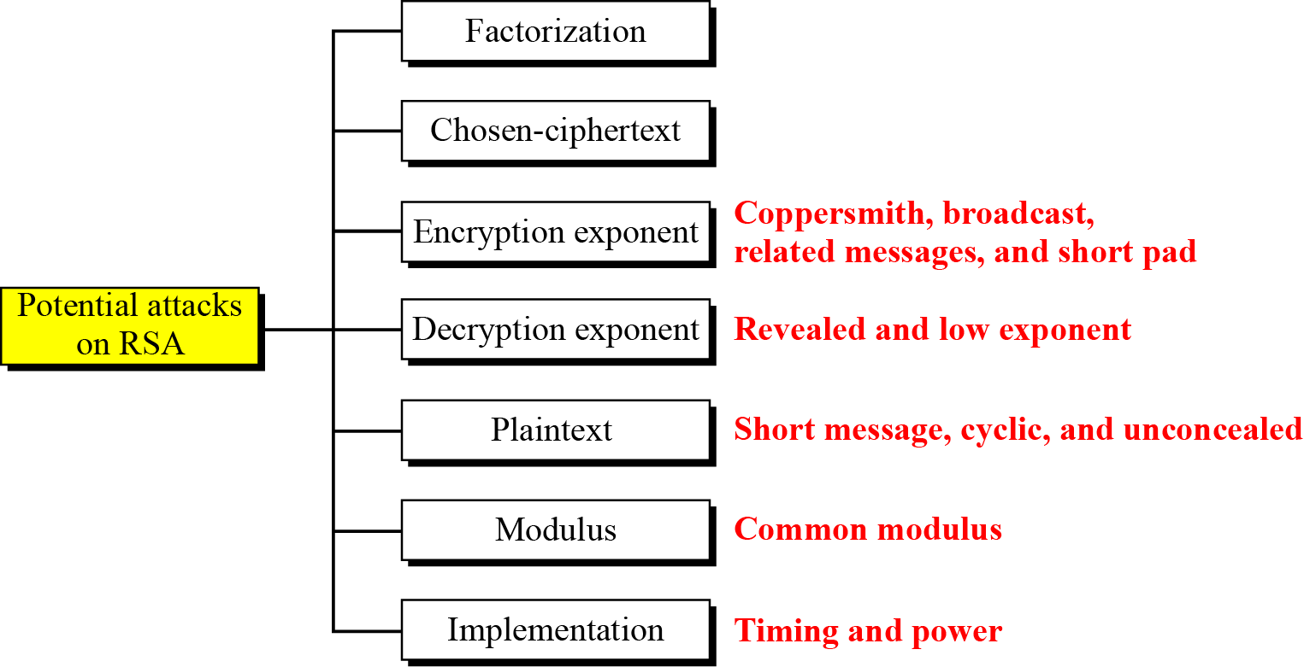
Potential Attacks on RSA
Taxonomy of potential attacks on RSA
If Eve can factorize n.
If Bob would decrypt some cipher other than C to Eve. Is it safe?
Short P, like 4-digit, brute-force, use padding;
Cyclic: E(E..(E(C))) = P; Unconcealed: C = P
Alice and Bob use same n.

Slide 20

Attacks on RSA
Chosen ciphertext attack:
If Bob would decrypt a cipher other than C to Eve.
Eve chooses integer r relatively prime to n.
Eve sends Y = r^{e}.C (mod n) to Bob for decryption.
Bob decrypts Y and sends Z = Y^{d} (mod n) to Eve.
Eve computes: Z.r⁻¹ (mod n) = (r^{e}.C)^{d} . r⁻¹ = (r^{ed} . C^{d}) . r⁻¹
= (r¹. P) . r⁻¹ = P

Slide 21
Attacks on RSA
Plaintext
Short Plaintext attack: If P is short, like 4-digit:
Eve encrypts all plaintexts P_{i} from 0000 to 9999.
Eve stops when she gets ciphertext = C, and output P_{i}.
Cyclic attack: ciphertext is a permutation of plaintext, therefore, E(E(…E(C)..)) = P.
Eve keeps encrypting C k-times until she get back to C.
Eve output P as the last value she got (at step k -1)
This is not practical, and may need same time as brute-force.
Unconcealed message attack: If C = P, the encryption algorithm should reject the plaintext. The use should use padding.

Slide 22
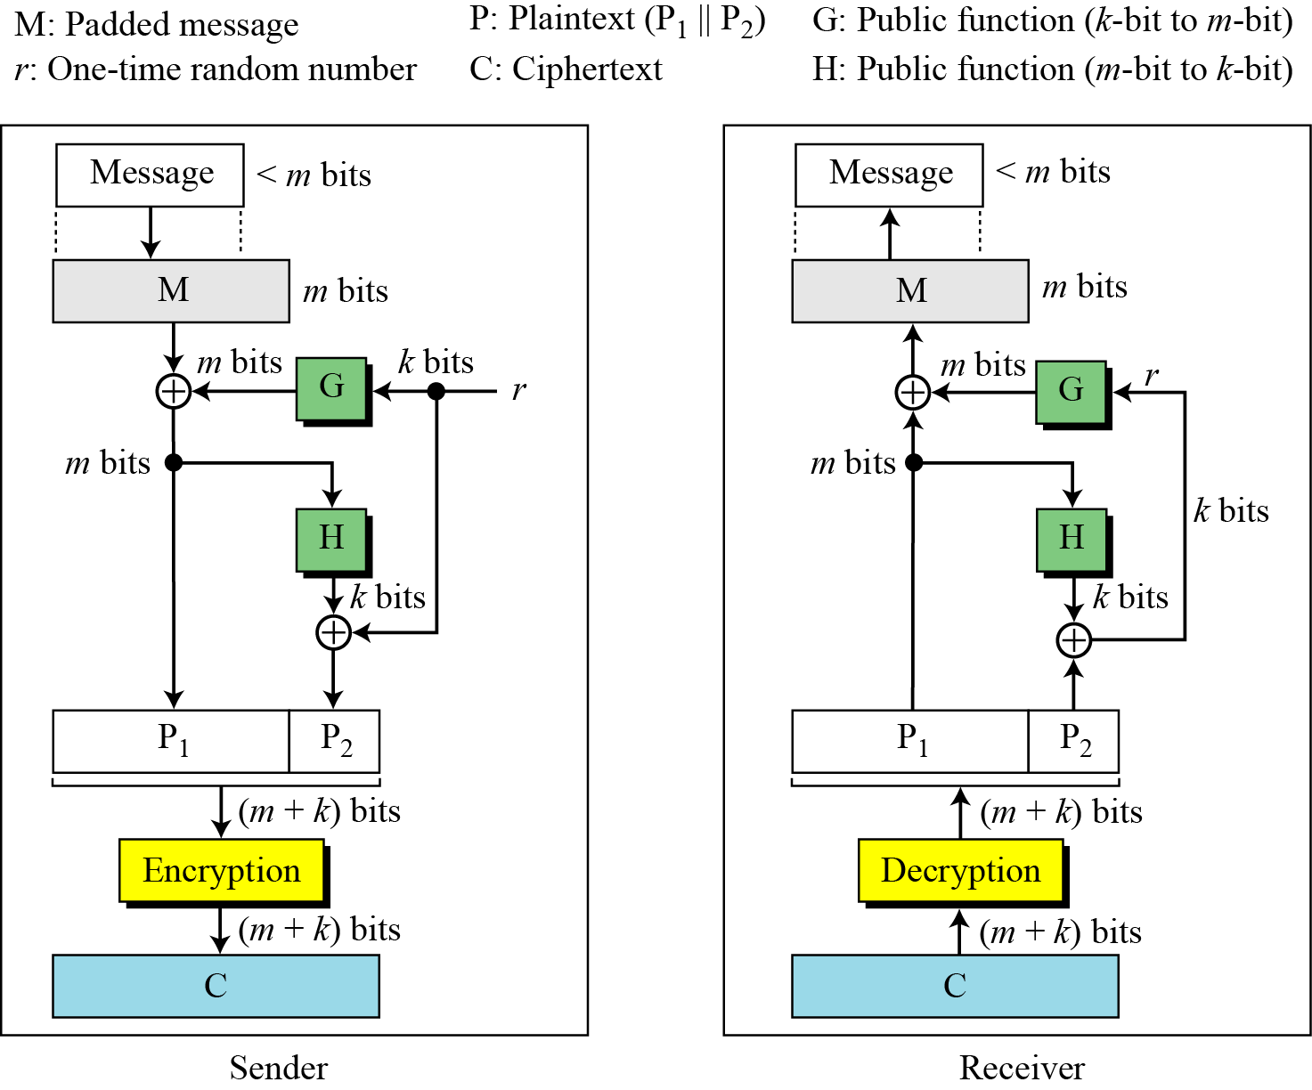
Attacks on RSA
Optimal asymmetric encryption padding (OAEP)

Slide 23
Summary
Public-key cryptosystems
Applications for public-key cryptosystems
Requirements for public-key cryptography
Public-key cryptanalysis
RSA Cryptosystem
RSA Encryption and Decryption
Potential Attacks on RSA
Optimal Padding (OAEP)
Notes:
Chapter 9 summary.

