Slide 1
Quantum Cryptography:
An Overview
King Fahd University of Petroleum & Minerals
Sultan Almuhammadi
ICS 562: Quantum Cryptography

Slide 2

What is Cryptography?

Slide 3
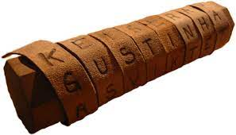
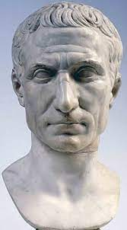
What is Cryptography?
The art of secret writing
Very old technique
Ceasar Method (Shift cipher)
DWWDN DW GDZQ
( - 3 )
ATTACK AT DAWN

Slide 4
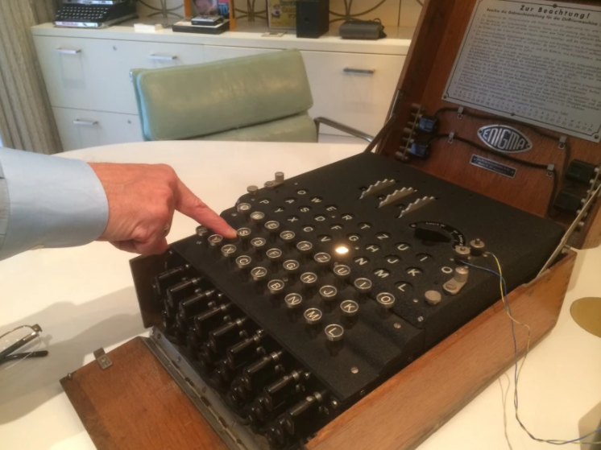
History
Enigma
(1923)

Slide 5
Modern Cryptography
(1970’s)
Cryptography is based on science and math
  Information Theory
  Number Theory
  The cryptosystem depends only on the “key”
Block Ciphers (Symmetric-key)
  DES (1977)
  AES (2001)

Slide 6
Public-Key Cryptography
(1980’s)
Public-key (Asymmetric) Cryptography
  Public-key Encryption
  Digital Signatures
  Key-Exchange Protocols
The security depends on computational problems
  RSA (depends on integer factorization)
  ElGamal (depends on DLP)
  Elliptic-Curve cryptography (Curve-based)
Applications:
  Public-key cryptography has many applications in securing today’s cyberspace, and almost everything we do on the internet.
  Emails, Online-Banking, Cloud Computing, etc.

Slide 7
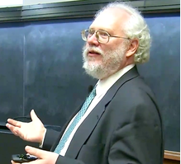

Quantum Computing
Quantum computing speeds up classical computations drastically.
Shor’s Algorithm:
  Exponential speedup for Integer Factorization
Grover’s Algorithm:
  Quadratic speedup for Searching Problem

Slide 8

Quantum Attacks
Huge impact on Cryptography in the Quantum Era:
Potential Quantum Attacks on Modern Cryptography:
  Solving Factorizations: Breaks RSA, ElGamal, ECDSA, etc.
  Speedup in Searching: High risks on Secure Hashing, Blockchain, Cryptocurrency.

Slide 9




Impact on Cryptocurrency
Cryptocurrency Industry will be at high risk in the Quantum Era
  Market cap: Over 1 Trillion Dollars.
  Most of major coins (Bitcoin, Ethereum) are based on DLP and ECDSA (vulnerable to quantum attack)
  Only small portion of cryptocurrency is quantum-safe as of today.
  > 99.98% of the total market cap is not protected against quantum attack.

Slide 10
What to Do?
How to prevent or reduce the impact of Quantum Attacks?
  Quantum Cryptography
  Post-Quantum Cryptography

Slide 11
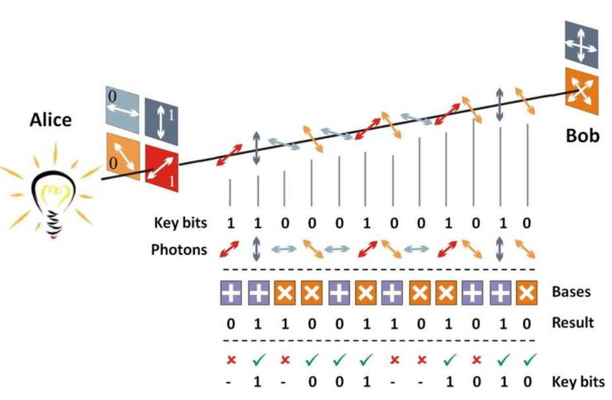
Quantum Cryptography
Quantum Cryptography uses the law of quantum mechanics to design quantum-safe cryptosystems.
  E.g. BB84 (by Bennett and Brassard in 1984)

Slide 12
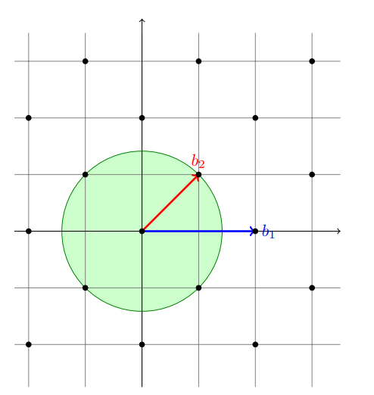
Post-Quantum Cryptography
Post-Quantum Cryptography is to develop cryptographic systems that are secure against both quantum and classical computers.
  Can be implemented on existing computers
  E.g. Lattice-based Cryptography
  Lattice Computational Problems
    Short Vector Problem (SVP)
    Closest Vector Problem (CVP)

Slide 13
Remarks
Modern Cryptosystems that we commonly use today cannot survive in the Quantum Era.
Post-Quantum Cryptography provides tools that can secure our digital world today and in the Quantum Era.
What is known today to be “secure” against quantum attack might be broken in the future.
Research should continue to find new solutions in the coming years.

Slide 14
Course Topics
Introduction to cryptography and cybersecurity
Number theory, Modular arithmetic
Symmetric-key Cryptography, Block ciphers
Public Key Encryption: RSA, Diffie-Hellman, ElGamal cryptosystems
Hash functions, Digital Signatures
Quantum information processing, Quantum cryptanalysis
Quantum key distribution protocols
Commitment schemes, Coin-flipping protocols
Post-quantum cryptography
Quantum money, Quantum one-time pad

Slide 15
Course Evaluation
Coursework | 30%
Project | 20%
Midterm Exam | 20%
Final Exam (comprehensive) | 30%

Slide 16
Conclusion
After completion of this course, you should be able to:
Describe the setups and the security issues of some existing cryptosystems.
Explain foundational concepts in quantum information security and their applications.
Apply number theory concepts in modern and quantum cryptography.
Apply advanced cryptanalysis techniques using quantum computers.
Design and analyze a crypto-scheme that achieves some security requirements.
Search and utilize information on conventional and quantum algorithms from a variety of sources.

Slide 17
THANK YOU

