Slide 1



On the Capabilities of
Quantum Machine Learning
Data Science and Machine Learning Applications
Sultan Almuhammadi

Slide 2
Overview
Introduction​
Background ​
Preliminaries
Quantum Machine Learning
  Quantum Neural Network
  Quantum Autoencoder
  Quantum Kernel Method
Experiment: Quantum Neural Network
  Data Preparation
  Quantum Neural Network Implementation
  Testing and Results
Analysis and discussion
Conclusion

Slide 3
Introduction
Machine learning techniques give impressive results in many areas. However, due to the physical limitation of integrated circuits which restricts their computational power growth, and the rapid advances in quantum computing, lots of research studies on quantum machine learning (QML) have been done recently. In this work, we discuss three QML algorithms, and provide a prototype of a Quantum Neural Network (QNN) implemented and tested on a real quantum machine.

Slide 4
Introduction
Machine learning gives impressive results. Why?
  Increasing computational power
  Increasing data availability
  Recent ML algorithmic advances
Problems:
  Physical limits of integrated circuit chips fabrication restricts the growth of computational power in the future.
  Researchers must find computing alternatives that support the need of high computational power for ML applications.
Quantum computing is one promising alternative for ML algorithms.
  It uses the properties of:
    quantum mechanics for calculation
    quantum states to represent data

Slide 5
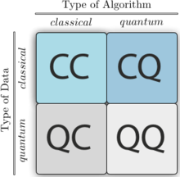
Background
Machine learning models can be divided into four different categories based on the data and the algorithm types

Slide 6
Preliminaries

Slide 7
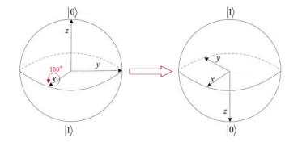

Basics of Quantum Computing
Quantum gates
Gates as rotation
Gates as matrices

Slide 8
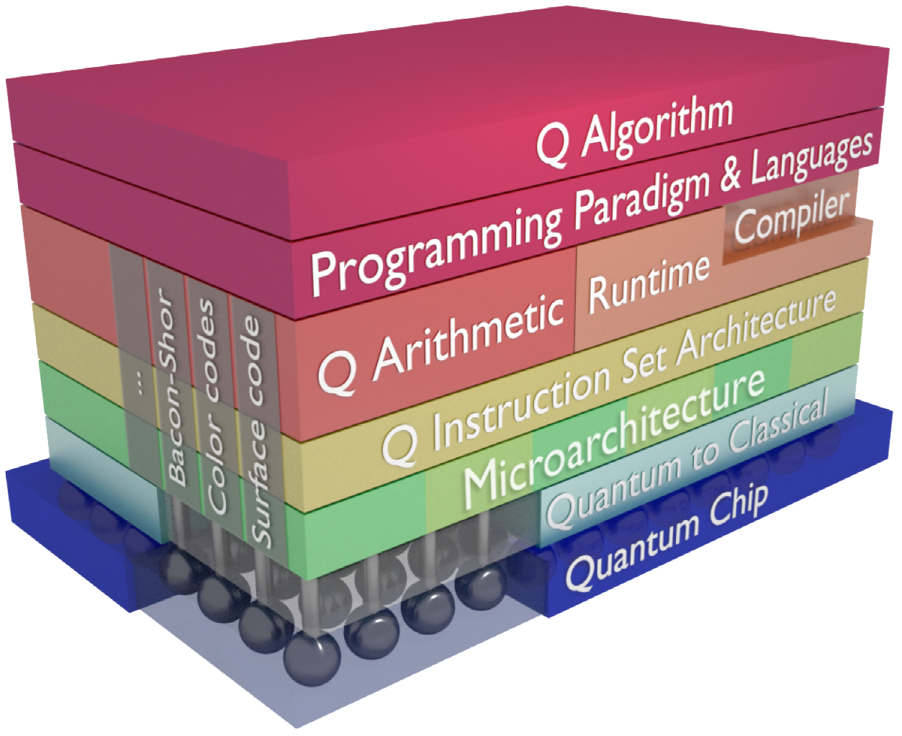
Quantum Computer Architecture

Slide 9
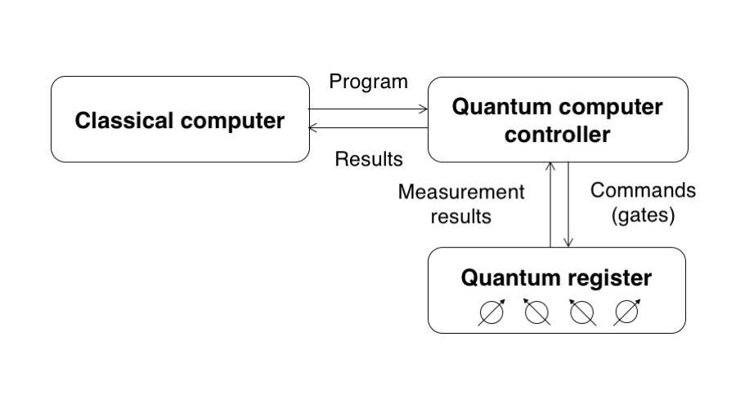
Quantum Algorithm Layout

Slide 10


Basics of Quantum Computing
Quantum State:
Qubits:
  The states in the quantum computers are modeled by normalized vectors in C^{n}.
  The two-dimensional state in C² represents a qubit.
  The coordinates of such qubit can be represented with respect to the orthonormal basis as follows:

Slide 11
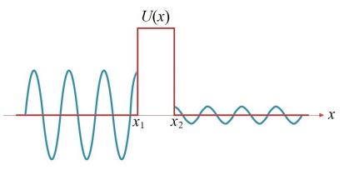
Quantum Tunneling
In classical systems:
  particle is unable to overcome the obstacle if E < U(x).
In the quantum systems:
  the particle may pass through the barrier with some probability p > 0.
  The probability of tunneling reduces as the potential barrier increases.
Using quantum tunneling, simulated quantum annealing avoids being caught in local minima.

Slide 12
Quantum Machine Learning
Quantum Neural Network
Quantum Autoencoder
Quantum Kernel Method

Slide 13
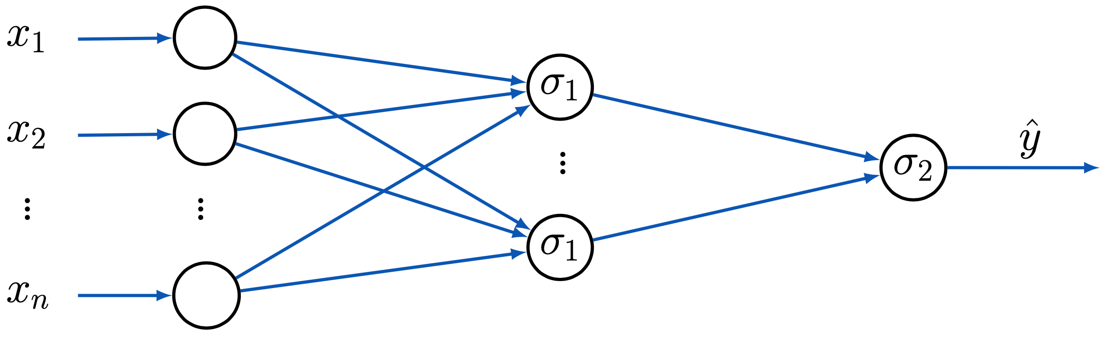
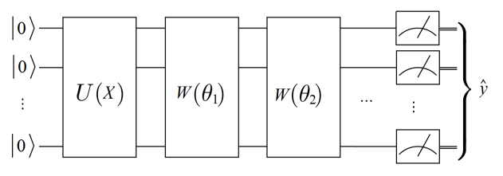
Quantum Neural Network
Neural Networks (NNs) are one of the best ML algorithms in terms of performance and accuracy. It shows desired results in many applications.
QNNs have the potential to outperform their classical ones in many tasks. To allow the progressive membership of data instances, QNNs employ the superposition of quantum states.
Feedforward Neural Network
General Structure of Quantum Neural Network

Slide 14
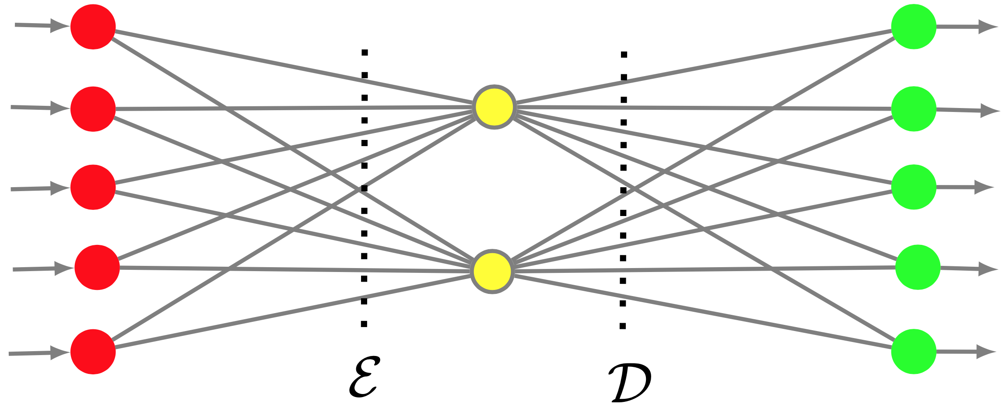
Quantum Autoencoder
Autoencoders are neural networks that can learn efficient low-dimensional representations of data in higher-dimensional space.
Quantum Autoencoder:
  Unitary operation U(θ) to encode the input state |X⟩ into a smaller intermediate state (the latent space).
  The decoder unitary operation U′(θ) takes uses the intermediate state to reconstruct |X⟩.

Slide 15
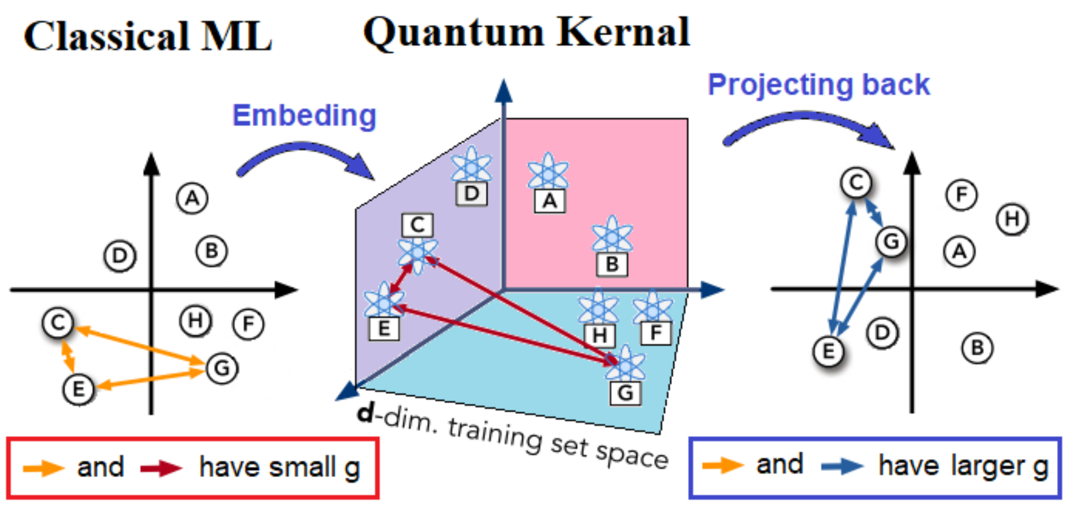
Quantum Kernel Method
The kernel function defined by classical and QML models.
The nodes (A, B,..., etc.) represent data points in different spaces.
The edges between these nodes represent the similarity measure (the kernel function) between data.
The geometric difference, g, is a difference between similarity measures (edges) in different ML models.
Quantum Kernel Method

Slide 16
Experiment: Quantum Neural Network

Slide 17
Data Preparation
The Iris dataset
  available at Scikit-Learn website
  100 samples for the two types of irises (Setosa and Versicolour).
We divide the dataset into two sets,
  training test (X train)
  testing set (X test).

Slide 18
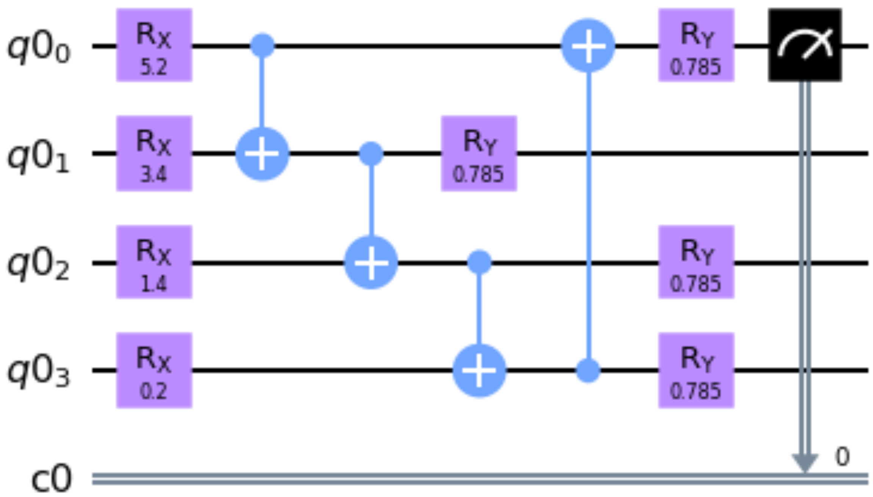
Quantum Neural Network Implementation
We apply two rotations:
1. Rx for input data
2. Ry for learning parameters
Experimental Quantum Neural Network Circuit with 4 Qubits

Slide 19
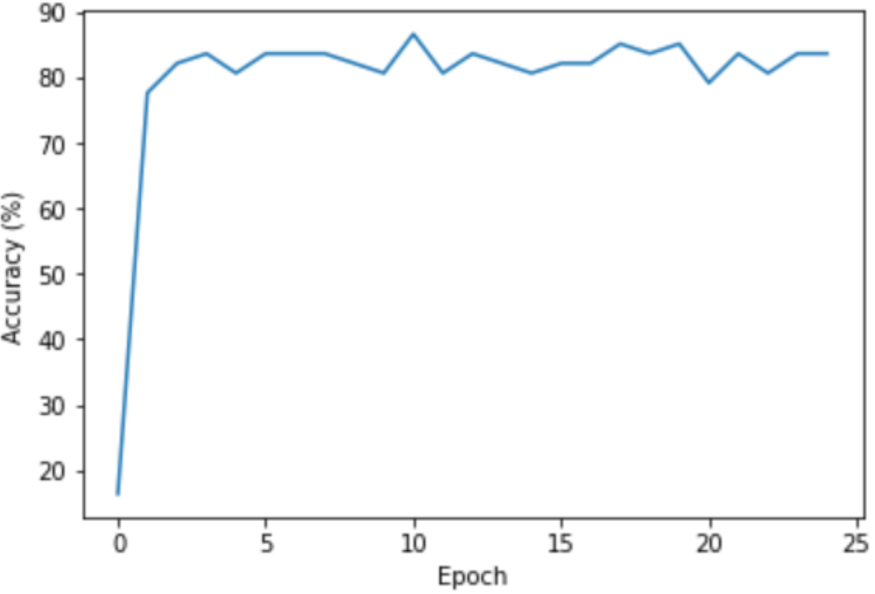

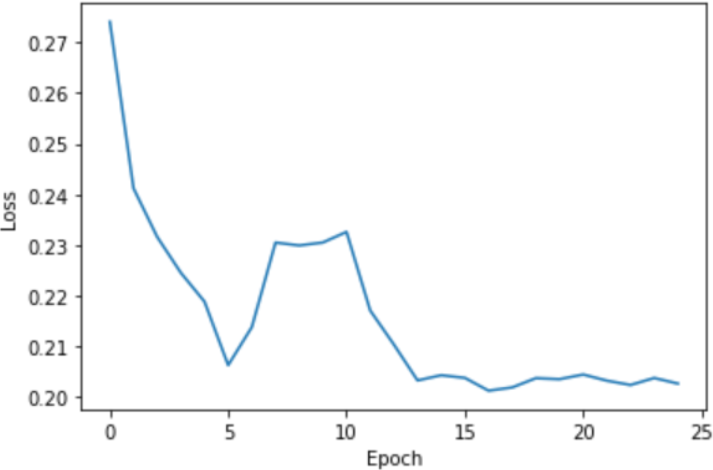
Testing and Results
The Accuracy Graph of the Quantum Neural Network
The Loss Graph of the Quantum Neural Network

Slide 20
Analysis and discussion

Slide 21
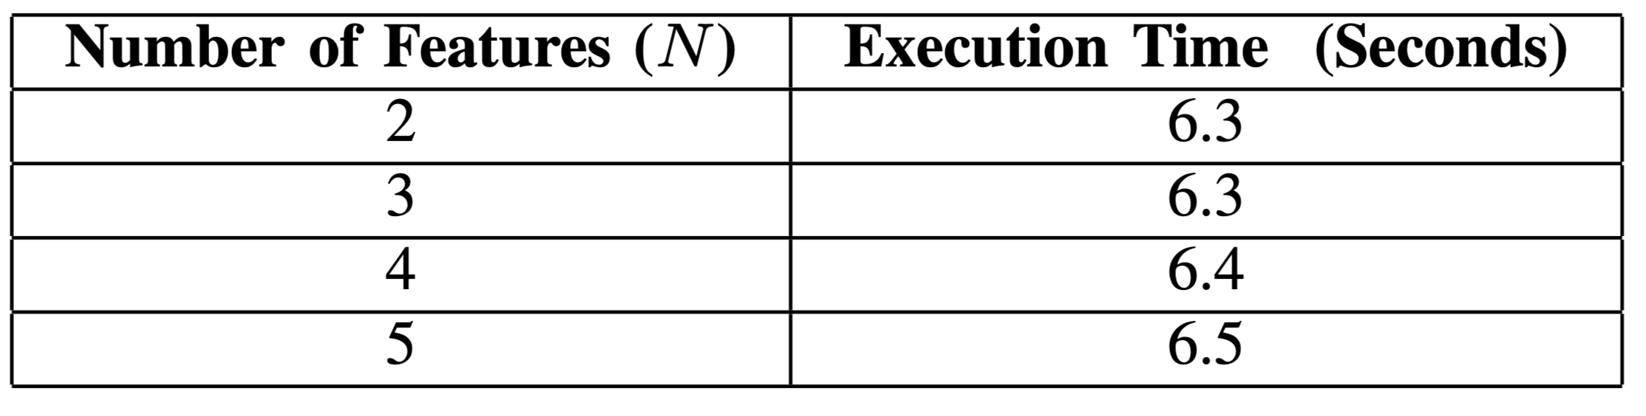
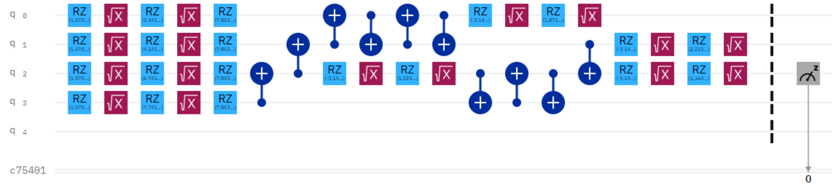
Analysis and discussion
Quantum Neural Network Performance Test Results
Actual Circuit Running On IBM Bogota Quantum Computer

Slide 22
Conclusion
Quantum machine learning:
  QML remains an interesting issue despite the noise and long execution time of today quantum computers.
  QML is very promising for near-term quantum computers.
However, we should be careful:
  The advantages of applying quantum computing in machine learning are not guaranteed.
  Understanding the foundation of quantum advantage is essential.

Slide 23
Thank You!

