Slide 1
Divisibility and Modular Arithmetic
King Fahd University of Petroleum & Minerals
College of Computer Sciences & Engineering
Prepared by:
Sultan Almuhammadi
This lecture is based on:
Stallings, Cryptography and Network Security: Sec 2.1-2.3
Notes:
This book focuses on two broad areas: cryptographic algorithms and protocols, which
have a broad range of applications; and network and Internet security, which rely
heavily on cryptographic techniques.

Slide 2
Divisibility
We say that a nonzero b divides a if a = mb for some m, where a, b, and m are integers
b divides a if there is no remainder on division
The notation b | a is commonly used to mean b divides a
If b | a we say that b is a divisor of a
The positive divisors of 24 are 1, 2, 3, 4, 6, 8, 12, and 24
13 | 182; - 5 | 30; 17 | 289; - 3 | 33; 17 | 0
Notes:
We say that a nonzero b divides a if a=mb for some m, where a, b, and m are integers. That is, b divides a if there is no remainder on division.
The notation b | a is commonly used to mean b divides a . Also, if b | a , we say that b is a divisor of a .

Slide 3
Properties of Divisibility
If a | 1, then a = ±1
If a | b and b | a, then a = ±b
Any b ≠ 0 divides 0
If a | b and b | c, then a | c
If b | g and b | h, then b | (mg + nh) for arbitrary integers m and n
11 | 66 and 66 | 198, implies 11 | 198
Notes:
Subsequently, we will need some simple properties of divisibility for integers, which are as follows:
• If a|1, then a = ±1.
• If a|b and b|a, then a = ±b.
• Any b ≠ 0 divides 0.
• If a | b and b | c, then a | c
• If b|g and b|h, then b|(mg + nh) for arbitrary integers m and n.

Slide 4
Properties of Divisibility
To see this last point, note that:
If b | g , then g is of the form g = b * g₁ for some integer g₁
If b | h , then h is of the form h = b * h₁ for some integer h₁
mg + nh = mbg₁ + nbh₁ = b * (mg₁ + nh₁ )
and therefore b divides mg + nh
b = 7; g = 14; h = 63; m = 3; n = 2
7 | 14 and 7 | 63.
To show 7 (3 * 14 + 2 * 63),
we have (3 * 14 + 2 * 63) = 7(3 * 2 + 2 * 9), and it is obvious that 7 | (7(3 * 2 + 2 * 9)).
Notes:
To see this last point, note that
• If b | g , then g is of the form g = b * g₁ for some integer g₁ .
• If b | h , then h is of the form h = b * h₁ for some integer h₁ .
So
mg + nh = mbg₁ + nbh₁ = b * (mg₁ + nh₁ )
and therefore b divides mg + nh .

Slide 5
Division Algorithm
Given any positive integer n and any integer a, if we divide a by n we get unique two integers, q and r, such that
a = qn + r and 0 ≤ r < n;
Here, q is called the quotient and r is remainder.
Moreover, q = [a / n] (the integer division function)
r = a mod n (the mod function)
Examples:
Let a = 11, n = 4, find q and r
Let a = -11, n = 4, find q and r
Notes:
Given any positive integer n and any nonnegative integer a, if we divide a by n, we get an integer quotient q and an integer remainder r that obey the following relationship:
a = qn + r, 0 ≤ r < n; q = [a/n] which is referred to as the division algorithm.

Slide 6
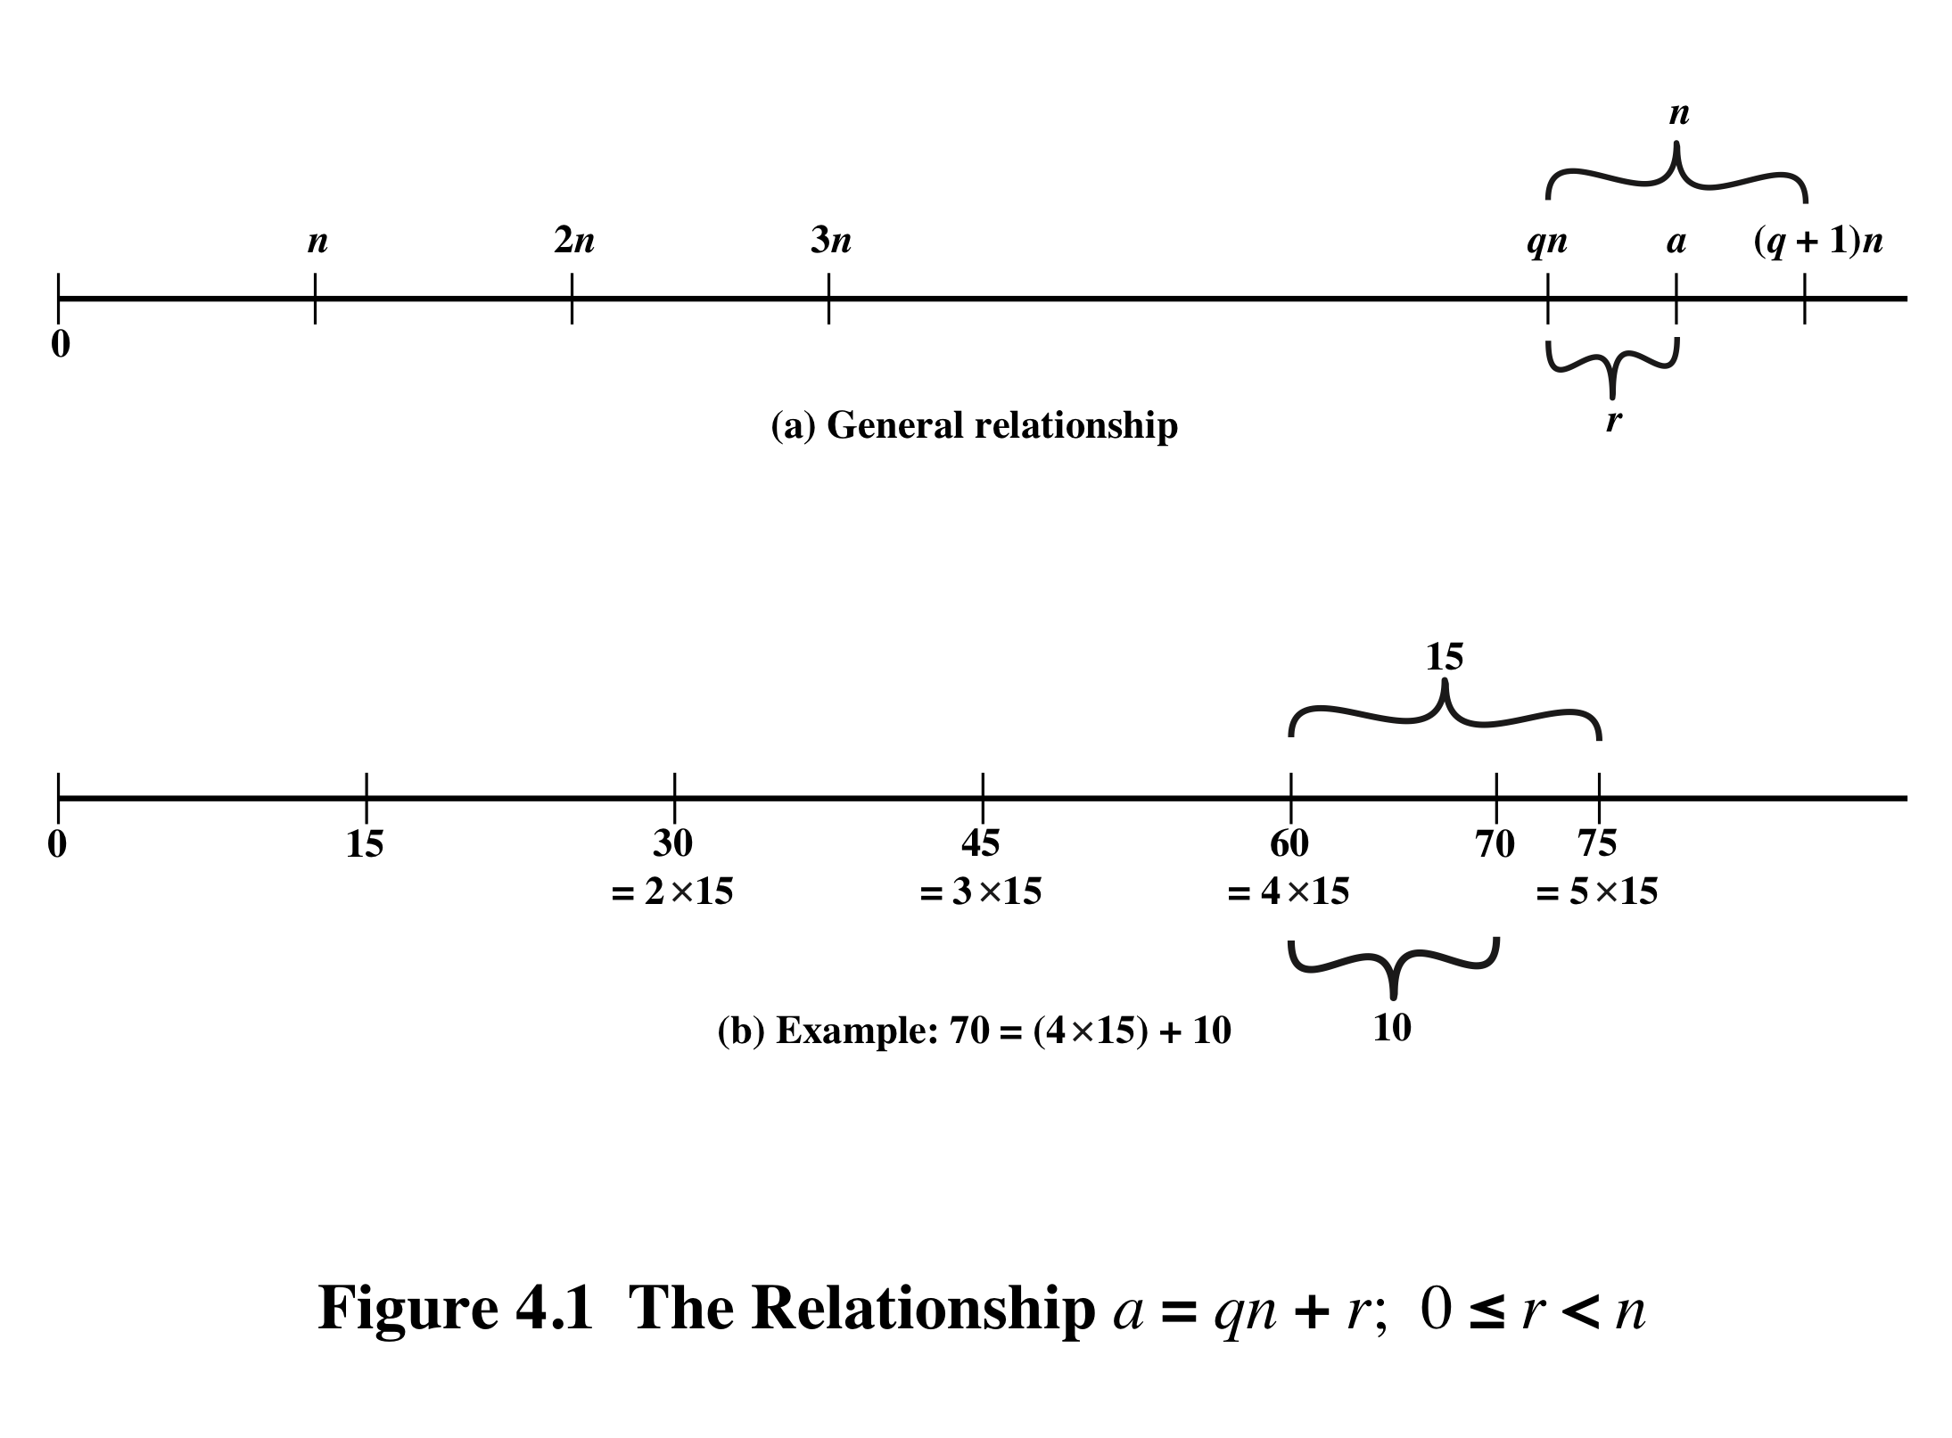
Notes:
Figure 4.1a demonstrates that, given a and positive n, it is always possible to find q and r that satisfy the preceding relationship. Represent the integers on the number line; a will fall somewhere on that line (positive a is shown, a similar demonstration can be made for negative a). Starting at 0, proceed to n, 2n, up to qn such that qn ≤ a and (q + 1)n > a. The distance from qn to a is r, and we have found the unique values of q and r. The remainder r is often referred to as a residue .
For example:
a = 11; n = 7; 11 = 1 x 7 + 4; r = 4 q = 1
a = –11; n = 7; –11 = (–2) x 7 + 3; r = 3 q = –2
Figure 4.1b provides another example.

Slide 7
Greatest Common Divisor (GCD)
The greatest common divisor of a and b is the largest integer that divides both a and b
We can use the notation gcd(a,b) to mean the greatest common divisor of a and b
We also define gcd(0,0) = 0
Positive integer c is said to be the gcd of a and b if:
c is a divisor of a and b
Any divisor of a and b is a divisor of c
An equivalent definition is:
gcd(a,b) = max[k, such that k | a and k | b]
Notes:
Recall that nonzero b is defined to be a divisor of a if a = mb for some m , where a , b , and
m are integers. We will use the notation gcd(a , b ) to mean the greatest common divisor
of a and b . The greatest common divisor of a and b is the largest integer that divides
both a and b . We also define gcd(0, 0) = 0.
More formally, the positive integer c is said to be the greatest common divisor
of a and b if
1. c is a divisor of a and of b .
2. Any divisor of a and b is a divisor of c .
An equivalent definition is the following:
gcd(a , b ) = max[k , such that k | a and k | b ]

Slide 8
GCD
Because we require that the greatest common divisor be positive, gcd(a,b) = gcd(a,-b) = gcd(-a,b) = gcd(-a,-b)
In general, gcd(a,b) = gcd(| a |, | b |)
Also, because all nonzero integers divide 0, we have gcd(a,0) = | a |
We stated that two integers a and b are relatively prime if their only common positive integer factor is 1; this is equivalent to saying that a and b are relatively prime if gcd(a,b) = 1
gcd(60, 24) = gcd(60, - 24) = 12
8 and 15 are relatively prime because the positive divisors of 8 are 1, 2, 4, and 8, and the positive divisors of 15 are 1, 3, 5, and 15. So 1 is the only integer on both lists.
Notes:
Because we require that the greatest common divisor be positive, gcd(a , b ) =
gcd(a , -b ) = gcd(-a , b ) = gcd(-a ,-b ). In general, gcd(a , b ) = gcd( | a | , | b | ).
Also, because all nonzero integers divide 0, we have gcd(a , 0) = a .
We stated that two integers a and b are relatively prime if their only common
positive integer factor is 1. This is equivalent to saying that a and b are relatively
prime if gcd(a , b ) = 1.

Slide 9
Euclidean Algorithm (EA)
One of the basic techniques of number theory
Procedure for determining the greatest common divisor of two positive integers
Euclidean Algorithm: gcd(a,b) = gcd(b, a mod b)
Notes:
One of the basic techniques of number theory is the Euclidean algorithm, which
is a simple procedure for determining the greatest common divisor of two positive
integers. First, we need a simple definition: Two integers are relatively prime if their
only common positive integer factor is 1.

Slide 10
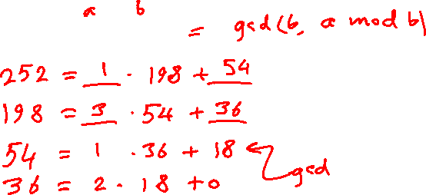
Example (EA mathematician style)
Euclidean Algorithm:
gcd(a,b) = gcd(b, a mod b)
Find: gcd(252, 198)
Notes:
One of the basic techniques of number theory is the Euclidean algorithm, which
is a simple procedure for determining the greatest common divisor of two positive
integers. First, we need a simple definition: Two integers are relatively prime if their
only common positive integer factor is 1.

Slide 11
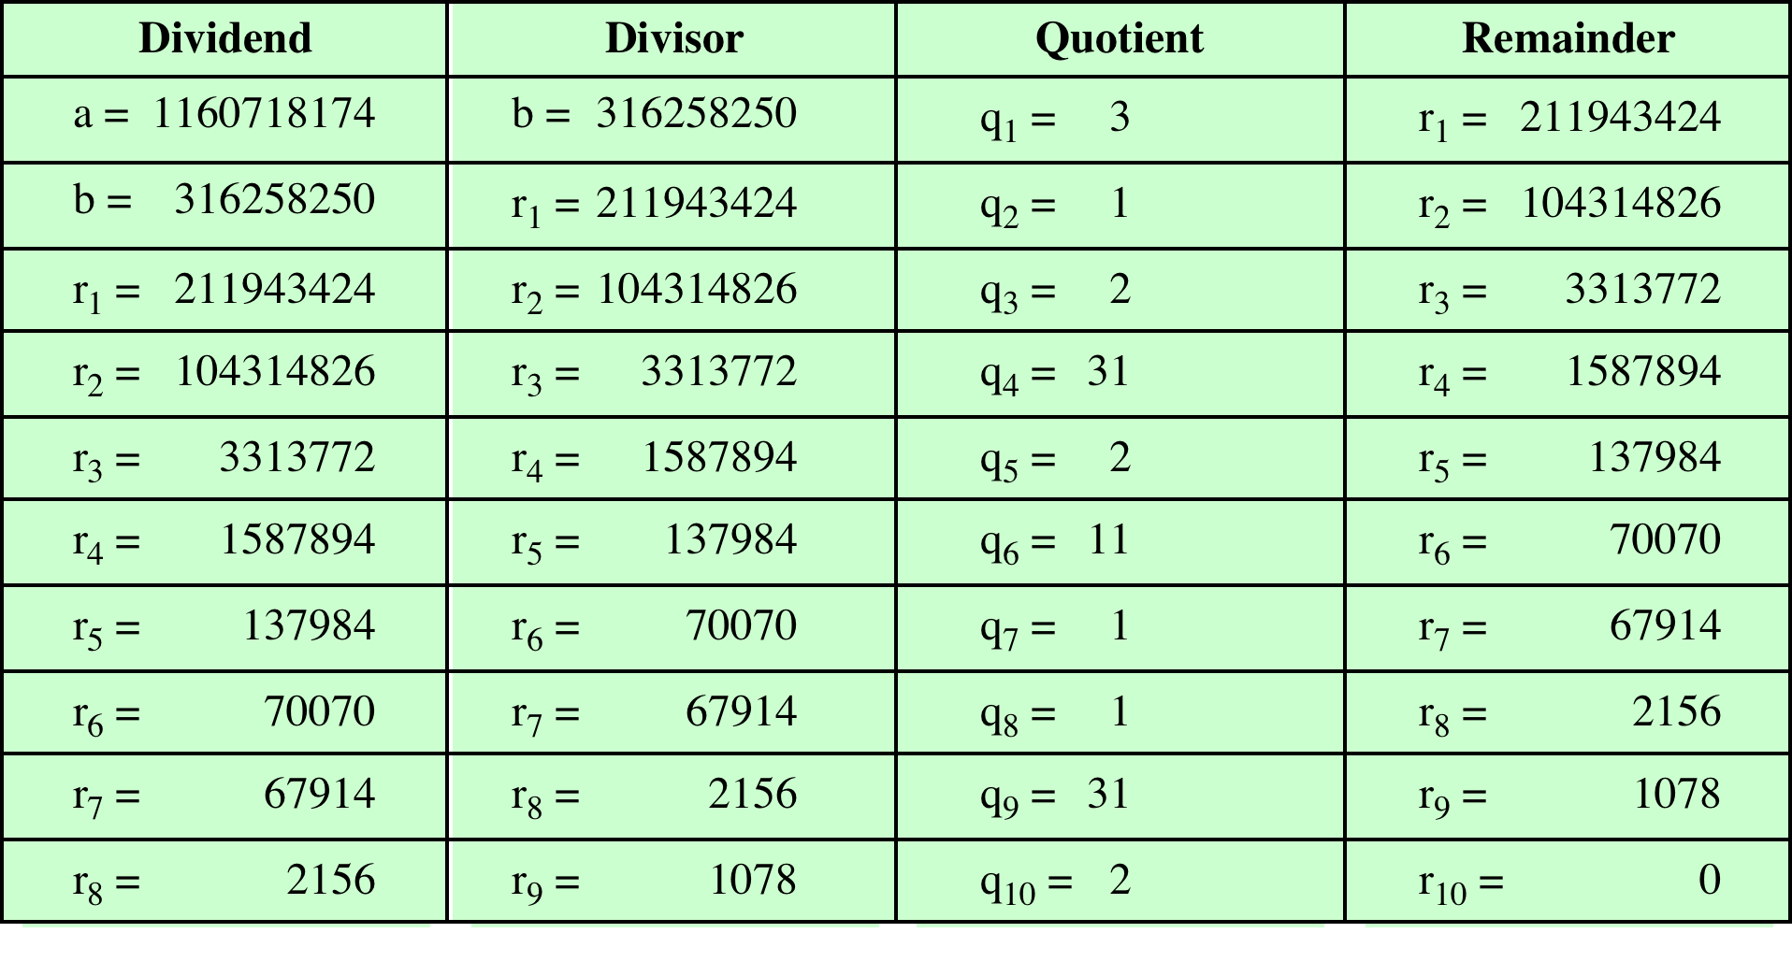

Table 4.1 Euclidean Algorithm Example
(Programmer style)
(This table can be found on page 91 in the textbook)
Notes:
In this example, we begin by dividing 1160718174 by 316258250, which gives 3
with a remainder of 211943424. Next we take 316258250 and divide it by 211943424.
The process continues until we get a remainder of 0, yielding a result of 1078.

Slide 12
Extended Euclidean Algorithm (EEA)
Theorem:
For any two positive integers, a and b, the gcd(a,b) can be expressed as a linear combination of a and b.
Thus, there are two integers x and y such that
gcd(a,b) = x a + y b
Example: Express gcd(252, 198) as a linear combination of 252 and 198.
Notes:
Example of the Extended Euclidean Algorithm. (See pages 97 – 99 in textbook for details.)

Slide 13
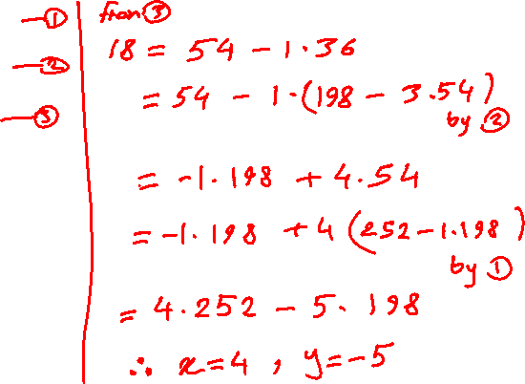
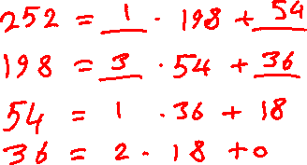
Extended Euclidean Algorithm (EEA)
Example: Express gcd(252, 198) as a linear combination of 252 and 198.
Notes:
Example of the Extended Euclidean Algorithm. (See pages 97 – 99 in textbook for details.)

Slide 14
Extended Euclidean Algorithm (EEA)
Example: Express gcd(252, 198) as a linear combination of 252 and 198.
Notes:
Example of the Extended Euclidean Algorithm. (See pages 97 – 99 in textbook for details.)

Slide 15
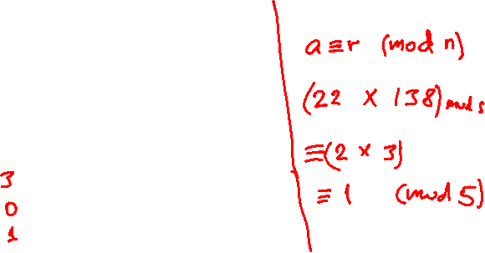
Modular Arithmetic
The modulus
If a is an integer and n is a positive integer, we define a mod n to be the remainder when a is divided by n; the integer n is called the modulus
thus, for any integer a:
a = qn + r 0 ≤ r < n; q = [a/ n]
a = [a/ n] * n + ( a mod n)
Examples:
8 mod 5 =
15 mod 5 =
-14 mod 5 =
Notes:
If a is an integer and n is a positive integer, we define a mod n to be the remainder
when a is divided by n . The integer n is called the modulus . Thus, for any integer a:
a = qn + r 0 ≤ r < n; q = [ a/ n]
a = [a/ n] * n + ( a mod n)

Slide 16

Modular Arithmetic
Congruent modulo n
Two integers a and b are said to be congruent modulo n if (a mod n) = (b mod n)
This is written as a = b(mod n)
Note that if a = 0 (mod n), then n | a
73 = 4 (mod 23); 21 = - 9 (mod 10)
Notes:
Two integers a and b are said to be congruent modulo n , if (a mod n ) =
(b mod n ). This is written as a K b (mod n ).²
Note that if a = 0 (mod n ), then n | a .

Slide 17
Properties of Congruences
Congruences have the following properties:
1. a = b (mod n) if n (a – b)
2. a = b (mod n) implies b = a (mod n)
3. a = b (mod n) and b = c (mod n) imply a = c (mod n)
To demonstrate the first point, if n (a - b), then
(a - b) = kn for some k
So we can write a = b + kn
Therefore, (a mod n) = (remainder when b + kn is divided by n) = (remainder when b is divided by n) = (b mod n)
23 = 8 (mod 5) because 23 - 8 = 15 = 5 * 3
- 11 = 5 (mod 8) because - 11 - 5 = - 16 = 8 * (- 2)
81 = 0 (mod 27) because 81 - 0 = 81 = 27 * 3
Notes:
Congruences have the following properties:
1. a = b (mod n) if n (a – b)
2. a = b (mod n) implies b = a (mod n)
3. a = b (mod n) and b = c (mod n) imply a = c (mod n)
To demonstrate the first point, if n (a - b), then (a - b) = kn for some k
So we can write a = b + kn
Therefore, (a mod n) = (remainder when b + kn is divided by n) = (remainder when b is divided by n) = (b mod n)

Slide 18
Modular Arithmetic
Modular arithmetic exhibits the following properties:
If a = b (mod n)
and c = d (mod n),
then
1. a + c = b + d (mod n)
2. a – c = b – d (mod n)
3. a * c = b * d (mod n)
Examples:
Compute: (23 * 22) mod 5
Compute: (220 * 3499) mod 7
Notes:
Modular arithmetic exhibits the following properties:
1. [(a mod n) + (b mod n)] mod n = (a + b) mod n
2. [(a mod n) - (b mod n)] mod n = (a - b) mod n
3. [(a mod n) * (b mod n)] mod n = (a * b) mod n
We demonstrate the first property:
Define (a mod n) = r_{a} and (b mod n) = r_{b}. Then we can write a = r_{a} + jn for some integer j and b = r_{b} + kn for some integer k.
Then:
(a + b) mod n = (ra + jn + rb + kn) mod n
= (ra + rb + (k + j)n) mod n
= (ra + rb) mod n
= [(a mod n) + (b mod n)] mod n

Slide 19
More Examples:
Notes:
Modular arithmetic exhibits the following properties:
1. [(a mod n) + (b mod n)] mod n = (a + b) mod n
2. [(a mod n) - (b mod n)] mod n = (a - b) mod n
3. [(a mod n) * (b mod n)] mod n = (a * b) mod n
We demonstrate the first property:
Define (a mod n) = r_{a} and (b mod n) = r_{b}. Then we can write a = r_{a} + jn for some integer j and b = r_{b} + kn for some integer k.
Then:
(a + b) mod n = (ra + jn + rb + kn) mod n
= (ra + rb + (k + j)n) mod n
= (ra + rb) mod n
= [(a mod n) + (b mod n)] mod n

Slide 20
Addition and multiplication tables
Definition: Zn = {0, 1, 2, …, n-1}
Example: Z₈ = {0, 1, 2, 3, 4, 5, 6, 7}
Compute the addition and multiplication tables of Z₈ in modulo 8
Notes:
Modular arithmetic exhibits the following properties:
1. [(a mod n) + (b mod n)] mod n = (a + b) mod n
2. [(a mod n) - (b mod n)] mod n = (a - b) mod n
3. [(a mod n) * (b mod n)] mod n = (a * b) mod n
We demonstrate the first property:
Define (a mod n) = r_{a} and (b mod n) = r_{b}. Then we can write a = r_{a} + jn for some integer j and b = r_{b} + kn for some integer k.
Then:
(a + b) mod n = (ra + jn + rb + kn) mod n
= (ra + rb + (k + j)n) mod n
= (ra + rb) mod n
= [(a mod n) + (b mod n)] mod n

Slide 21
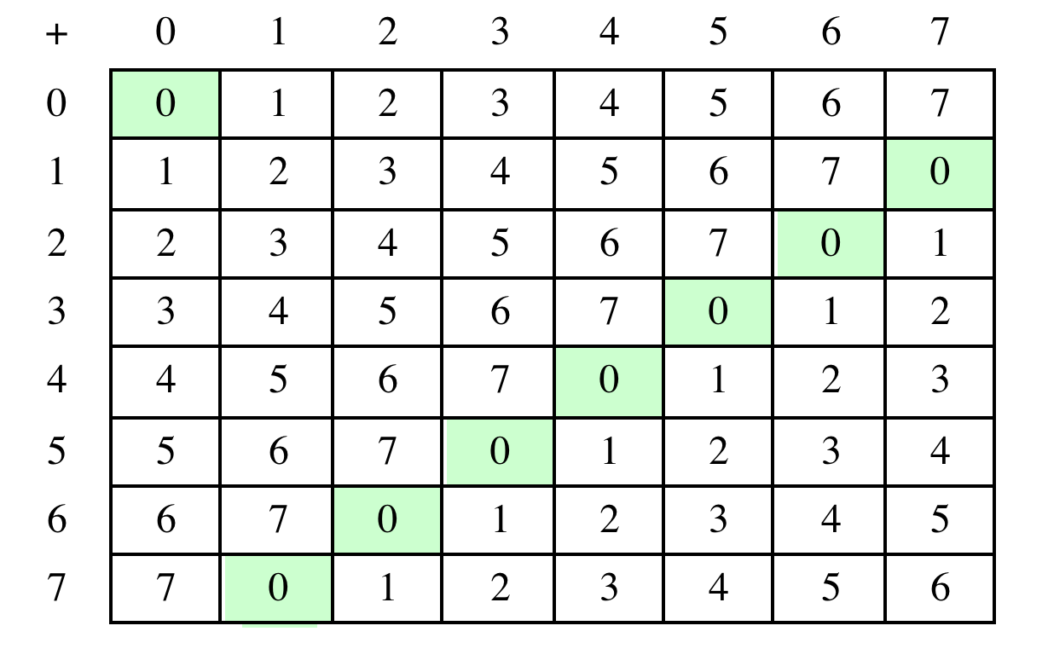
Table 4.2(a) Arithmetic Modulo 8
Notes:
Table 4.2 provides an illustration of modular addition and multiplication
modulo 8. Looking at addition, the results are straightforward, and there is a regular
pattern to the matrix. Both matrices are symmetric about the main diagonal
in conformance to the commutative property of addition and multiplication.

Slide 22
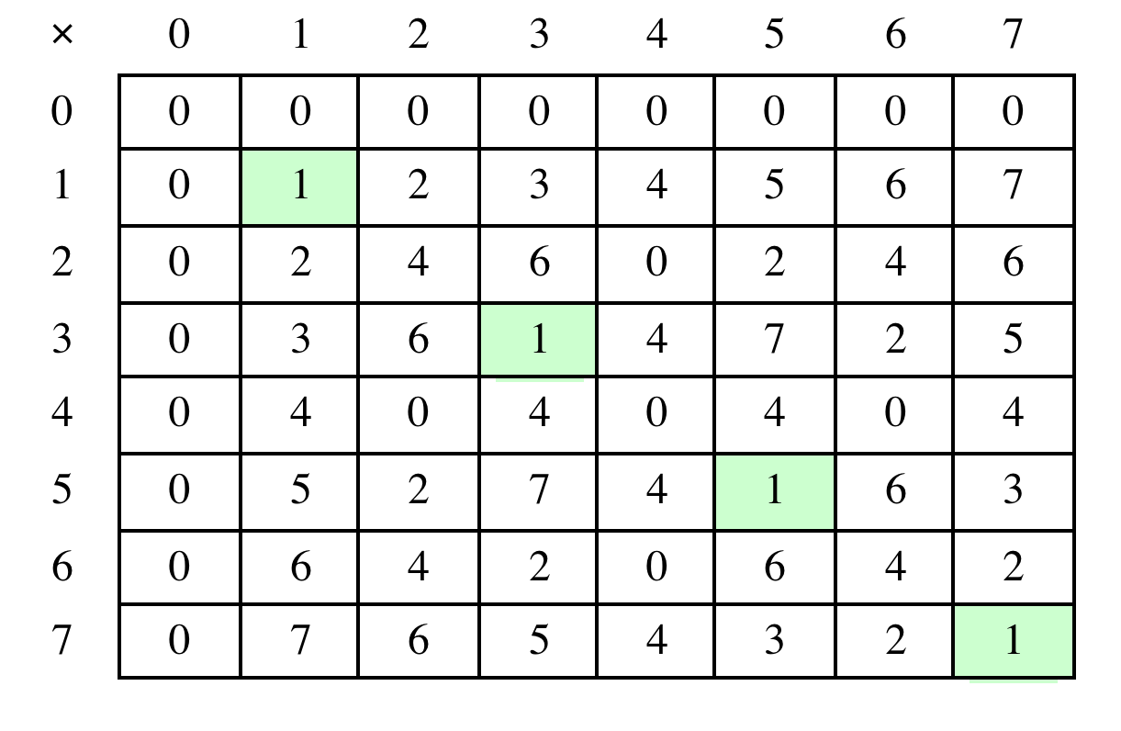
Table 4.2(b) Multiplication Modulo 8
Notes:
Similarly, the entries in the multiplication table are straightforward. In ordinary
arithmetic, there is a multiplicative inverse, or reciprocal, to each integer. In modular
arithmetic mod 8, the multiplicative inverse of x is the integer y such that
(x * y ) mod 8 = 1 mod 8. Now, to find the multiplicative inverse of an integer
from the multiplication table, scan across the matrix in the row for that integer to
find the value 1; the integer at the top of that column is the multiplicative inverse;
thus, (3 * 3) mod 8 = 1. Note that not all integers mod 8 have a multiplicative
inverse; more about that later.

Slide 23
Linear congruence
To solve for x in the following equation:
a x = b (mod n)
We need to divide both sides by a, but division is not defined in modulo-n.
Is there a good way to safely divide by a (i.e. without getting fractions)?
Notes:
Example of the Extended Euclidean Algorithm. (See pages 97 – 99 in textbook for details.)

Slide 24
Linear congruence
The inverse of a in modulo-n is a⁻¹ such that
a * a⁻¹ = a⁻¹ * a = 1 (mod n)
Example: What is the inverse of
5 (mod 7) ?
2 (mod 7) ?
5 (mod 8) ?
2 (mod 8) ?
Notes:
Example of the Extended Euclidean Algorithm. (See pages 97 – 99 in textbook for details.)

Slide 25
Linear congruence
To solve for x in the following equation:
a x = b (mod n)
We may multiply both sides by a⁻¹ (mod n)
Then we have: x = b a⁻¹ (mod n)
Example: solve 5x = 2 (mod 7)
Notes:
Example of the Extended Euclidean Algorithm. (See pages 97 – 99 in textbook for details.)

Slide 26
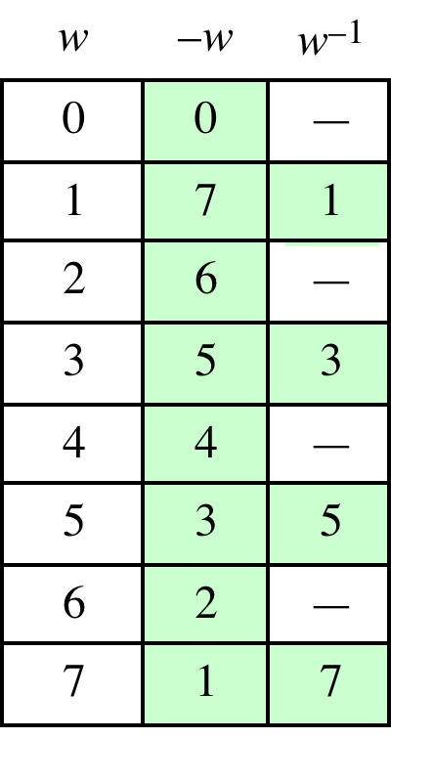
Table 4.2(c) Additive and Multiplicative Inverses Modulo 8
Notes:
As in ordinary addition, there is an additive inverse, or negative, to each integer in
modular arithmetic. In this case, the negative of an integer x is the integer y such
that (x + y ) mod 8 = 0. To find the additive inverse of an integer in the left-hand
column, scan across the corresponding row of the matrix to find the value 0; the
integer at the top of that column is the additive inverse; thus, (2 + 6) mod 8 = 0.

Slide 27
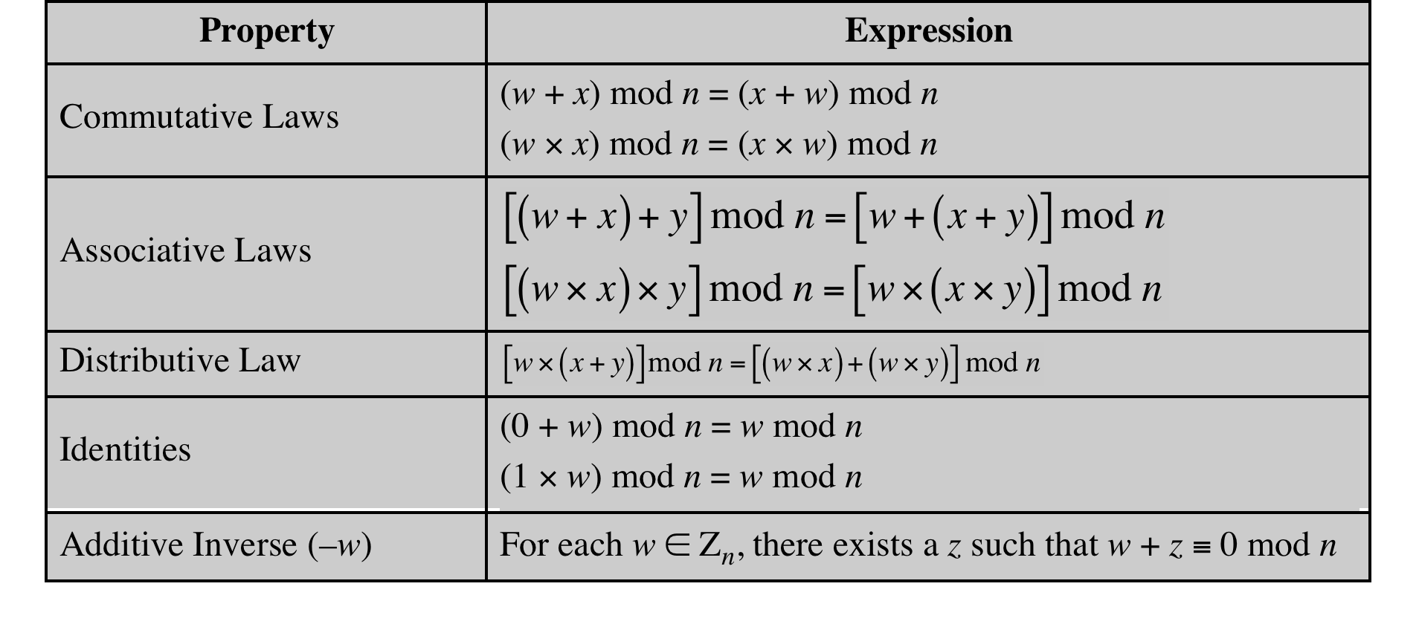
Table 4.3 Properties of Modular Arithmetic for Integers in Z_{n}
Notes:
If we perform modular arithmetic within Z_{n}, the properties shown in Table 4.3 hold for integers in Z_{n} We show in the next section that this implies that Z_{n} is a commutative ring with a multiplicative identity element. Note that unlike ordinary arithmetic, the following statement is true only with the attached condition:
if (a x b) = (a x c) (mod n) then b = c (mod n) if a is relatively prime to n
In general, an integer has a multiplicative inverse in Z_{n} if that integer is relatively prime to n. Table 4.2 cin the text shows that the integers 1, 3, 5, and 7 have a multiplicative inverse in Z 8, but 2, 4, and 6 do not.

Slide 28
Summary
Divisibility and the division algorithm
The Euclidean algorithm
To compute the gcd efficiently
Modular arithmetic
Linear congruence
To solve: a x = b (mod n)
We have x = b a⁻¹ (mod n)
What if a has no inverse in modulo n? (HW)
Notes:
Chapter 4 summary.

