Slide 1
ICS 353: Design and Analysis of Algorithms
King Fahd University of Petroleum & Minerals
Information & Computer Science Department
Basic Computability

Slide 2
Reading Assignment
J. Savage, “Models of Computation: Exploring the Power of Computing”, Addison Wesley, 1998.
Chapter 3 Section 7
Chapter 5 Sections 1-2 and 5-8.
This set of slides is based on Slides by Zeph Grunschlag from Columbia University www1.cs.columbia.edu/~zeph/3261/L14/L14.ppt

Slide 3
Outline
Alan Turing
[Standard] Turing Machines
Extensions to the Standard Turing Machines
Acceptors vs. Deciders
Universal Turing Machines
Encodings of Strings and Turing Machines
Limits on Language Acceptance
Reducibility and Unsolvability

Slide 4
Alan Turing
Alan Turing was one of the founding fathers of CS.
His computer model –the Turing Machine– was inspiration/premonition of the electronic computer that came two decades later
Was instrumental in cracking the Nazi Enigma cryptosystem in WWII
Invented the “Turing Test” used in AI

Slide 5
The Turing Test
Mentioned in his 1950 paper “Computing machinery and intelligence”
A human judge engages in a natural language conversation with two other parties, one a human and the other a machine; if the judge cannot reliably tell which is which, then the machine is said to pass the test.
It is assumed that both the human and the machine try to appear human.
In order to keep the test setting simple and universal (to explicitly test the linguistic capability of the machine instead of its ability to render words into audio), the conversation is usually limited to a text-only channel.

Slide 6
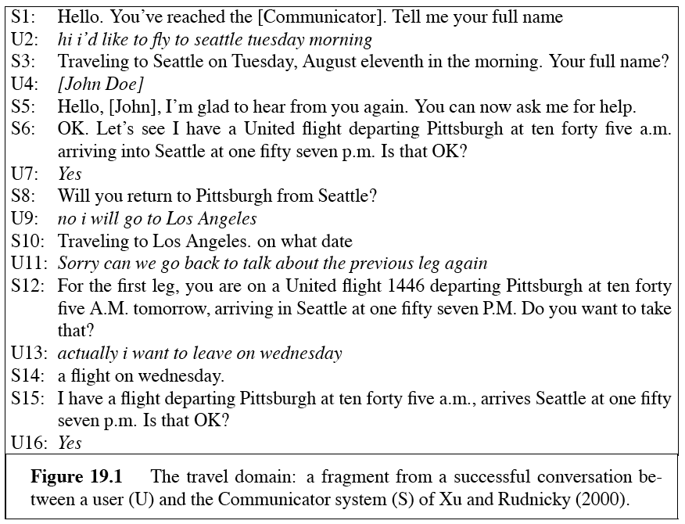
A Travel Dialog

Slide 7
Turing Machines
First Goal of Turing’s Machine: A model that can compute anything that a human can compute.
Before invention of electronic computers the term “computer” actually referred to a person who’s line of work is to calculate numerical quantities!

Slide 8
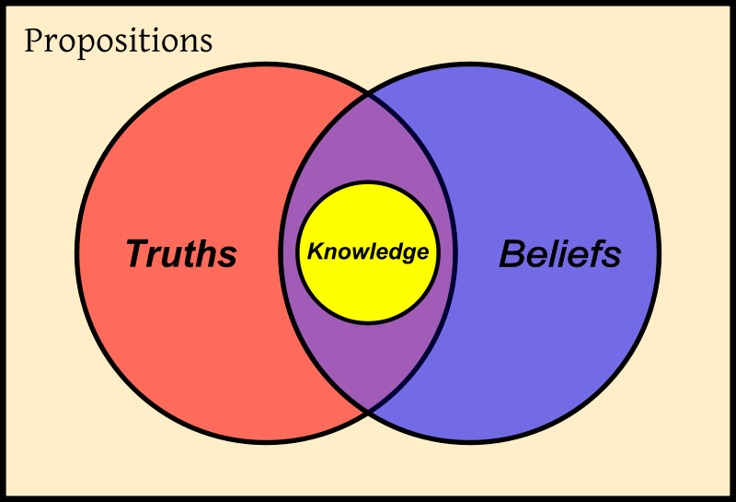
Turing Machines
Second Goal of Turing’s Machine: A model that’s so simple, that can actually prove interesting epistemological results, i.e. a thinking machine.
Epistemology: is the branch of philosophy that studies the nature and scope of knowledge and belief.
According to Plato, knowledge is a subset of that which is both true and believed

Slide 9
Turing Machines
Imagine a super-organized, obsessive-compulsive human computer.
The computer wants to avoid mistakes so everything written down is completely specified one letter/number at a time.
The computer follows a finite set of rules which are referred to every time another symbol is written down.
Rules are such that at any given time, only one rule is active so no ambiguity can arise.
Each rule activates another rule depending on what letter/number is currently read.

Slide 10
Turing Machines
A TM consists of an infinite length tape, on which input is provided as a finite sequence of symbols.
A head reads the input tape. The TM starts at start state s. On reading an input symbol it optionally replaces it with another symbol, changes its internal state and moves one cell to the right or left.

Slide 11
Turing Machines: Successor Program
Sample Rules:
If read 1, write 0, go right, repeat.
If read 0, write 1, HALT!
If read β, write 1, HALT! β stands for the blank symbol
Let’s see how they are carried out on a piece of paper that contains the reverse binary representation of 47:
Notes:
“” stands for reading a blank cell, in which nothing has been written.

Slide 12
Turing Machines: Successor Program
If read 1, write 0, go right, repeat.
If read 0, write 1, HALT!
If read β, write 1, HALT!
1 | 1 | 1 | 1 | 0 | 1

Slide 13
Turing Machines: Successor Program
If read 1, write 0, go right, repeat.
If read 0, write 1, HALT!
If read β, write 1, HALT!
0 | 1 | 1 | 1 | 0 | 1

Slide 14
Turing Machines: Successor Program
If read 1, write 0, go right, repeat.
If read 0, write 1, HALT!
If read β, write 1, HALT!
0 | 0 | 1 | 1 | 0 | 1

Slide 15
Turing Machines: Successor Program
If read 1, write 0, go right, repeat.
If read 0, write 1, HALT!
If read β, write 1, HALT!
0 | 0 | 0 | 1 | 0 | 1

Slide 16
Turing Machines: Successor Program
If read 1, write 0, go right, repeat.
If read 0, write 1, HALT!
If read β, write 1, HALT!
0 | 0 | 0 | 0 | 0 | 1

Slide 17
Turing Machines: Successor Program
If read 1, write 0, go right, repeat.
If read 0, write 1, HALT!
If read β, write 1, HALT!
0 | 0 | 0 | 0 | 1 | 1

Slide 18
Turing Machines: Successor Program
So the successor’s output on 111101 was 000011 which is the reverse binary representation of 48.
Similarly, the successor of 127 should be 128:
Notes:
“” stands for reading a blank cell, in which nothing has been written.

Slide 19
Turing Machines: Successor Program
If read 1, write 0, go right, repeat.
If read 0, write 1, HALT!
If read β, write 1, HALT!
1 | 1 | 1 | 1 | 1 | 1 | 1

Slide 20
Turing Machines: Successor Program
If read 1, write 0, go right, repeat.
If read 0, write 1, HALT!
If read β, write 1, HALT!
0 | 1 | 1 | 1 | 1 | 1 | 1

Slide 21
Turing Machines: Successor Program
If read 1, write 0, go right, repeat.
If read 0, write 1, HALT!
If read β, write 1, HALT!
0 | 0 | 1 | 1 | 1 | 1 | 1

Slide 22
Turing Machines: Successor Program
If read 1, write 0, go right, repeat.
If read 0, write 1, HALT!
If read β, write 1, HALT!
0 | 0 | 0 | 1 | 1 | 1 | 1

Slide 23
Turing Machines: Successor Program
If read 1, write 0, go right, repeat.
If read 0, write 1, HALT!
If read β, write 1, HALT!
0 | 0 | 0 | 0 | 1 | 1 | 1

Slide 24
Turing Machines: Successor Program
If read 1, write 0, go right, repeat.
If read 0, write 1, HALT!
If read β, write 1, HALT!
0 | 0 | 0 | 0 | 0 | 1 | 1

Slide 25
Turing Machines: Successor Program
If read 1, write 0, go right, repeat.
If read 0, write 1, HALT!
If read β, write 1, HALT!
0 | 0 | 0 | 0 | 0 | 0 | 1

Slide 26
Turing Machines: Successor Program
If read 1, write 0, go right, repeat.
If read 0, write 1, HALT!
If read β, write 1, HALT!
0 | 0 | 0 | 0 | 0 | 0 | 0

Slide 27
Turing Machines: Successor Program
If read 1, write 0, go right, repeat.
If read 0, write 1, HALT!
If read β, write 1, HALT!
0 | 0 | 0 | 0 | 0 | 0 | 0 | 1

Slide 28
Turing Machines
It was hard for the ancients to believe that any algorithm could be carried out on such a device. For us, it’s much easier to believe, especially if you’ve programmed in assembly!
However, ancients did finally believe Turing when Church’s lambda-calculus paradigm (on which lisp programming is based) proved equivalent!

Slide 29
Turing Machines
A Turing Machine (TM) is a device with a finite amount of read-only “hard” memory (states), and an unbounded amount of read/write tape-memory. There is no separate input. Rather, the input is assumed to reside on the tape at the time when the TM starts running.
Just as with Automata, TM’s can either be input/output machines (compare with Finite State Transducers), or yes/no decision machines. Start with yes/no machines.
Notes:
¹ Students (and others) often complain about allowing unbounded/infinite tape in the description of a supposedly physically realizable machine. If this bothers you, think instead that the machine has a finite tape, but that another finite tape is added, every time the machine runs out of memory.

Slide 30
Turing Machines
The Turing machine model is the classical model introduced by Alan Turing
As a model,
No other model of computation has been found that can compute functions that are not computable by Turing machines
Theoreticians use it to understand the limits on serial computation

Slide 31
The Standard Turing Machine
Definition: A standard Turing machine (TM) is a six-tuple M = ( Γ, β, Q, δ, s, h), where
Γ : Tape alphabet not containing β
β : Blank symbol
Q : Set of states
δ : Next-state function
δ : (Q × (Γ ∪ {β})) → (Q ∪ {h}) × (Γ ∪ {β})×{L, R})
s : Initial state
h : Accepting halt state
h∉ Q
TM cannot exit from h.
Left
Right

Slide 32
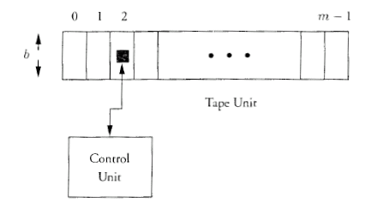
The Standard Turing Machine

Slide 33
The Standard Turing Machine
If M is in state q with letter a under the tape head and δ(q, a) = (q’, a’, C), its control unit enters state q’, writes a’, and moves the head left, if possible, or right if C is L or R, respectively.
The TM M accepts the input string w ∈ Γ* if when started in state s with w placed left-adjusted on its otherwise blank tape, the last state entered by M is h.
If M has other halting states, these are rejecting states.
M may not halt on certain input

Slide 34
Example
current state (cs) | read symbol (rs) | δ (cs,rs) = (next state, write symbol, moving direction)
S₀ | b | (halt, a, stop)
S₀ | a | (S₁ , a, right )
S₁ | b | (halt, b, stop)
S₁ | a | (S₀ , a, right )
Input = “aaaabb”
What is the output for this input?

Slide 35
The Standard Turing Machine
The TM M accepts the language L(M) consisting of all strings accepted by M.
If a TM M halts on all inputs, we say that M recognizes the language that it accepts.
For simplicity, we assume that when M halts for language acceptance, M writes 1 in its first tape cell if its input string is accepted and 0 otherwise.
The language L is called decidable or recursive.
Languages accepted by M are called recursively enumerable
If a TM M halts on all inputs, it implements an algorithm.

Slide 36
The Standard Turing Machine
The function computed by a TM M on input string w is the string z written leftmost on the non-blank portion of the tape after halting
It is called partial if M fails to halt on some input strings and complete otherwise
If TM M is used for language acceptance, it accepts w by halting in the accepting state h. If TM M is used for computation, the result of a computation on input w is the string z that remains on the non-blank portion of its tape.

Slide 37
TM Acceptors vs. Deciders
Three possibilities occur on a given input w :
The TM M eventually enters h (accepting) and therefore halts and accepts. (w ∈ L(M) )
The TM M eventually enters h (rejecting) or crashes somewhere. M rejects w . (w ∉ L(M) )
Neither occurs! i.e., M never halts its computation and is caught up in an infinite loop, never reaching h (accepting) or h (rejecting) . In this case w is neither accepted nor rejected. However, any string not explicitly accepted is considered to be outside the accepted language. (w ∉ L(M) )

Slide 38
TM Acceptors vs. Deciders
Any Turing Machines is said to be a recognizer and recognizes L(M); if in addition, M never enters an infinite loop, M is called a decider and is said to decide L(M).
Q: Is the above M a recognizer? What is L(M)?
0→R
acc
rej
0
β →R
0→R
2
1
1→L
1→R
0→R
1→R

Slide 39
TM Acceptors vs. Deciders
A: M is a recognizer but not a decider because 101 causes an infinite loop.
L(M) = 1⁺ 0⁺
0→R
acc
rej
0
β →R
0→R
2
1
1→L
1→R
0→R
1→R

Slide 40
Standard Turing Machines
Definition: A language L ⊆ Γ* is in P if there is a TM M with tape alphabet Γ and a polynomial p(n) such that for every w ∈ Γ* , M halts in p(|w|) steps and accepts w if it is in L and rejects it otherwise.
Does that remind you of anything!!!!!!!!

Slide 41
Nondeterministic Turing Machines
A non-deterministic Turing Machine (NTM) is the extension of the TM model by the addition of a choice input to its control unit. Thus
Definition: an NTM is a seven-tuple M= ( Σ, Γ, β, Q, δ, s, h), where
Σ : Choice input alphabet
Γ : Tape alphabet not containing β
β : Blank symbol
Q : Set of states
δ : Next-state function
δ : Q × Σ × (Γ ∪ {β}) → ((Q ∪ {h}) × (Γ ∪ {β})×{L, R}) ∪ ⊥
s : Initial state
h : Accepting halt state
h∉ Q
TM cannot exit from h.

Slide 42
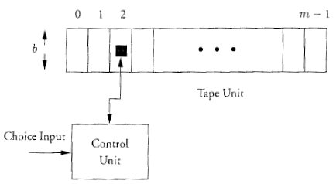
Nondeterministic Turing Machines

Slide 43
Nondeterministic Turing Machines
If M is in state q with letter a under the tape head reading choice input c, its next state function
δ : Q × Σ × (Γ ∪ {β}) → ((Q ∪ {h}) × (Γ ∪ {β})×{L, R}) ∪ ⊥
has value δ(q,c,a).
If δ(q,c,a) = ⊥, there is no successor to the current state with choice input c and tape symbol a.
If δ(q,c,a) = (q’, a’, C), M’s control unit enters state q’, writes a’ in the cell under the head, and moves the head left, if possible, or right if C is L or R, respectively.
An NTM M reads one character of its choice input string c ∈ Σ* on each step.
The TM M accepts the input string w ∈ Γ* if there is some choice input string c such that the last state entered by M is h when M is started in state s with w placed left-adjusted on its otherwise blank tape.
If M has other halting states, these are rejecting states.
M may not halt on certain input

Slide 44
Nondeterministic Turing Machines
The NTM M accepts the language L(M) ⊆ Γ* consisting of all strings w accepted by M.
Therefore, if w ∉ L(M), there is no choice input for which M accepts w.
Definition: A Language L ⊆ Γ* is in NP if there is a nondeterministic Turing Machine M and a polynomial p(n) such that M accepts L and for each w ∈ L, there is a choice input c such that M on input w with this choice input halts in p(|w|) steps.

Slide 45
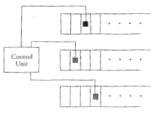
Extensions to the Standard TM
Double-ended Turing Machine
k-Tape Turing Machine
Theorem: For each k-tape TM M_{k}, there is a one-tape TM M₁ such that a terminating T-step computation by M_{k} can be simulated in O(T²) steps by M₁.

Slide 46
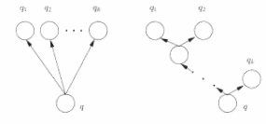
Extensions to the Standard TM
If a nondeterministic TM, NDTM, has more than two nondeterministic choices for a particular state and letter under the tape head, we can design another NDTM that has at most two choices.
One may assume that there are either one or two next states from each state of an NDTM.

Slide 47
Extensions to the Standard TM
Theorem: Any language accepted by a nondeterministic TM can be accepted by a deterministic TM.
This shows that the range of computations that can be performed by deterministic and nondeterministic Turing machines is the same. However, this does not mean that with identical resource bounds, (e.g. time), they compute the same set of function.
Corollary: Any language accepted by a nondeterministic multi-tape TM can be accepted by a deterministic TM.

Slide 48
Universal Turing Machine
A Universal Turing machine is a Turing machine that can simulate the behavior of an arbitrary Turing machine
Including a universal Turing machine.
Without loss of generality, DTMs are included.
Here, the inputs are data, plus a description of computation
i.e. the Universal TM is a “computer”
i.e. the Universal TM is “programmable”
A computer can emulate a Universal TM and vice versa
Hence, a computer is a Universal computing device

Slide 49
Universal Turing Machine
Universal Turing Machine: MUniversal
Input: (M,I) where
M is a Turing Machine Description
I is the input to the machine M
Results: L(MUniversal) = ATM = {(M,I): M accepts I)
If M accepts I, then MUniversal accepts (M,I)
If M rejects I, then MUniversal rejects (M,I)
If M does not halt on I, MUniversal does not halt on (M,I)

Slide 50
Encodings of Strings and TMs
Lexicographic ordering of strings
Strings of length n – 1 precede strings of length n
Among strings of length n,
If a and b are in the alphabet and a < b, strings starting with a precede those starting with b
If the two strings have the same prefix, their order is determined by the order of the next letter (after the prefix)
How can we identify the j^{th} Universal TM?
If an encoding does not correspond to a TM, associate it with the Null TM
δ(s, a) = (h, a)
Each proper encoding of a TM is considered, in order.

Slide 51
Limits on Language Acceptance
A language that is decidable (recursive) has a TM that halts on all inputs, accepting only those strings in the language.
Deterministic finite state machines, regular expressions and context-free grammars are all examples of decidable languages
A language that is recursively enumerable is ....
A language is called unsolvable if no TM exists that accepts that language.
Notes:
A language that is recursively enumerable is that in which a TM that accepts that language exists.

Slide 52
A Language that is not recursively enumerable
Consider L₁ = { w_{i} | w_{i} is not accepted by M_{i}}
L₁ is not recursively enumerable
The complement of L₁ (called L₂) is an example of a recursively enumerable language that is not decidable.
This comes from the fact that the complement of a decidable language is decidable.

Slide 53
Reducibility and Unsolvability
Motivation: We have just shown that L₂ is unsolvable. Using reducibility, we will see that there are many languages that are unsolvable
Actually, we will only consider two such problems
Definition: The language L_{a} is reducible to L_{b} if there is an algorithm computing a total [complete] function f: C*→ D* that translates each string w over the alphabet C of L_{a} into a string z = f(w) over the alphabet D of L_{b} such that w ∈ L_{a} if and only if z ∈ L_{b}.

Slide 54
Reducibility and Unsolvability
Lemma: Let L_{a} be reducible to L_{b}. If L_{b} is decidable, L_{a} is decidable. If L_{a} is unsolvable, L_{b} is also unsolvable.

Slide 55
Unsolvable Problems
Halting Problem:
Input: An arbitrary TM M, and an arbitrary input string x.
Question: Does M halt on x?
The halting problem can be characterized by the language L_{H} = { ρ(M), w | M halts on input w}
The halting problem is unsolvable

Slide 56
Unsolvable Problems
Empty Tape Acceptance Problem:
Input: An arbitrary TM M
Question: Does M accept the empty string?
L_{ET} = { ρ(M) | L(M) contains the empty string}
This problem is unsolvable

